Slide 1



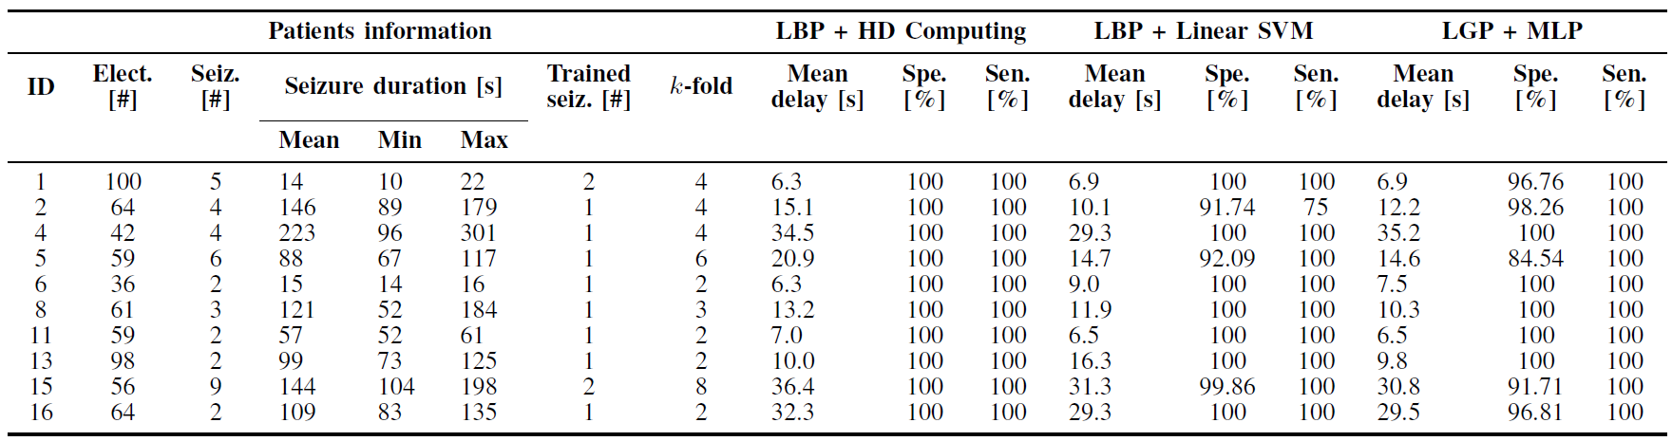
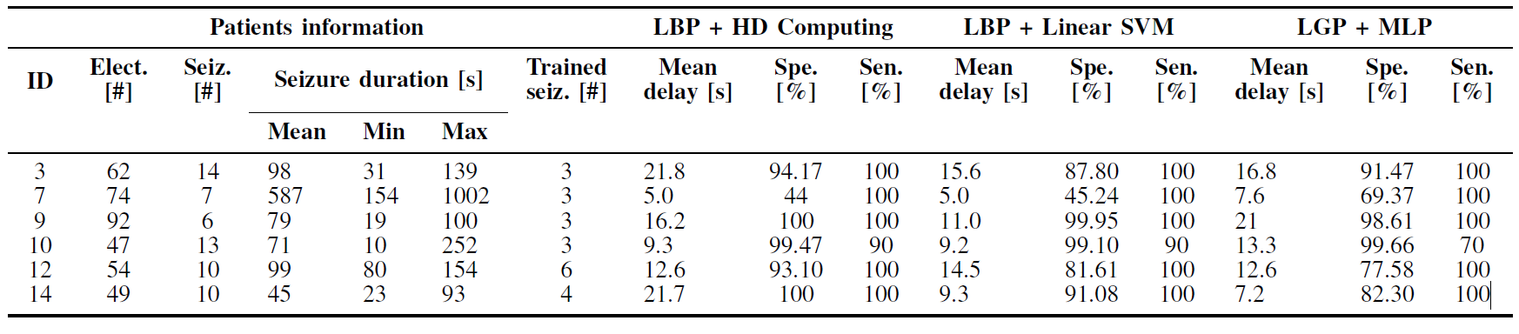
One-shot Learning for iEEG Seizure Detection Using End-to-end Binary Operations:
Local Binary Patterns with Hyperdimensional Computing
Alessio Burrello¹, Kaspar Schindler², Luca Benini¹, Abbas Rahimi¹
¹Integrated Systems Laboratory, ETH Zurich, Switzerland ²Sleep-Wake-Epilepsy-Center, Inselspital Bern, Switzerland
Emails: bualessi@student.ethz.ch, kaspar.schindler@insel.ch, lbenini@iis.ee.ethz.ch, abbas@ee.ethz.ch
  ieeg-swez.ethz.ch
Main idea: Combining Local Binary Patterns (LBP) with Hyperdimensional Computing
Experimental Results with short-term iEEG
Learning from one/two seizure(s) with perfect (100%) generalization for patient majority using k-fold cross-validation
Learning from three to six seizures and testing with the remaining seizures for patient minority
Interictal state: the LBP codes are almost evenly distributed over all the possible codes
Ictal state: the LBP codes have asymmetric distribution leading to a polarized histogram
Highlights
Pseudo code (LBP with 6-bit length)
(1) For i in samples iEEG:
if iEEG[i+1] > iEEG[i]
Δ[i] = 1
else
Δ[i]= 0
(2) For i in samples iEEG:
LBP[i] = {Δ[i], Δ[i+1], Δ[i+2], Δ[i+3], Δ[i+4], Δ[i+5]}
One-/few-shot learning from seizure examples
Superior sensitivity/specificity compared to feedforward MLP and SVM
End-to-end binary operations during both learning and classification
  up to 13X lower memory
Scalable to all patients having 36 to 100 electrodes implanted
FREE code and dataset
  16 drug-resistant patients
  99 iEEG recordings with 3 min immediately pre-seizure, seizure
  (10 -1002 s) and 3 min of post-seizure time
  Available at http://ieeg-swez.ethz.ch/

