Slide 1








ARGO:
Aging-aware GPGPU Register File Allocation
Majid Shoushtari
Nikil Dutt
Abbas Rahimi
Rajesh Gupta
Puneet Gupta
Computer Science
Computer Science and Engineering
Electrical Engineering
http://variability.org

Slide 2
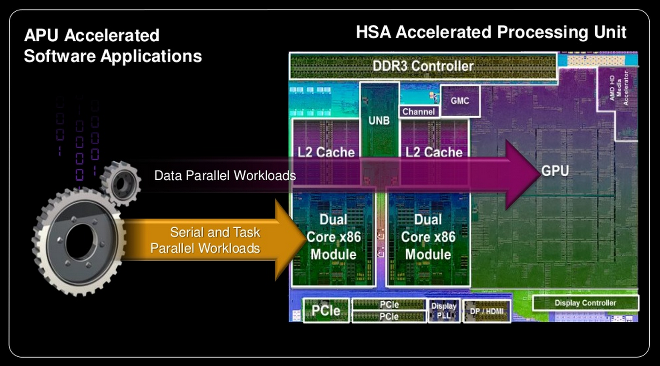
The Future is Heterogeneous Computing
Slide borrowed from AMD keynote in ISSCC 2013

Slide 3
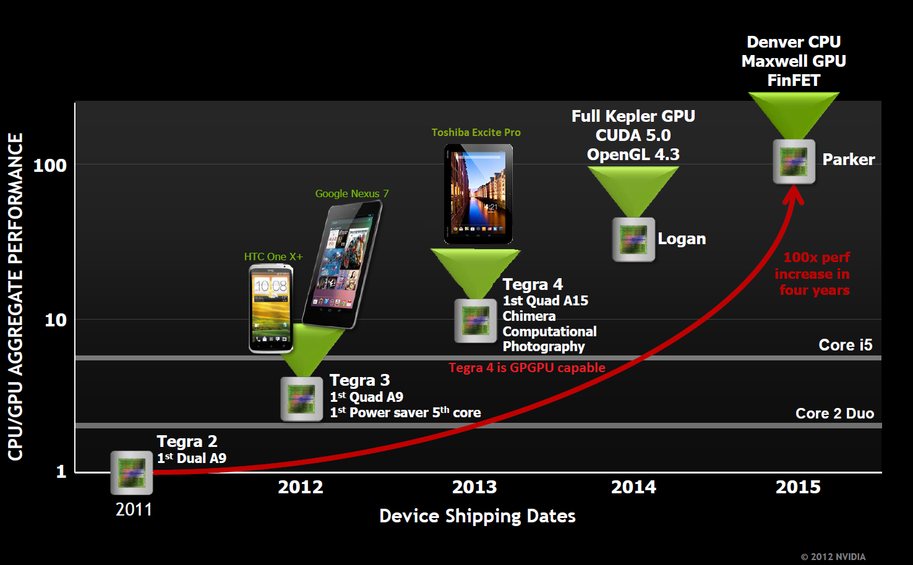
CPU+GPU Integration in Mobile SoCs
Slide borrowed from NVIDIA

Slide 4
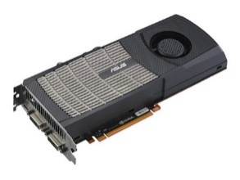
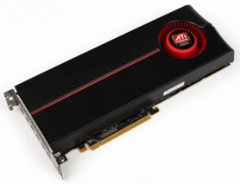
What’s the problem?
To support highly parallel execution, GPGPUs contain large RFs
  NVIDIA GTX480: 2MB
  AMD Radeon HD5870: 5MB
Aging mechanisms are becoming one of the most pressing sources of circuit variations as technology shrinks.
Large RFs are being threatened by Aging

Slide 5
Outline
Background on NBTI
Related Work
GPGPU Architectural Model
Observation: RF Underutilization
ARGO
Experimental Results

Slide 6
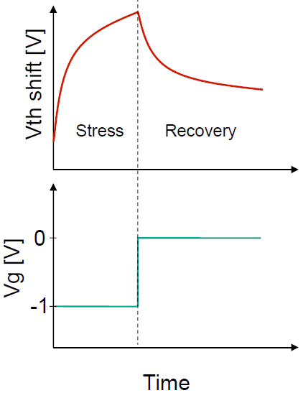
NBTI: A Major Aging Mechanism
Negative Bias Temperature Instability has emerged as a major reliability problem in current and future technology generations.
NBTI manifests itself as a shift in V_{th}
  Logic: Slower circuit ➔ Timing Error
  Memory: Reduced “Signal to Noise Margin”
NBTI makes the memory cell unstable.
Existing Strategies:
1) Higher Vdd (guardband) required; or
2) Life-time decreased by NBTI
ARGO:
Increase Life-time without Vdd guardband
Recovery effect in periods of no stress
  Full recovery from a stress period only possible in infinite time
  In practice overall V_{th} shift increases monotonously
Higher Temperature ➔ Faster Aging

Slide 7
Related Work
RF/Caches
  Wearout-aware register allocation [Ahmed’12]
  Exploiting RF underutilization for power saving [Tabkhi’12]
  Partitioned cache for reducing NBTI-induced aging [Calimera’11]
GPGPUs
  Aging in functional units of GPGPU [Rahimi’13]
No work on aging of RFs for
multi-threaded GPGPUs

Slide 8
GPGPU Architecture & Execution Model:
AMD Evergreen
Compute Device
Compute Unit (CU)
Stream Core (SC)
Ultra-threaded Dispatcher
SIMD Fetch Unit
Processing Elements (PEs)
Compute Unit (CU₀)
Compute Unit (CU₁₉)
Stream Core
(SC₀)
Stream Core (SC₁₅)
T
X
Y
Z
W
Branch
Wavefront Scheduler
L1
L1
Crossbar
General-purpose Reg.
Local Data Storage
Global Memory Hierarchy
X
Y
Z
W
Radeon HD 5870 (5 MB RF)
  20 Compute Units (CUs)
    16 Stream Cores (SCs) per CU (SIMD execution)
      5 Processing Elements (PEs) per SC (VLIW execution)
      16 KB Register File per SC
ND-Range
Work-Group
Work-Item
.
.
.
16 KB
.
.
.
…
…
Common OpenCL Kernel:
_kernel func()
{
}
WG
WG
WI
WI
WG
…
WG
WI
…
WI
.
.
.
.
.
.
.
.
.
.
.
.

Slide 9
Observation: RF Underutilization
Resources are fixed per compute unit
  local memory size
  maximum number of threads
  number of registers
Any one of these resource constraints
may limit #WG / CU ≡ occupancy
On average 54% of RF is not utilized at all
Kernel | #of Registers | RF Utilization
Reduction | 4 | 50%
BinarySearch | 2 | 25%
DwtHaar1D | 4 | 50%
BitonicSort | 4 | 13%
FastWalshTransform | 4 | 50%
FloydWarshall | 6 | 75%
BinomialOption | 13 | 81%
DiscreteCosineTransform | 7 | 22%
MatrixTranspose | 3 | 38%
MatrixMultiplication | 22 | 69%
SobelFilter | 9 | 99%
URNG | 6 | 19%
RadixSort | 16 | 6%
Histogram | 16 | 13%
BlackScholes | 19 | 89%
This characteristic is preserved across set of OpenCL compiler options
Opportunistically exploiting RF
underutilization for NBTI recovery

Slide 10
ARGO: Overall Approach
Detect aging (which RF banks are stressed?)
  Use “Virtual Sensor” to predict stressed banks
Distribute stress in RFs
  Perform leveling (rotating allocation) of RFs
Power gate stressed RF banks
  Allow stressed RF banks to recover

Slide 11
Sliced RF Organization
RF is allocated at granularity of WG
Dispatcher maps a WG to an available CU
RF allocator assigns a portion of RF to WG
WG + head of allocated space will be inserted into scheduler queue
Logical Address
WG #
+
WI #
+
Allocated RF Head
RF is partitioned into 16 Slices
Each slice serves one SC
RF is horizontally banked into 256 banks
Each bank is 1KB and has separate power domain
Each bank serves one WF
Physical Address

Slide 12
Baseline (Aging Oblivious) RF Allocation
Kernel | #Reg. | Limited by | #WF per WG | #WG per CU | #Bank required | RF Utilization
Reduction | 4 | Max # of threads | 4 | 8 | 4*8*4 = 128 | 128/256 = 50%
WG1
WG12
WG2
WG9
WG3
WG10
WG4
WG13
WG5
WG11
WG6
WG14
WG7
WG15
Low-indexed RF banks are stressed more
WG8
WG16
256 banks
16 banks

Slide 13
ARGO: RF Allocation
Distributing stress by rotating allocated RF portions
Healing
Level
WG1
WG12
Recovery
WG2
WG9
WG3
WG10
WG4
WG13
WG5
WG11
WG6
WG14
WG7
WG15
WG8
WG16

Slide 14
ARGO: Overview
Aging Instrumentation options
  NBTI Sensors
    Area and Power Overhead
  Light-weight Virtual Sensing
    Estimating Aging Profile of RF Portions in Relative Manner
Modifying RF Allocator + Adding RF Power-gators

Slide 15
ARGO: Virtual Sensing
Ultra-threaded dispatcher doesn’t allocate different type of kernels to a CU at a time.
Observation: Variation in execution time of different WG of a kernel is < 8% for a wide range of kernels. Why?
  Round-robin WF scheduler.
  Strategy that GPGPUs follow handling thread divergence.

Slide 16
ARGO: Virtual Sensing (cont.)
RF portions are allocated per WG.
All cells within a RF portion are aged at the same rate.
At WG granularity, RF banks aged at the same rate
  Why? Because all are under stress for near-constant amount of time.
Least-degraded portion of RF is least-recently-allocated portion

Slide 17
ARGO: RF Allocator
Based on Virtual Sensing:
  One rotation per each new WG
    Guarantees greedily allocating least-recently-allocated (= least-degraded) RF portion
Issues proper power-gating signals
  Primary goal is recovery
  Side benefit is opportunistic saving of leakage power for unused banks

Slide 18
ARGO: Overheads
Overheads imposed by ARGO’s micro-architectural modifications?
  Performance:
    No performance overhead thanks to single-cycle implementation of ARGO RF allocator, similar to baseline RF allocator
  Area:
    <1% of RF area
  Power:
    < 0.5% of leakage power of RF
Overheads are negligible

Slide 19
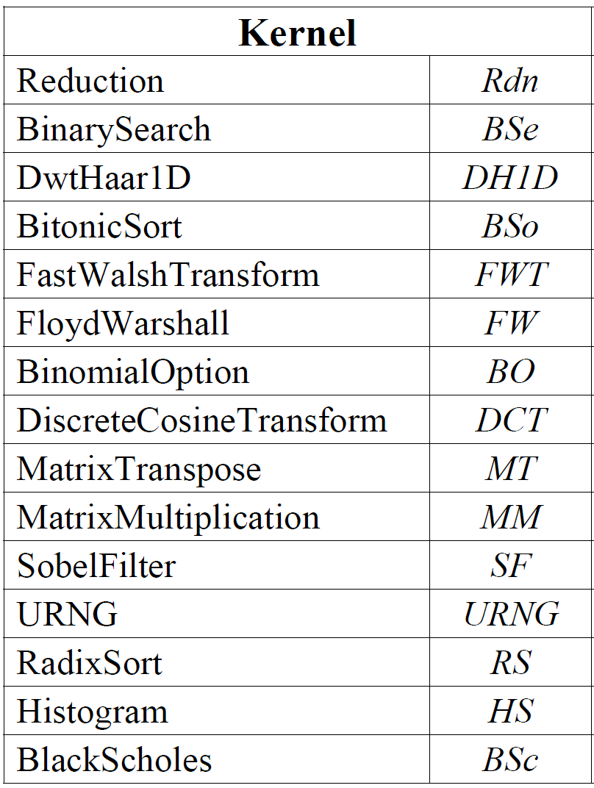
Experimental Setup
Multi2Sim
  A cycle-accurate simulation framework − a CPU-GPU model for heterogeneous computing targeting AMD Evergreen ISA
Kernels of AMD APP SDK 2.5
  Large parameters to put highest load on resources
HSPICE for SNM measurements

Slide 20
Simulation Result: V_{th} Shift
Max Improvement:
43%
Normalized to reduction in baseline mode
~100% RF utilization, no opportunity for recovery
No improvement, but no performance degradation too
Min Improvement: 10%
On average 27% improvement in V_{th} shift

Slide 21
Simulation Result: SNM Degradation
Improvements in SNM and V_{th} show the same trend as expected [23]
On average 30% improvement in SNM

Slide 22
Simulation Result: Trend of SNM Degradation
Depending on tech. and init. SNM, 15% to 20% reduction in SNM makes SRAM unreliable
Aging-Oblivious Trend
Unsafe Zone
All curves below 20%
after 5 years of execution
Entrance to “Unsafe Zone” shifted from 0.7 to 1.45

Slide 23
Summary
Aging is becoming a reliability threat
GPGPUs have large RFs susceptible to aging
Observation: GPGPU RF utilization is ~46%
ARGO: Key Ideas
  Exploit RF underutilization
  Overcome aging by leveling (rotating) allocation of stressed RFs
ARGO improves SNM by 30% on average.
Please come to our poster for more details

Slide 24

Thank you
Q&A
NSF Expedition in Computing, Variability-Aware Software for Efficient Computing with Nanoscale Devices http://variability.org

Slide 25
Supplementary Slides

Slide 26
Simulation Result: Recovery / Bank Size Tradeoff
Overhead of power-gating logic can be reduced by coarser bank size
2K or 4K banks are near optimal
WF per WG × #of registers is already a multiple of bank size.
Kernel | Recovery Time (%)
 | 1K | 2K | 4K | 8K
Rdn | 48% | 48% | 48% | 48%
BSe | 63% | 63% | 63% | 63%
DH1D | 44% | 44% | 44% | 44%
BSo | 87% | 87% | 87% | 87%
FWT | 53% | 53% | 53% | 53%
FW | 29% | 29% | 29% | 29%
BO | 13% | 13% | 13% | 8%
DCT | 77% | 73% | 73% | 73%
MT | 56% | 56% | 56% | 42%
MM | 21% | 21% | 14% | 14%
SF | 0% | 0% | 0% | *
URNG | 81% | 81% | 75% | 75%
RS | 86% | 86% | 86% | 86%
HS | 78% | 78% | 78% | 78%
BSc | 9% | 9% | 9% | 4%
Bank Size
8K bank results in performance degradation

Slide 27
Simulation Result: Different Process Corners
Temp. constant, varying Voltage
Voltage constant, varying Temp.
Gain is almost constant over the years

