Slide 1


A Variability-Aware OpenMP Environment for Efficient Execution of Accuracy-Configurable Computation on Shared-FPU Processor Clusters
Abbas Rahimi, Andrea Marongiu,
Rajesh K. Gupta, Luca Benini
UC San Diego, and University of Bologna
Micrel.deis.unibo.it
/MultiTherman
variability.org

Slide 2
Outline
Introduction and motivation
Contribution
Architecture
OpenMP extensions
  Programming interface
  Runtime environment
Profiling-based approximation control
Experimental Results

Slide 3
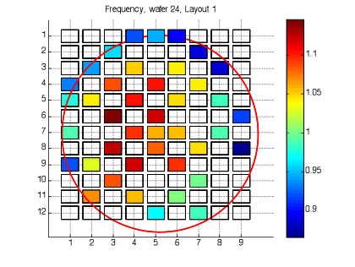
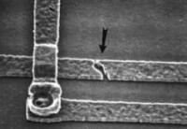
Introduction and Motivation
Variability in transistor characteristics is a major challenge in nanoscale CMOS:
  Static variation (Process); Dynamic variations (Temperature fluctuations, supply Voltage droops, and device Aging)
To handle variations
  Designers use conservative guardbands → loss of operational efficiency ☹
  Resilient designs impose costly error recovery 😐
actual circuit delay
guardband
Clock
Process
Aging
Temperature
V_{CC} Droop

Slide 4
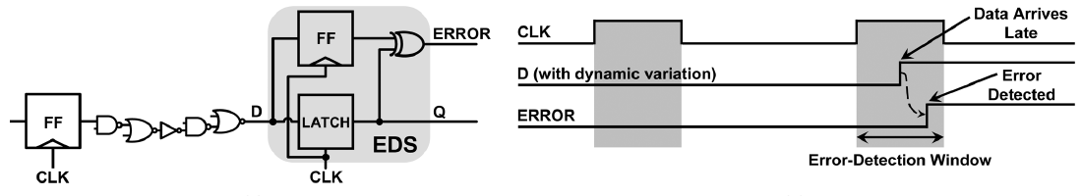
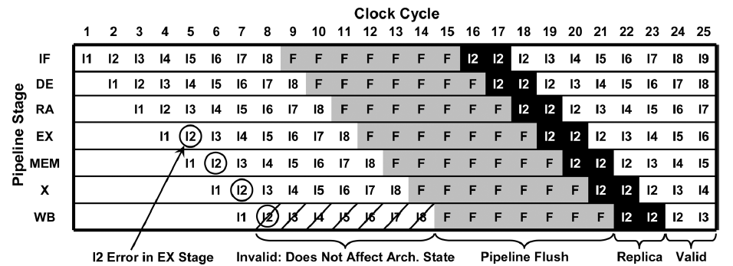
Introduction and Motivation
  Resilient designs impose costly error recovery 😐
  Error Detection Sequential (EDS)
  Multiple-Issue Instruction Replay
[1] K.A. Bowman, et al., “A 45 nm Resilient Microprocessor Core for Dynamic Variation Tolerance,” IEEE Journal of Solid-State Circuits, 46(1): 194-208, Jan. 2011.

Slide 5
Introduction and Motivation
  Resilient designs impose costly error recovery 😐
  This is especially true for floating-point (FP) pipelined architectures
    High latency (up to 32 cycles)
    Deep pipelines also induce higher cost of recovery (REPLAY)
  Even more troublesome for SHARED FPUs among multi-cores

Slide 6
Contribution
Our goal is to reduce the cost of a resilient FP environment which is dominated by the error correction
An integrated approach to vertically expose FPU vulnerability at the programming model level based on
  EDS sensing
  Runtime components to schedule less vulnerable FPUs first
By leveraging the inherent tolerance of certain applications to approximation
  Programming model extensions to specify approximate blocks
  Reconfigurable EDS in resilient FPUs
  Profiling-based technique to achieve controlled approximation
ACCURATE
APPROXIMATE
We show the usage of profiling that can even drive synthesis!

Slide 7
Architecture
Tightly-coupled shared memory multi-core cluster
Multi-core architecture
16x 32-bit RISC cores
L1 SW-managed Tightly Coupled Data Memory (TCDM)
  Multi-banked/multi-ported
  Fast concurrent read access
Fast logarithmic interconnect
Shared FPU
  32-bit single precision
  IEEE 754 compliant
EDS
ECU
FPU
SLAVE
PORT
CORE 0
FPU
EDS
ECU
I$
I$
MASTER
PORT
SLAVE PORT
LOW-LATENCY LOGARITHMIC INTERCONNECT
L2/L3
BRIDGE
SLAVE
PORT
SLAVE
PORT
SLAVE
PORT
SLAVE
PORT
SHARED L1 TCDM
test-and-set
semaphores
BANK 0
BANK 1
BANK N

Slide 8
Architecture
Every pipeline block has two dynamically reconfigurable operating modes:
(i) accurate, and (ii) approximate.
Accurate mode: every pipeline uses
EDS circuit sensors to detect any timing errors [1]
ECU to correct errors using multiple-issue operation replay mechanism (without changing frequency) [2]
EDS
ECU
FPU
SLAVE
PORT
[1] K.A. Bowman, et al., “Energy-Efficient and Metastability-Immune Resilient Circuits for Dynamic Variation Tolerance,” IEEE Journal of Solid-State Circuits, 44(1): 49-63, 2009.
[2] K.A. Bowman, et al., “A 45 nm Resilient Microprocessor Core for Dynamic Variation Tolerance,” IEEE Journal of Solid-State Circuits, 46(1): 194-208, Jan. 2011.

Slide 9
Controlled Approximation
Approximate computation leverages the inherent tolerance of some (type of) applications within certain error bounds that are acceptable to the end application
To ensure that it is safe not to correct a timing error when approximating the associated computation:
  The error significance is controllable ≤ given threshold;
  The error rate is controllable ≤ given error rate threshold;
  There is a region of the program that can produce an acceptable fidelity metric by tolerating the uncorrected, thus propagated, errors with the above-mentioned properties.

Slide 10
Accuracy-Configurable Architecture
In the approximate mode
Pipeline disables the EDS sensors on the less significant N bits of the fraction where N is reprogrammable through a memory-mapped register.
The sign and the exponent bits are always protected by EDS.
Thus pipeline ignores any timing error below the less significant N bits of the fraction and save on the recovery cost.
Switching between modes disables/enables the error detection circuits partially on N bits of the fraction → FP pipeline can efficiently execute subsequent interleaved accurate or approximate software blocks.

Slide 11
Floating-point Pipeline Vulnerability
The FPV metadata is defined as the percentage of cycles in which a timing error occurs on the pipeline reported by the EDS sensors.
The ECU dynamically characterizes this per-pipeline metric over a programmable sampling period.
The characterized FPV of each pipeline is visible to the software through memory-mapped registers.
Enables runtime scheduler to perform on-line selection of best FP pipeline candidates.

Slide 12
OpenMP Compiler Extension
#pragma omp accurate
structured-block
#pragma omp approximate [clause]
structured-block
error_significance_threshold (<value N>)
#pragma omp parallel
{
#pragma omp accurate
#pragma omp for
for (i=K/2; i <(IMG_M-K/2); ++i) {
// iterate over image
for (j=K/2; j <(IMG_N-K/2); ++j) {
float sum = 0;
int ii, jj;
for (ii =-K/2; ii<=K/2; ++ii) {
// iterate over kernel
for (jj = -K/2; jj <= K/2; ++jj) {
float data = in[i+ii][j+jj];
float coef = coeffs[ii+K/2][jj+K/2];
float result;
#pragma omp approximate error_significance_threshold(20) {
result = data * coef;
sum += result;
}
}
}
out[i][j]=sum/scale;
} } }
Code snippet for Gaussian filter utilizing OpenMP variability-aware directives
int ID = GOMP_resolve_FP (GOMP_APPROX, GOMP_MUL, 20);
GOMP_FP (ID, data, coeff, &result);
int ID = GOMP_resolve_FP (GOMP_APPROX, GOMP_ADD, 20);
GOMP_FP (ID, sum, result, &sum);
Invokes the runtime FPU scheduler
programs the FPU

Slide 13
Runtime Support and FPV Utilization
The variation-aware scheduler reduces
  Number of recovery cycles for accurate blocks
    by favoring utilization of FPUs with a lower FPV
    → lower error rate and recovery
  Cost of error correction
    by deliberately propagating the error toward application
    → excluding the recovery (correction) cost

Slide 14
Runtime Support and FPV Utilization
Scheduler ranks all the individual pipelines based on their FPV.
The sorted list is maintained in the shared TCDM
Allocate P_{R1}
Allocate P_{R2}
Allocate P_{RK}
Allocate P_{RN}
Appr.
Acc.
Appr.
Acc.
Appr.
Acc.
Appr.
Acc.
Configure opmode
Configure opmode
Configure opmode
Configure opmode
Start
point
No
No
No
No
No
No
No
No
Accurate
Busy
(P_{R1})?
Yes
Busy
(P_{R2})?
Busy
(P_{RK})?
Busy
(P_{RN})?
Yes
Yes
Yes
Yes
…
…
Yes
Yes
Yes
End
point
Approximate
For every operation type of P, sorted list of P: FLV (P_{R1}) ≤ … ≤ FLV (P_{RK}) ≤ … ≤ FLV (P_{RN})
FLV (P_{RK}) < error rate threshold for approximate computation

Slide 15
Application-Driven FPU Synthesis and Optimization
A methodology to optimize FPU written in VHDL
Utilizing profiling information during synthesis, placement & routing
Profiling can even drive synthesis!
Utilizing fast leaky cells (low-V_{TH}) for these paths
Utilizing regular and slow cells (regular-V_{TH} and high-V_{TH}) for the rest of paths → since errors can be ignored!

Slide 16
Profiling-based controlled approximation
We analyze the manifestation of a range of error significance and error rate on the PSNR of two image processing kernels (gauss and sobel)
In a series of profiling runs we monotonically increase the error significance by injecting timing errors as random multiple-bit toggling up to a certain bit position. We also vary the error rate {25%, 50%, 100%}
For our experiments we consider as a fidelity metric PSNR ≥ 30dB [3]
[3] M. A. Breuer et al., “Intelligible Test Techniques to Support Error Tolerance,” Proc, Asian Test Symp, 2004

Slide 17
Error rate = 100%

Slide 18
Error rate = 50%

Slide 19
Error rate = 25%

Slide 20
Error-tolerant Applications
Profiling with annotated approximate region
For error rates of {100%, 50%, 25%} if the error lies within the bit position of 0 to {20, 21, 22} of the fraction part, these two applications can tolerate error by delivering a PSNR ≥ 30dB. We set
  the error rate threshold to 100%
  the error significance threshold to 20

Slide 21
Experimental Setup
ARM v6 core | 16 | TCDM banks | 16
I$ size(per core) | 16KB | TCDM latency | 2 cycles
I$ line | 4 words | TCDM size | 256 KB
Latency hit | 1 cycle | L3 latency | ≥ 60 cycles
Latency miss | ≥ 59 cycles | L3 size | 256MB
Shared-FPUs | 8 | FP ADD latency | 2
FP MUL latency | 2 | FP DIV latency | 18
OpenMP-enabled SystemC-based virtual platform
Shared-FPUs are generated and optimized by FloPoCo
TSMC 45nm ASIC flow (SS/0.81V/125°C)
  Synopsys Design Compiler (front-end)
  Synopsys IC Compiler (back-end)
  Synopsys PrimeTime VX (static and dynamic variations)
Variation-induced delays are back-annotated to the SystemC models

Slide 22
Error-tolerant Applications
Execution without approximation directives
Energy and execution time of RANK scheduling (normalized to round-robin) for accurate Gaussian and Sobel filters:
  up to 12% lower energy
  the maximum timing penalty is less than 1%

Slide 23
Error-tolerant applications
Execution with approximation directives
25%
23%
By ignoring the errors within the bit position of 0 to 20 of the fraction
The shared-FPUs consume 4.6μJ for the accurate Sobel program (60x60), while execution of the approximate version of the program reduces the energy to 3.5μJ, achieving 25% energy saving.

Slide 24
Error-intolerant Applications
Compared to the worst-case design, on average 22% (and up to 28%) energy saving is achieved at temperature of 125°C, thanks to allocating the FP operations to the appropriate pipelines.
This saving is consistent (20%-22% on average) across a wide temperature range (∆T=125°C), thanks to the online FPV metadata characterization which reflects the latest variations.

Slide 25
Conclusion
A vertically integrated approach to reducing the cost of a resilient FPU. This is achieved by:
An integrated approach to vertically expose FPU vulnerability at the programming model level based on
EDS sensing and Runtime components to schedule less vulnerable FPUs first
By leveraging the inherent tolerance of certain applications to approximation
Programming model extensions to specify approximate blocks
Reconfigurable EDS in resilient FPUs
Profiling-based technique to achieve controlled approximation
Results show that our approach achieves significant energy reduction for both accurate and approximate programs, with negligible performance impact.
We propose a methodology that utilizes profiling information to optimize approximate FPUs during synthesis, placement & routing.

Slide 26
Our Resilient View
Floating-point Operations
Scalar Operations
FP pipeline Vulnerability (FPV)
Sense & Adapt: Cross-layer vulnerability analysis to vertically expose errors to the SW stack
Manifestation of variability from instruction-level to task-level for integer scalar pipelines
[ILV] A. Rahimi, L. Benini, R. K. Gupta, “Analysis of Instruction-level Vulnerability to Dynamic Voltage and Temperature Variations,” DATE, 2012.
[SLV] A. Rahimi, L. Benini, R. K. Gupta, “Application-Adaptive Guardbanding to Mitigate Static and Dynamic Variability,” IEEE Tran. on Computer, 2013.
[PLV] A. Rahimi, L. Benini, R. K. Gupta, “Procedure Hopping: a Low Overhead Solution to Mitigate Variability in Shared-L1 Processor Clusters,” ISLPED, 2012.
[TLV] A. Rahimi, A. Marongiu, P. Burgio, R. K. Gupta, L. Benini, “Variation-Tolerant OpenMP Tasking on Tightly-Coupled Processor Clusters,” DATE, 2013.

Slide 27
Comparison with Truffle
on average, 20% more energy saving by reducing the conservative voltage for the accurate parts
Iso-area comparison with Truffle → dual-voltage FPUs and changes the voltage depending on the instruction being executed.
36% more energy saving, as Truffle faces with the overhead of switching between modes which is imposed by interference of the accurate and approximate operations from the concurrent execution

