Slide 1

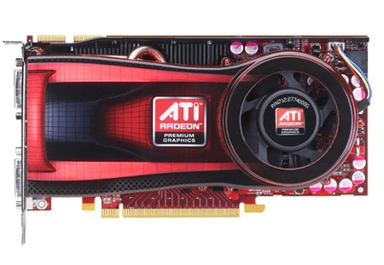
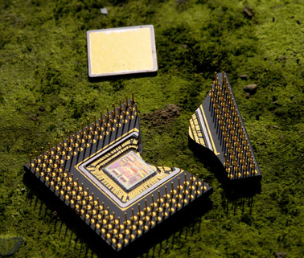


Aging-Aware Compiler-Directed VLIW Assignment for GPGPU Architectures
Aging-Aware Compiler-Directed VLIW Assignment for GPGPU Architectures
Aging-Aware Compiler-Directed VLIW Assignment for GPGPU Architectures
Aging-Aware Compiler-Directed VLIW Assignment for GPGPU Architectures
Abbas Rahimi‡, Luca Benini†, Rajesh K. Gupta‡
‡UC San Diego, †University of Bologna
Micrel.deis.unibo.it
/MultiTherman
Variability.org

Slide 2
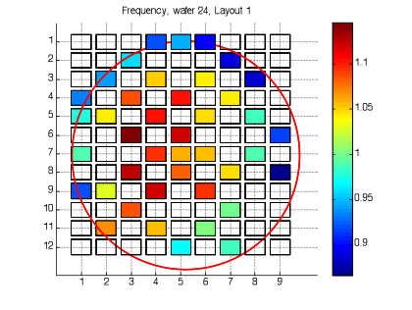
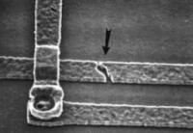
Variability is about Cost and Scale
NBTI-induced performance degradation
∆V_{TH} = F (Process, Temp, Voltage, Stress)
Stress consumes timing margin.
Variability in transistor characteristics is a major challenge in nanoscale CMOS:
  Static Process variation: L_{eff} and V_{th}
  Dynamic variations: Temperature fluctuations, supply Voltage droops, and device Aging (NBTI, HCI)
To handle variations →designers use conservative guardbands → loss of operational efficiency ☹
guardband
Failure
Operational
V_{TH}
Stress (workload)
Lifetime is limited by the most aged component.
Complicated with 512 CUDA cores, or 320 5-way VLIW cores!
actual circuit delay
guardband
☹
Clock
∆V_{th}
Process
Aging
Temperature
V_{CC} Droop
∆P

Slide 3
Related Work
NBTI-aware power-gating exploits the sleep state where a circuit is inherently immune to aging [Calimera’09, Calimera’12]
  High power-gating factors impose performance degradation ☹
Equalize the stress among various functional units in single-core [Gunadi’10]
  They intrusively modified pipeline to support complement mode execution and operand swapping 😐
Traditional coarse-grained multi-core utilize selective voltage scaling [Tiwari’08, Karpuzcu’09]
  Difference between adaptive voltage and over-designed voltage is small ☹
Process variation in GPGPU [Lee’11]
  Disabling the slowest cores! ☹
  Cannot capture the aging which is dynamic in nature!

Slide 4

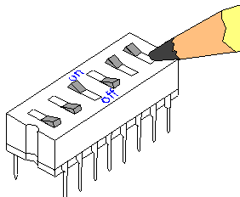


Contribution
Aging-aware compiler that utilizes a dynamic binary optimizer for customizing the kernels code to respond to the specific health state of hardware:
  Specific health state (online NBTI sensors)
  Uniformly distributes the stress of instructions among various VLIW slots, results in a healthy code generation.
An adaptive reallocation strategy, a fully software solution, without any architectural modification with
iso-throughput kernels:
  Throughput (healthy kernel) = Throughput (naïve kernel)

Slide 5
AMD Evergreen GPGPU Architecture
Compute Device
Compute Unit (CU)
Stream Core (SC)
Ultra-threaded Dispatcher
SIMD Fetch Unit
Processing Elements (PEs)
Compute Unit (CU₀)
Compute Unit (CU₁₉)
Stream Core (SC₀)
Stream Core (SC₁₅)
T
X
Y
Z
W
Branch
Wavefront Scheduler
L1
L1
Crossbar
Local Data Storage
General-purpose Reg
Global Memory Hierarchy
ILP→VLIW
Packing ratio = 3/5
X : MOV R8.x, 0.0f
Y : AND_INT T0.y, KC0[1].x
Z : ASHR T0.x, KC1[3].x
Radeon HD 5870
  20 Compute Units (CUs)
    16 Stream Cores (SCs) per CU (SIMD execution)
      5 Processing Elements (PEs) per SC (VLIW execution)
        4 Identical PEs (PE_{X}, PE_{Y}, PE_{W}, PE_{Z})
        1 Special PE_{T}
W:________
T:_________

Slide 6
GPGPU Workload Variation
✓
Instructions are NOT uniformly distributed among PEs !!
Seven kernels execute more than 40% of the ALU engine instructions only on PE_{X} ☹
Compiler only increases the packing ratio → weighted VLIW code generation is needed
Inter-compute units
Inter-stream cores
Inter-processing elements
✓
SIMD Execution ☺
Uniform workload variation between CUs: 0%−0.26%
Load balancing algorithm of the ultra-thread dispatcher ☺
×
50%
Compute Device
Compute Unit (CU)
Stream Core (SC)
We leverage an average packing ratio of 0.3 towards reliability improvement!
Finding N-young slots among all available slots
Ultra-threaded Dispatcher
SIMD Fetch Unit
Processing Elements (PEs)
Compute Unit (CU₀)
Compute Unit (CU₁₉)
Stream Core (SC₀)
Stream Core (SC₁₅)
T
X
Y
Z
W
Branch
L1
Wavefront Scheduler
L1
Crossbar
Local Data Storage
General-purpose Reg
Global Memory Hierarchy

Slide 7
Aging-Aware Compilation Flow
Host CPU
Naïve Kernel
Dynamic Binary Optimizer
Healthy Kernel
GPGPU
5-Way VLIW Bundle
Static Code Analysis
Limited Packing Ratio
NBTI Sensors
Periodic healthy kernels generation:
1. “Fatigued” PEs are relaxing!
2. “Young” PEs are working hard!
Non-uniform Inst. Distribution
Uniform VLIW Assignment
Leveling of slots
Equalizes the expected lifetime of each PEs
X : MOV …
X :_________
Y : ASHR …
Y :_________
Z :_________
Z : MOV …
W:________
W: ASHR …
T:_________
T:_________

Slide 8
Experimental Results
Extended lifetime ☺
uniform ∆V_{TH}=0.6mV
V_{TH} = 413mV
V_{TH} = 406mV
Inter-PEs ∆V_{TH}=10mV
Process variation and NBTI-induced for 360 hours without power gating in HD 5870.
Periodically the execution of healthy kernels, compared to the naïve kernels
  Reduces V_{th} shift up to 49%(11%) and on average 34%(6%) in presence(absence) of power-gating supports
  Imposes 0% throughput penalty (maintaining the naïve ILP)

Slide 9

Conclusion
An adaptive compiler-directed technique that uniformly distributes the stress of instructions throughout various VLIW resource slots.
Equalizing the expected lifetime of each processing element by regenerating aging-aware healthy kernels that respond to the specific health state of GPGPU while maintaining iso-throughput execution.
Work in progress
  Memory subsystems: reducing V_{th} shift by up to 43% for register files of GPGPU.
Thank you!

Slide 10
Aging-aware Kernel Adaptation Flow
Reading sensors measurements
Static code analysis technique estimates the percentage of instructions that will carry out on every PE (a linear calibration module later fits the predicted ∆V_{TH} shift to the observed ∆V_{TH} shift).
Finally, the uniform slot assignment assigns fewer/more instructions to higher/lower stressed slots.
Healthy kernel binary ☺
Naïve Kernel
Host CPU
Naïve Kernel Binary
2
Just-in-time Disassembler
Device-dependent Assembly Code
Static Code Analysis
Wearout
Estimation
Module
∆V_{th−{X,…,W}}[t]
Pred-∆V_{th−{X,…,W}}[t+1]
Performance
Degradation
Measurement
Linear Calibration
∆V_{th−{X,…,W}} [t+1]
Rank | V_{th} | τ
Age[1] | V_{th-X} [t] | τ_{X} [t]
Age[2] | V_{th-Y} [t] | τ_{Y} [t]
… | … | …
Rank | ∆V_{th} | ∆τ
Util[1] | ∆V_{th-Y} [t+1] | ∆τ_{Y} [t+1]
Util[2] | ∆V_{th-Z} [t+1] | ∆τ_{Z} [t+1]
… | … | …
τ_{{X,…,W}} [t]
∆τ_{{X,…,W}} [t+1]
3
Aging-aware Slot Assignment
4
Healthy Code Generation
Healthy Kernel Binary
Memory
Memory Mapped Sensors
Input
Output
Kernel
1
NBTI
Sensors Banks
GPGPU Compute Device

Slide 11
Total execution time of adaptation flow
Average execution time of the entire process, starting from disassembler up to the healthy code generation.
  Kernel disassembly using online CAL (95% total time)
  Static code analysis: 220K−900K cycles
  Uniform slot assignment algorithm ≤ 2K cycles
On average 13 millisecond on a host machine with an Intel i5 2.67GHz

Slide 12
AMD APP SDK 2.5 kernels with parameters
Kernel | Parameter
Reduction (Rdn) | N= 100,000
BinarySearch (BSe) | N= 10,000
DwtHaar1D (DH1D) | N= 10,000
BitonicSort (BSo) | N= 1,000
FastWalshTransform (FWT) | N= 1,000
FloydWarshall (FW) | N= 100
BinomialOption (BO) | N= 100
DiscreteCosineTransform (DCT) | X= 500 Y= 500
MatrixTranspose (MT) | X= 300 Y= 300
MatrixMultiplication (MM) | X= 300 Y= 300 Z= 300
SobelFilter (SF) | default input file
URNG | default input file

