Slide 1

Temporal Memoization for
Energy-Efficient
Timing Error Recovery in GPGPUs
Abbas Rahimi, Luca Benini, Rajesh K. Gupta
UC San Diego, UNIBO and ETHZ
NSF Variability Expedition
ERC MultiTherman

Slide 2
Outline
Motivation
  Sources of variability
  Cost of variability-tolerance
Related work
  Taxonomy of SIMD Variability-Tolerance
Temporal memoization
Temporal instruction reuse in GPGPUs
Experimental setup and results
Conclusions and future work

Slide 3
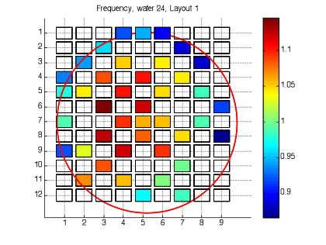
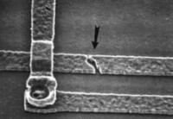
Sources of Variability
Variability in transistor characteristics is a major challenge in nanoscale CMOS:
  Static variation: process (L_{eff}, V_{th})
  Dynamic variations: aging, temperature, voltage droops
To handle variations
  Conservative guardbands → loss of operational efficiency ☹
actual circuit delay
guardband
Clock
Process
Aging
Temperature
V_{CC} droop
Slow
Fast

Slide 4
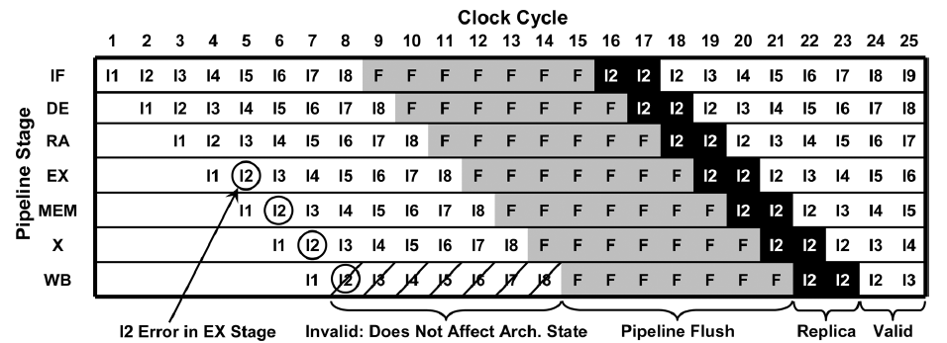
Variability is about Cost and Scale
Eliminating guardband ☺
Timing error 😐
Bowman et al, JSSC’09
Costly error recovery ☹
3×N recovery cycles per error for scalar pipeline!
N= # of stages
3
Bowman et al, JSSC’11

Slide 5
Cost of Recovery is Higher in SIMD!
Cost of recovery is exacerbated in SIMD pipelined:
  Vertically: Any error within any of the lanes will cause a global stall and recovery of the entire SIMD pipeline.
  Horizontally: Higher pipeline latency causes a higher cost of recovery through flushing and replaying.
error rate × wider width
Recovery cycles increases linearly with pipeline length
Wide lanes
quadratically expensive
Deep pipes

Slide 6
SIMD is the Heart of GPGPU
Compute Device
Compute Unit (CU)
Stream Core (SC)
Ultra-threaded Dispatcher
SIMD Fetch Unit
Processing Elements (PEs)
Compute Unit (CU₀)
Compute Unit (CU₁₉)
Stream Core (SC₀)
Stream Core (SC₁₅)
T
X
Y
Z
W
Branch
Wavefront Scheduler
L1
L1
Crossbar
Local Data Storage
General-purpose Reg
Global Memory Hierarchy
X : MOV R8.x, 0.0f
VLIW
Y : AND_INT T0.y, KC0[1].x
Z : ASHR T0.x, KC1[3].x
Radeon HD 5870 (AMD Evergreen)
  20 Compute Units (CUs)
    16 Stream Cores (SCs) per CU (SIMD execution)
      5 Processing Elements (PEs) per SC (VLIW execution)
        4 Identical PEs (PE_{X}, PE_{Y}, PE_{W}, PE_{Z})
        1 Special PE_{T}
W:________
T:_________

Slide 7
Taxonomy of SIMD Variability-Tolerance
Guardband
Adaptive
Eliminating
No timing error
Timing error
Hierarchically focused guardbanding and uniform instruction assignment
Error recovery
Rahimi et al, DATE’13
Rahimi et al, DAC’13
Predict & prevent
Memoization
Decoupled recovery
Recalling recent context of error-free execution
Lane decoupling through provate queues
Rahimi et al, TCAS’13
Pawlowski et al, ISSCC’12
Krimer et al, ISCA’12
6
Detect-then-correct

Slide 8
Related Work: Predict & Prevent
Uniform VLIW assignment periodically distributes the stress of instructions among various slots resulting in a healthy code generation.
Host CPU
Naïve Kernel
Dynamic Binary Optimizer
Healthy Kernel
GPGPU
× These predictive techniques cannot eliminate the entire guardbanding to work efficiently at the edge of failure!
Rahimi et al, DAC’13
Tuning clock frequency through an online model-based rule in view of sensors, observation granularity, and reaction times.
Rahimi et al, DATE’13

Slide 9
Related Work: Detect-then-Correct
Lane decoupling by private queues that prevent errors in any single lane from stalling all other lanes→ self-lane recovery
Pawlowski et al, ISSCC’12
Krimer et al, ISCA’12
  Causes slip between lanes → additional mechanisms to ensure correct execution
  Lanes are required to resynchronize for a microbarrier (load, store) → performance penalty

Slide 10
Taxonomy of SIMD Variability-Tolerance
Guardband
Adaptive
Eliminating
No timing error
Timing error
Hierarchically focused guardbanding and uniform instruction assignment
Error ignorance
Error recovery
Predict & prevent
Ensuring safety of error ignorance by fusing multiple data-parallel values into a single value
Detect & ignore
Memoization
Decoupled recovery
Recalling recent context of error-free execution
Lane decoupling through provate queues
Detect-then-correct:
exactly or approximately through memoization
Detect-then-correct
9

Slide 11

Memoization: in Time or Space
Reduce the cost of recovery by memoization-based optimizations that exploit spatial or temporal parallelisms
Temporal error correction
Context_{a} [t-k]
✔
Context_{b} [t-k]
✔
Context_{c} [t-k]
✔
…
…
…
Context_{a} [t-1]
✔
Context_{b} [t-1]
✔
Context_{c} [t-1]
✔
Context_{a} [t]
✔
Context_{b} [t]
✔
Context_{c} [t]
✔
Spatial error correction
Reuse
x
Context_{i}
HW
Sensors
[Spatial Memoization] A. Rahimi, L. Benini, R. K. Gupta, “Spatial Memoization: Concurrent Instruction Reuse to Correct Timing Errors in SIMD,” IEEE Tran. on CAS-II, 2013.

Slide 12
Contributions
A temporal memoization technique for use in SIMD floating-point units (FPUs) in GPGPUs
  Recalls the context of error-free execution of an instruction on a FPU.
  Maintain the lock-step execution ☺
To enable scalable and independent recovery, a single-cycle lookup table (LUT) is tightly coupled to every FPU to maintain contexts of recent error-free executions.
The LUT reuses these memorized contexts to exactly, or approximately, correct errant FP instructions based on application needs.
Scalability ✓
low-cost self-resiliency ✓
in the face of high timing error rates!

Slide 13
Concurrent/Temporal Inst. Reuse (C/TIR)
Concurrent/Temporal Inst. Reuse (C/TIR)
Parallel execution in SIMD provides an ability to reuse computation and reduce the cost of recovery by leveraging inherent value locality
  CIR: Whether an instruction can be reused spatially across various parallel lanes?
  TIR: Whether an instruction can be reused temporally for a lane itself?
Utilizing memoization:
    C/TIR memoizes the result of an error-free execution on an instance of data.
    Reuses this memoized context if they meet a matching constraint (approximate or exact)
CIR
TIR
12

Slide 14
FP Temporal Instruction Reuse (TIR)
A private FIFO for every individual FPU
  Exact matching constraint; for Black-Scholes
  Approximate matching constraint (ignoring the less significant 12 bits of the fraction); for Sobel
With approximate matching constraint, PSNR > 30dB✓
11%↑
13%↑
5×↑

Slide 15
Overall TIR Rate of Applications
Programmable through
memory-mapped registers
Approximate matching
Exact matching
Mostly, hit rate increases < 10% when FIFO increases from 10 to 1,000
FIFOs with 4 entries
  ✓ provide an average hit rate of 76% (up to 97%)
  ✓ have 2.8× higher hit rate per power compared to the 10 entries

Slide 16
Temporal Memoization Module
temporal memoization
module (in gray) superposed on the baseline recovery with EDS+ECU (replay)
Hit | Error | Action | Q_{Pipe}
0 | 0 | LUT update | Q_{S}
0 | 1 | Trigger ECU | Q_{S}
1 | 0 | LUT reuse + FP CLK gating | Q_{L}
1 | 1 | LUT reuse + FP CLK gating + error masking | Q_{L}

Slide 17
Experimental Setup
We focus on energy-hungry high-latency single-precision FP pipelines
  Memory blocks are resilient by using tunable replica bits
  The fetch and decode stages display a low criticality [Rahimi et al, DATE’12]
  Six frequently exercised units: ADD, MUL, SQRT, RECIP, MULADD, FP2FIX; 4 cycles latency (except RECIP with 16 stages) generated by FloPoCo.
Have been optimized for signoff frequency of 1GHz at (SS/0.81V/125°C), and then for power using high V_{TH} cells in TSMC 45nm. 0.11% die area overhead for Radeon HD 5870.
Multi2Sim, a cycle-accurate CPU-GPU simulator for AMD Evergreen
The naive binaries of AMD APP SDK 2.5

Slide 18
Energy Saving for Various Error Rates
error rate of 0%: on average 8% saving
error rate of 1%: on average 14% saving
error rate of 2%: on average 20% saving
error rate of 3%: on average 24% saving
error rate of 4%: on average 28% saving
Temporal memoization module does NOT produce an erroneous result, as it has a positive slack of 14% of the clock period.
Thanks to efficient memoization-based error recovery that does not impose any latency penalty as opposed to the baseline

Slide 19
Efficiency under Voltage Overscaling
66% saving
6% saving
8% saving @ nominal volt
FPUs of the baseline are reduced their power as consequence of negligible error rate, while we cannot proportionally scale down the power of the temporal memoization modules.
Baseline faces an abrupt increasing in error rate therefore frequent recoveries!

Slide 20
Conclusion
A fast lightweight temporal memoization module to independently store recent error-free executions of a FPU.
To efficiently reuse computations, the technique supports both exact and approximate error correction.
Reduces the total energy by average savings of 8%-28% depending on the timing error rate.
Enhances robustness in the voltage overscaling regime and achieves relative average energy saving of 66% with 11% voltage overscaling.

Slide 21
Work in Progress
To further reduce the cost of memoization, we replaced LUT with associative memristive (ReRAM) memory module that has a ternary content addressable memory [Rahimi et al, DAC’14]
  39% reduction in average energy use by the kernels
Collaborative compilation + Approximate storage

Slide 22
Grazie dell’attenzione!
NSF Variability Expedition
ERC MultiTherman

