Slide 1

Approximate Associative Memristive Memory for Energy-Efficient GPUs
Abbas Rahimi, Amirali Ghofrani, Kwang-Ting Cheng, Luca Benini, Rajesh K. Gupta
UC San Diego, UC Santa Barbara, ETH Zurich
NSF Variability Expedition
ERC MultiTherman

Slide 2
Outline
Motivation
  Energy Efficiency in GPUs
Approximate Associative Memristive Memory
  Memoization using memristor under VOS
  Programming flow
TCAM Operation
  Approximate TCAM operation
Experimental Setup and Results
Conclusion

Slide 3
Why GPU?
CPU
Westmere 32nm
1690 pJ/flop
GPU
Kepler 28nm
140 pJ/flop

Slide 4
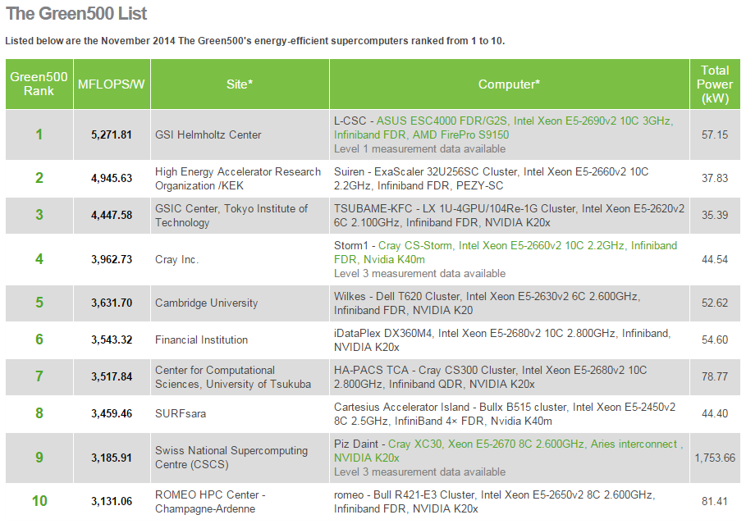
Why GPU?

Slide 5
AMD GPU Architecture
Radeon HD 7970 device from Southern Islands family
  32 compute units
    4 SIMD units
      16 stream cores (parallel lanes)
2048 stream cores per device
Thermal design power: 300W!
Stream Core 1
Compute Device
Compute Unit
SIMD Unit
Stream Core 2
Ultra-threaded Dispatcher
Wavefront Scheduler
Stream Core 3
IF/ID
Compute Unit 1
…
Compute Unit 32
SIMD Unit 1
SIMD Unit 2
SIMD Unit 3
SIMD Unit 4
Stream Core 16
Local Memory
…
Vector/Scalar RF
Global Memory
4

Slide 6
Voltage Over-Scaling (VOS)
VOS achieves energy efficiency at costs to:
  Performance loss
  → SIMD ☺
  Increasing timing sensitivity in the presence of variations
  → Timing errors ☹
5X
Dreslinski et al, Proc. IEEEE’10

Slide 7
Timing Errors Kill SIMD!
Cost of error recovery is exacerbated in SIMD pipelined:
  Horizontally: higher pipeline latency → higher cost of recovery through flushing and replaying
  Vertically: any error within any of the lanes → global stall → recovery of the entire SIMD
RF
ALU
M
WB
IF/ID
RF
ALU
M
WB
Wide lanes
SIMD Unit
….
RF
ALU
M
WB
More expensive recovery
Deep pipeline
6

Slide 8
SIMD Error-Tolerance
Guardband
Adaptive
Eliminating
No timing error
Timing error
Hierarchically focused guardbanding and adaptive instruction assignment
Error handling
Rahimi et al, DATE’13
Rahimi et al, DAC’13
Accepting errors
Error recovery
Memoization
Independent lane
Recalling recent context of error-free execution
Lane decoupling through private queues
Rahimi et al, TCAS’13
Rahimi et al, DATE’14
Pawlowski et al, ISSCC’12
Krimer et al, ISCA’12

Slide 9
Our Contributions
Energy saving for GPUs, subject to few controllable timing errors
Combining Memoization + VOS
Designing Approximate Associative Memristive Memory (A²M²)
  Accepts 0-2 Hamming distance matches

Slide 10
Why Memristor?
Memristor is a 2 terminal resistive memory
Offers high density and low energy operation with 1.0V–270mV
Downside is limited durability beyond billion write operations
30x denser!
Memristor: 4F²
SRAM: 120 F²

Slide 11
Memristor Is Reality: Fabricated Chips
4-Mb memristor chip [Chang, JSSC’13]
7.2 ns read-write access time
Reliable operations: a process-temperature detector with feedback
1-Mb memristor chip in 28nm [Chang, ISSCC’14]
404ns read access time at V_{DD} = 0.27V

Slide 12
Approximate Associative Memristive Memory (A²M²)
A²M² is tightly-integrated with FPU
A²M² is composed of a TCAM + Memory
Mimics partial functionality of the related FPU
A²M² is a software programmable module
  Profiler extracts highly frequent computations
  Pre-stores these computations in A²M²
A2M2 memorizes highly frequent computations → enables computing-with-memristor memory

Slide 13



A²M² Programming Flow
Kernel code
Profiler
HFC +
Exact/1HD/2HDAppr
Host code
GPU device
√ : {e₁} → {q₁}
Stream core
*: {c₁, d₁} → {p₁}
√ : 2HD Appr
A²M²
√ FPU
+: {a₁, b₁} → {o₁}
+: {a₂, b₂} → {o₂}
*: 1HD Appr
A²M²
* FPU
+: 1HD Appr
…: Exact
A²M²
+ FPU
Highly frequent computations (HFC)
A²M²
…
Desired PSNR
Functional Sim
Design time
Runtime

Slide 14
Computing with A²M²
Stream core
A²M²
√ FPU
A²M²
* FPU
Operands
Result
A²M²
+ FPU
A²M²
…
Execution stage of FPU
Search operands
Return pre-stored result
Hit
Ternary content addressable memory (TCAM)
2T-2R (2-transistor/2-resistive)
2-bit encoding
Stores high-frequent input patterns
Approximate

Slide 15
Outline
Motivation
  Energy Efficiency in GPUs
Approximate Associative Memristive Memory
  Memoization using memristor under VOS
  Programming flow
TCAM Operation
  Approximate TCAM operation
Experimental Setup and Results
Conclusion

Slide 16
TCAM Operation
Each bit is represented by a 2T-2R cell
A match line (ML) is pre-charged to VDD
Search pattern is applied on select transistors
Stored pattern is available on memristors
Mismatched patterns result in a low-resistance path to GND and discharge ML
Search Pattern | SL | SL_b
0 | 0 | 1
1 | 1 | 0
X | 0 | 0
1
0
0
1
1
0
1
0
1
0
1
0
Search for 101: match – no discharge
Search for 110: mismatch –discharge
Stored pattern= 10X

Slide 17
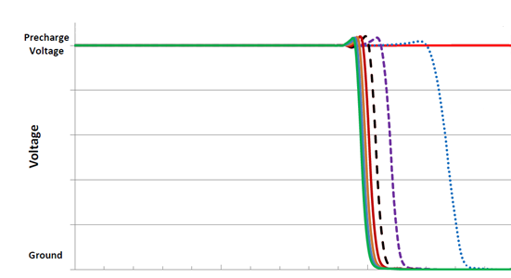
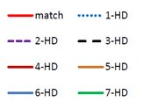
Approximate TCAM Operation
Faster reads or lower supply voltages subject to controllable approximate matching
  1000mv: Exact Matching
  775mv: 1-HD Matching
  720mv: 2-HD Matching
Evaluation
Precharge
Evaluation
Precharge
Evaluation
Precharge
775mV
725mV
1000mV

Slide 18
Outline
Motivation
  Energy Efficiency in GPUs
Approximate Associative Memristive Memory
  Memoization using memristor under VOS
  Programming flow
TCAM Operation
  Approximate TCAM operation
Experimental Setup and Results
Conclusion

Slide 19
Experimental Setup
AMD GPUs
  Image processing applications from AMD APP SDK v2.5
  Multi2Sim for AMD Southern Islands GPU, Radeon HD 7970 device
FPU ASIC flow
  6-stage balanced FPUs generated by FloPoCo
  Synthesized and mapped using a 45-nm TSMC
  Optimized for power and a signoff clock period of 1.5ns:
    Synopsys Design Compiler/ IC Compiler
    FPU power estimation: Synopsys PrimeTime (1.0V)
A²M² design flow
  Transistor-level SPICE simulations by Cadence Virtuoso for power and delay estimation

Slide 20
Energy Comparison: FPU versus A²M²
Energy (fJ) per operation in 45nm
Module | FPU (1.0V) | Exact |  | Approximate (2-HD)
 |  | 32-row | 64-row | 32-row | 64-row
ADD | 4742 | 2740 | 4568 | 999 | 1479
MUL | 9891 | 2740 | 4568 | 999 | 1479
SQRT | 9983 | 2322 | 3901 | 864 | 1332
MAC | 12051 | 3096 | 5071 | 1124 | 1627
Energy ratio | 1 | 0.34 | 0.56 | 0.12 | 0.18

Slide 21
Hit Rate versus Size/Accuracy
12%
Exact Matching
12%
18%
Approximate Matching (2-HD)

Slide 22
Energy Saving: Sobel Filter
20%
26%
24%
28%

Slide 23
Energy Saving: Roberts Filter
43%
45%
44%
40%
PSNR > 30dB
A²M² with 8-row: Sobel (28%), Sharpen (23%), and Shift (34%)
A²M² with 16-row: Robert (45%)

Slide 24
Visual Depiction of Output Quality
Quality loss is nearly indiscernible to the eye, whereas provides 28% energy savings

Slide 25
Conclusion
Approximate Associative Memristive Modules combines:
  Benefits of emerging memristor technology
  Tolerance of emerging approximate computing
A²M² tightly integrated to FPU to save energy by
  Recalling the frequent computations therefore avoiding re-executions
  Operating at VOS by accepting the approximate matches (1-HD and 2-HD)
A²M² saves 32% energy on average with 8-row

Slide 26
Thanks!

