Slide 1
Axilog: Language Support for Approximate Hardware Design
Amir Yazdanbakhsh
Divya Mahajan
Bradley Thwaites
Jongse Park
Anandhavel Nagendrakumar
Sindhuja Sethuraman
Kartik Ramkrishnan
Nishanthi Ravindran
Rudra Jariwala
Abbas Rahimi
Hadi Esmaeilzadeh
Kia Bazargan
Georgia Institute of Technology University of Minnesota UC San Diego
Georgia Institute of Technology
Alternative Computing Technologies (ACT) Lab
DATE 2015

Slide 2
Approximate computing
Embracing error
Relax the abstraction of near-perfect accuracy in general-purpose computing/communication/storage
Allow errors to happen during computation/communication/storage
  Improve resource utilization efficiency
    Energy, bandwidth, capacity, …
  Improve performance
Build acceptable systems from intentionally-made unreliable software and hardware components
Avoid overkill and worst-case design

Slide 3
Avoiding Worst-Case Design
Approximate Computing
Generality
Application
Programming Language
Compiler
Efficiency
Performance
Architecutre
Microarchitecture
Circuit
Precision
Reliability
Determinism
Cost
Cost
Physical Device

Slide 4
Goals
Criteria
Design the first HDL for
  Approximate Hw Design
  Approximate Hw Reuse
  Approximate Synthesis
Approximate HDL shall be
  High-level
  Automated
  Backward compatible

Slide 5
Safety in Hardware
Approximate
Precise
Precise
Controller
Datapath
Clock

Slide 6
Axilog Annotations
Design Annotations
relax
(relax_local)
restrict
(restrict_global)
Reuse Annotations
approximate
critical
bridge

Slide 7
Design Annotations

Slide 8
Relaxing Accuracy Requirements
module ripple_carry_adder(a, b, c_in, c_out, s)
…
full_adder f0(a[0], b[0], c_in, w0, s[0])
full_adder f1(a[1], b[1], w0, c_out, s[1])
relax (s);
…

Slide 9
Relaxing Accuracy Requirements
module ripple_carry_adder(a, b, c_in, c_out, s)
…
full_adder f0(a[0], b[0], c_in, w0, s[0])
full_adder f1(a[1], b[1], w0, c_out, s[1])
relax (s);
…

Slide 10
Scoping Approximation (relax_local)
module full_adder
(a, b, c_in, c_out, s)
…
relax_local (s);
…
…
full_adder f0 (…)
full_adder f1(…)
relax (s[0]);
…

Slide 11
Scoping Approximation (relax_local)
module full_adder
(a, b, c_in, c_out, s)
…
relax_local (s);
…
…
full_adder f0 (…)
full_adder f1(…)
relax (s[0]);
…

Slide 12
Restricting Approximation

Slide 13
Restricting Approximation

Slide 14
Restricting Approximation

Slide 15
Restricting Approximation Globally
module full_adder(a, b, c_in, c_out, s);
…
approximate output s;
relax (s);
…
endmodule
…
restrict_global(s[31:0]);

Slide 16
Restricting Approximation Globally
module full_adder(a, b, c_in, c_out, s);
…
approximate output s;
relax (s);
…
endmodule
…
restrict_global(s[31:0]);

Slide 17
Reuse Annotations

Slide 18
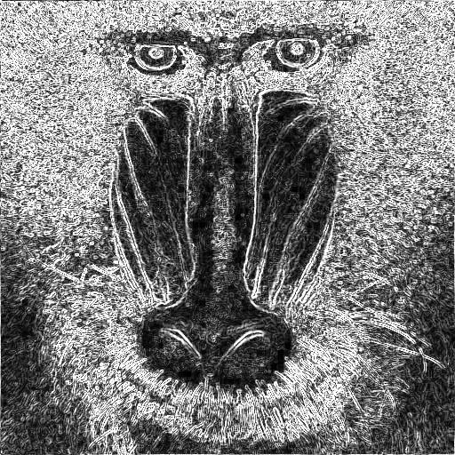
Outputs Carrying Approximate Semantics

Slide 19
Critical Inputs
…
critical input reset;
critical input clock;
…
reset
Next State
Logic
State
Register
Output
Logic
clock

Slide 20
Bridging Approximate Wires to Critical Inputs
…
and a1(s, a0, a1);
relax (s);
bridge (s);
multiplexer m0(s, a0, a1, out);
…

Slide 21
Bridging Approximate Wires to Critical Inputs
…
and a1(s, a0, a1);
relax (s);
bridge (s);
multiplexer m0(s, a0, a1, out);
…

Slide 22
Baseline Synthesis Flow
Highest frequency with minimum power and area

Slide 23
Relaxability Inference Analysis
Circuit under analysis with Axilog annotations
Identify the wires which are driving unannotated wires or annotated with restrict within the module under analysis
Identify the relaxed outputs of the instantiated submodules
Marks any wire that affects a globally restricted wire as precise
Safe to approximate gates

Slide 24
Approximate Synthesis Flow
Axilog Code
Axilog
Compiler
Safe to
Approximate
Gates

Slide 25
Measurements
Tools for Synthesis and Energy Analysis
Synopsys Design Compiler
Timing Simulation with SDF back annotations
Cadence NC-Verilog
Standard Cell Library
TSMC 45-nm multi-V_{t}
Synopsys Primetime
Slowest PVT corner (SS, 0.81V, 0C) for baseline results

Slide 26
Benchmarks
Arithmetic Computation, Signal Processing, Robotics, Machine Learning, Image Processing
FIR
# lines: 113
Signal Processing
# Annotations
Design: 6
Reuse: 5
Sobel
# lines: 143
Image Processing
# Annotations
Design: 6
Reuse: 3
Brent-Kung
# lines: 352
Arithmetic Computation
# Annotations
Design: 1
Reuse: 1
Kogge-Stone
# lines: 353
Arithmetic Computation
# Annotations
Design: 1
Reuse: 1
K-means
# lines: 10,985
Machine Learning
# Annotations
Design: 7
Reuse: 3
Wallace Tree
# lines: 13,928
Arithmetic Computation
# Annotations
Design: 5
Reuse: 3
ForwardK
# lines: 18,282
Robotics
# Annotations
Design: 5
Reuse: 4
Neural Network
# lines: 21,053
Machine Learning
# Annotations
Design: 4
Reuse: 3
InverseK
# lines: 22,407
Robotics
# Annotations
Design: 8
Reuse: 4
26

Slide 27
Energy Reduction
Error ≤ 5%
Error ≤ 10%

Slide 28
Area Reduction
Error ≤ 5%
Error ≤ 10%

Slide 29
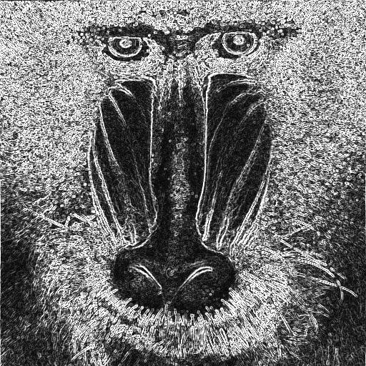

Output Quality Degradation in Sobel
0% Quality Loss
5% Quality Loss
10% Quality Loss
10% Quality loss is nearly indiscernible to the eye Yet provides 57% energy savings

Slide 30
Energy Reduction for Different PVT Corners
(SS, 0.81V, 0°C)
(SS, 0.81V, 125°C)

Slide 31
First HDL for Approximation
  Design
  Reuse
  Automation
  High-level
  Backward-compatibility
Axilog
Energy
Savings
Area
Reduction
Code
Annotations
54%
1.9×
2-12
http://www.act-lab.org/artifacts/axilog

