Slide 1



GRATER: An Approximation Workflow for Exploiting Data-Level Parallelism in FPGA Acceleration
Atieh Lotfi, Abbas Rahimi, Amir Yazdanbakhsh, Hadi Esmaeilzadeh, Rajesh K. Gupta
UC San Diego, UC Berkeley, Georgia Institute of Technology
NSF Variability Expedition

Slide 2
Outline
Motivation
OpenCL Execution Model
Approximation Design Workflow
Experimental Setup and Results
Conclusion

Slide 3
Motivation
The effective end of Dennard scaling
Performance
Generality
Efficiency
Solutions that provide significant performance and efficiency gains while retaining generality is needed
✓Programmable accelerators (FPGAs)
✓Approximate computing

Slide 4


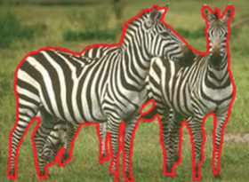




Motivation
Image Processing
Machine Learning
Web Search
Big Data Analytics
Multimedia
✓ Tolerance to imprecise computing
✓ Can benefit from FPGA acceleration
Quality
Performance
GRATER
An automated design workflow is to bridge the gap between approximation and FPGA acceleration

Slide 5
Our Contributions
Automatically leverages approximation to utilize data-level parallelism and achieve higher throughput for FPGA accelerators
Uses a source-to-source compiler to systematically tune the precision of operations and data in an OpenCL kernel
Exploits a genetic-based pre-synthesis optimization to reduce the synthesized kernel area while statistically satisfying the QoR target

Slide 6
Outline
Motivation
OpenCL Execution Model
Approximation Design Workflow
Experimental Setup and Results
Conclusion

Slide 7
OpenCL Platform Model
Kernel Code
Host Code
…
…
…
…
Host
…
Work-item
…
…
…
…
Processing Element
Compute Unit (CU)
Compute Device

Slide 8
Mapping OpenCL Programs on FPGAs
Altera OpenCL SDK
GPUs and FPGAs exploit data-level parallelism differently:
  GPUs: SIMD in a CU
  FPGAs: pipeline parallelism in a CU
FPGAs can improve throughput by creating multiple copies of the kernel pipelines
  Our aim is to increase the number of pipeline copies in a fixed FPGA chip

Slide 9
Outline
Motivation
OpenCL Execution Model
Approximation Design Workflow
Experimental Setup and Results
Conclusion

Slide 10
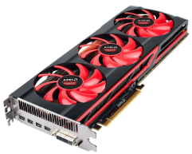
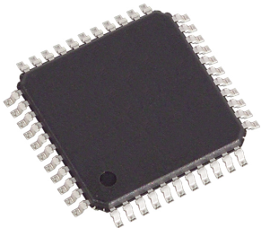
GRATER: Approximation Design Workflow
Test cases
Quality Metric
Exact
OpenCL kernel
Source-to-source compiler
1. Analysis and Pruning
Automatically reduces the precision of kernel’s variables (and operations)
e.g. float->{int, short, char}
2. Genetic-based Approximation Algorithm
Population
(Modified kernel)
Selection
Mutation/
Crossover
GPU
accelerated profiling
Fitness evaluation
Least Area
Acceptable QoR
HLS tool
(OpenCL to RTL)
Approximate kernel
FPGA

Slide 11



Source-to-source Compiler
Analysis and Pruning
Assign a precision tag (𝑷𝑻) to each variable type: e.g. data types {float, int, short, char} -> {4, 3, 2, 1}
Detect variables amenable to approximation (AV)
Find lowest possible precision(LP) for each $v∈AV$
Generate ${Kernel}_{min}$ with all $v_{i}∈AV$ replaced by LP_{i}
Run ${Kernel}_{min}$ on GPU
Yes
QoR
passed?
No
☺ Solution found: ${Kernel}_{min}$
Run genetic-based algorithm

Slide 12
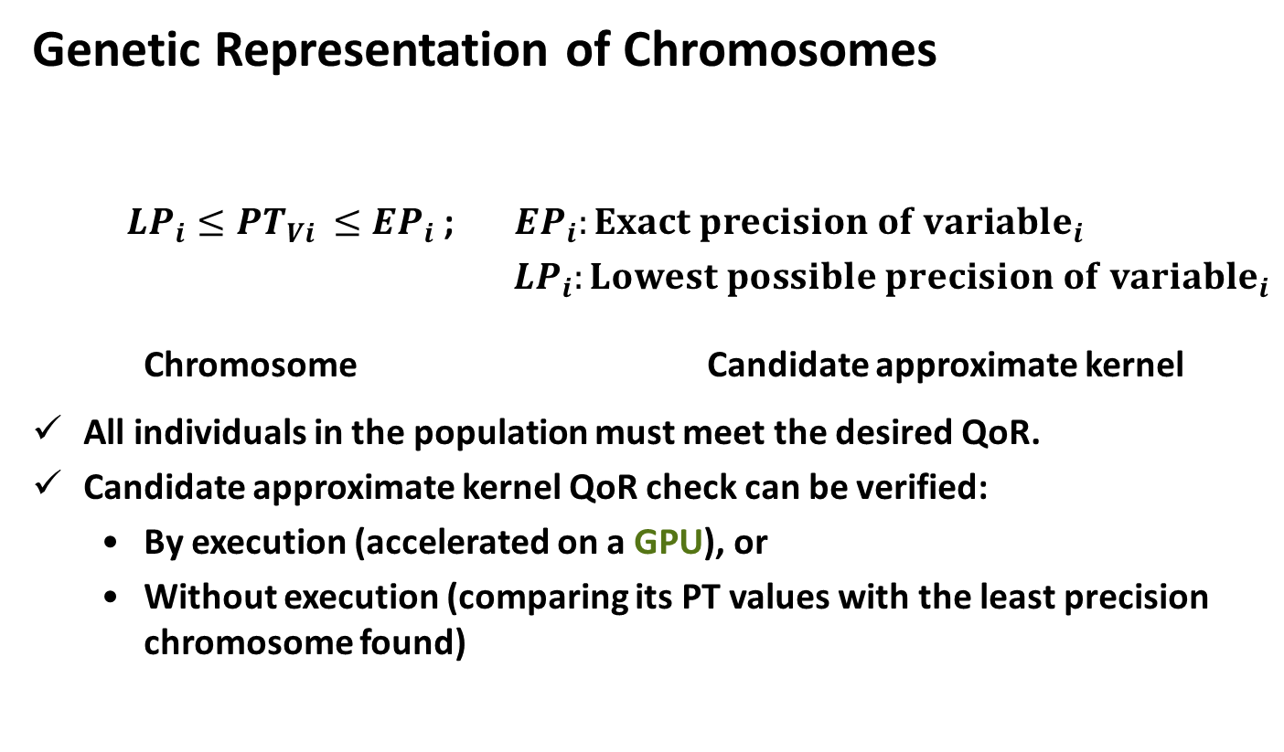
Source-to-source Compiler
Genetic-based Approximation Algorithm (1/3)
Genetic Representation of Chromosomes
${LP}_{i}≤{PT}_{Vi }≤{EP}_{i}$ ; ${EP}_{i}:Exact precision of {variable}_{i}$
${LP}_{i}:Lowest possible precision of {variable}_{i}$
Chromosome Candidate approximate kernel
All individuals in the population must meet the desired QoR.
Candidate approximate kernel QoR check can be verified:
  By execution (accelerated on a GPU), or
  Without execution (comparing its PT values with the least precision chromosome found)
PT_{V1} | PT_{V2} | PT_{V3} | …. | PT_{V|AV|}
1-to-1 correspondence

Slide 13
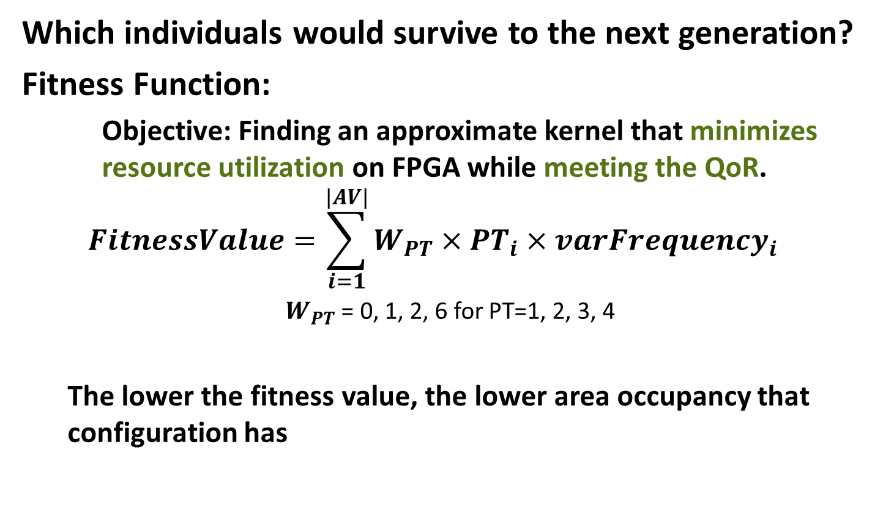
Source-to-source Compiler
Genetic-based Approximation Algorithm (2/3)
Which individuals would survive to the next generation?
Fitness Function:
    Objective: Finding an approximate kernel that minimizes resource utilization on FPGA while meeting the QoR.
  $$FitnessValue=\sum_{i=1}^{|AV|}{W_{PT}×{PT}_{i}×{varFrequency}_{i}}$$
            $W_{PT}$ = 0, 1, 2, 6 for PT=1, 2, 3, 4
  The lower the fitness value, the lower area occupancy that configuration has

Slide 14
Source-to-source Compiler
Genetic-based Approximation Algorithm (3/3)
Genetic Operators
  One-point crossover
  Mutation
  Selection
  Chromosomes are sorted based on their estimation of fitness value in each iteration
  Elitism selection + Proportionate selection
PT_{V1} | PT_{V2} | …. | …. | PT_{Vn}
PT_{V1} | PT_{V2} | …. | …. | PT_{Vn}
PT_{V1} | PT_{V2} | …. | …. | PT_{Vn}
PT_{V1} | PT_{V2} | …. | …. | PT_{Vn}
Random crossover point
PT_{V1} |  | …. |  | …. | PT_{Vn}
PT_{V1} | PT_{V2}’ | …. | PT_{Vk}’ | …. | PT_{Vn}
Random points

Slide 15
Outline
Motivation
OpenCL Execution Model
Approximation Design Workflow
Experimental Setup and Results
Conclusion

Slide 16
Experimental Setup
Image Processing, Signal Processing, Physical Simulation
OpenCL AMD APP SDK v2.9 benchmark
  Image Processing (recursive gaussian, sobel)
  Signal Processing (convolution, dct)
  Physical Simulation (n-body)
AMD Evergreen Radeon HD 5870 GPU device for accelerated profiling experiments
Kernels were synthesized for Altera DE5 board with a Stratix V FPGA using Altera OpenCL SDK 13.1 synthesis tool
100 training inputs and 100 test inputs

Slide 17
Experimental Results
Area Savings with Approximate Kernels
No. of Mapped Kernels
Logic: 96%
DSP: 91%
RAM: 91%
Logic: 92%
DSP: 93%
Reduction in resource utilization for 1 mapped kernel (14%–25%)
Increase in number of mapped kernels on FPGA (2x on average)

Slide 18
Experimental Results
Speedup
Speedup (Improved Throughput)
Increase in FPGA throughput (1.82x on average)
Increase in GPU speedup (1.07x on average)

Slide 19
Experimental Results
Quality Loss
Average Quality Loss
Average quality loss over 100 test input patterns is ≤ 1%

Slide 20
Conclusion
GRATER exploits approximation to increase the benefits of FPGA accelerators without changing the underlying FPGA hardware
More opportunities for parallel execution
1.4x–3.0x higher computational throughput on FPGA with less than 1% quality loss

Slide 21
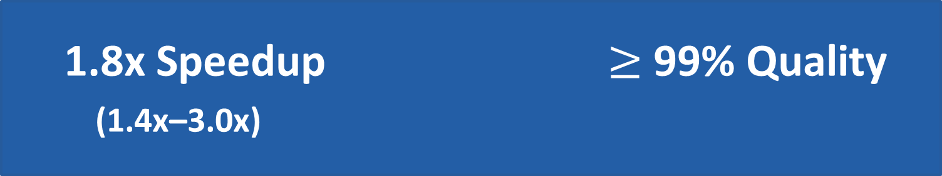
GRATER : An Approximation Workflow for Exploiting Data-Level Parallelism in FPGA Acceleration
Atieh Lotfi, Abbas Rahimi, Amir Yazdanbakhsh, Hadi Esmaeilzadeh, Rajesh K. Gupta
UC San Diego, UC Berkeley, Georgia Institute of Technology
1.8x Speedup $≥$ 99% Quality
(1.4x–3.0x)
GRATER

Slide 22
Source-to-source Compiler
Genetic-based Approximation Algorithm
Initial population
Modified kernel
Variable precision
…
Estimates kernel area
occupancy on FPGA
Fitness evaluation
Selection
(Elitism, roulette wheel )
Accelerated Profiling
Crossover / Mutation
Termination
criterion?
No
Satisfy
QoR
…
Yes
Next Generation
Solution ☺
(kernel with the least area)

Slide 23
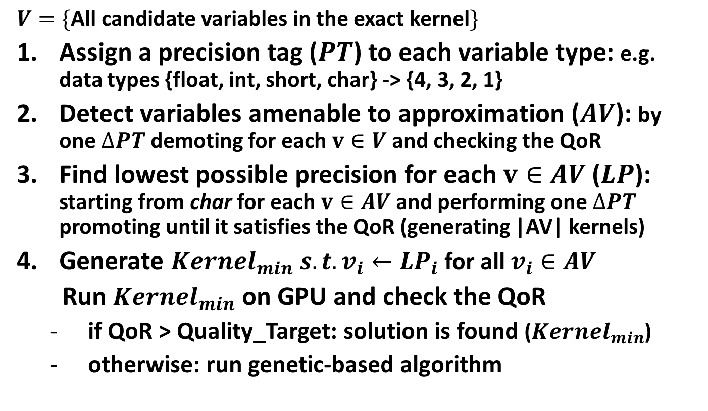
Source-to-source Compiler
Analysis and Pruning
$$V=\{\text{All} \text{candidate} \text{variables} \text{in} \text{the} \text{e}\text{xact} \text{k}\text{ernel}\}$$
Assign a precision tag ($PT$) to each variable type: e.g. data types {float, int, short, char} -> {4, 3, 2, 1}
Detect variables amenable to approximation ($AV$): by one $∆PT$ demoting for each $v∈V$ and checking the QoR
Find lowest possible precision for each $v∈AV$ ($LP$): starting from char for each $v∈AV$and performing one $∆PT$ promoting until it satisfies the QoR (generating |AV| kernels)
Generate ${Kernel}_{min} s.t. v_{i}←{LP}_{i}$ for all $v_{i}∈AV$
  Run ${Kernel}_{min}$ on GPU and check the QoR
  if QoR > Quality_Target: solution is found (${Kernel}_{min}$)
  otherwise: run genetic-based algorithm

