Slide 1
Resistive Conﬁgurable Associative Memory for Approximate Computing
Mohsen Imani, Abbas Rahimi*, Tajana S. Rosing
University of California San Diego
*University of California Berkeley

Slide 2
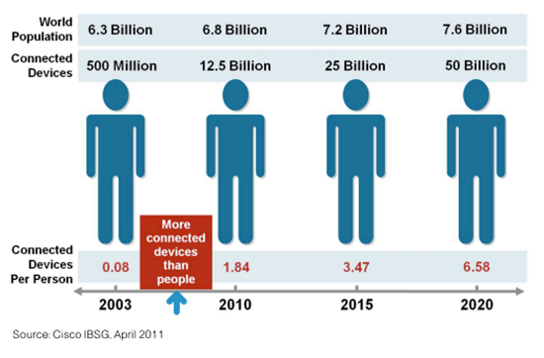
Motivation
Internet of Things (IoT):
Billions~Trillions of interconnected devices (large scale problem)
Amount of data generation in 2011 1.8 zettabytes which will be increased by 50% in 2020!
Battery powered → tight energy efficiency requirements
Software
Operating System
Architecture
Components
Technology
Materials

Slide 3
Motivation
Internet of Things (IoT):
Billions~Trillions of interconnected devices (large scale problem)
Amount of data generation in 2011 1.8 zettabytes which will be increased by 50% in 2020!
Battery powered → tight energy efficiency requirements
A promising solution: use of associative memories
Not a new technique, but a new application field!
Input operands
Processor Pipeline
Result of computation
Clock gating
Look up Table
MEM
Matching?
Requirements: low area, low energy, fast

Slide 4
Related Work
Energy efficient computation
Energy efficient computing units
Associative memory
(“Computation with memory”) [Kohonen 2012]
Lower energy consumption
CMOS-based [Lakshminarayanan 2005]
NVM-based [Li 2012]
Higher search speed and area efficiency
MTJ [Matsunaga 2012]
Memrist [Li 2012]
Exact matching [Rahimi 2014]
Approximate matching (VOS) [Rahimi 2015]
Lower energy consumption (at the cost of accuracy)
VOS: Voltage OverScaling
Energy efficient resistive associative memories !

Slide 5
Resistive Associative Memory (1/2)
Input operands
Processor Pipeline
Result of computation
Clock gating
Look up Table
MEM
Row
TCAM: Ternary Content Addressable Memory
Cell
Energy saving is proportional to hit rate
The higher the TCAM size, the higher hit rate
GOAL: Lower TCAM energy to achieve higher energy efficiency
Number of rows
Word size

Slide 6
Resistive Associative Memory (2/2)
Limitations of conventional Resistive TCAM:
Word size
Number of rows
Search energy
Long word → High leakage current
Lots of rows → Large and energy hungry input buffers
Search operation → All TCAM rows require precharging
Vdd
Energy
Solutions?
Input Buffer
Higher
Hit Rate
Low Energy TCAM
Online Profiling
Approximation

Slide 7
Profiling (1/3)
Hit rate
Larger TCAM
Online profiling
Energy limitation ☹
Cost of profiling?
How much energy improvement can we achieve with online profiling?
Is it worth to accept profiling cost?

Slide 8
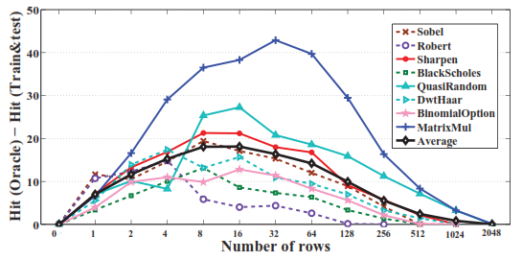
Profiling (2/3)
Considered Oracle as the best case representation of online profiling
Oracle: Trained on 100% of dataset, and then tested
Train-test: trained on 10%, and tested on 100% of dataset
Oracle achieves up to 18% higher hit rate!
Sobel
Is Oracle hit rate improvement enough for online profiling?

Slide 9
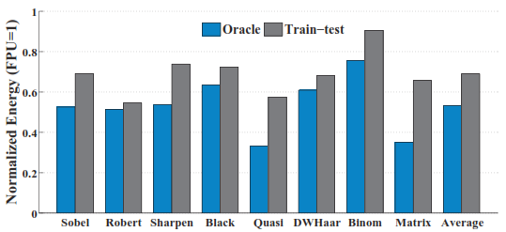
Profiling (3/3)
Comparing the best energy point of Oracle and Train-test profiling
Repeating the experiment on 8 different applications
Oracle results in 15% higher energy efficiency!
9

Slide 10
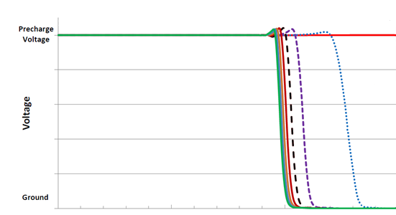
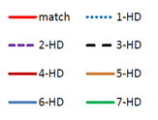
TCAM with Approximate Search (1/2)
TCAMs under VoS accept hamming distance matching
Faster reads or lower supply voltages subject to controllable approximate matching
1000mv: Exact Matching
775mv: 1-HD Matching
720mv: 2-HD Matching
Evaluation
Precharge
Evaluation
Precharge
Evaluation
Precharge
775mV
725mV
1000mV

Slide 11
TCAM with Approximate Search (2/2)
Advantages:
Lower TCAM search energy, lower swing ☺
Lower FPU energy ☺
Higher hit rate
Increases average clock gating rate
Disadvantages:
No difference between MSB and LSB bits ➔ Loss of accuracy ☹
Just provides enough accuracy on a few Multimedia applications
Limits the TCAM size (# of rows)

Slide 12
Contributions
State-of-the-art: Single-stage resistive associative memory
ReCAM: Resistive Configurable Associative Memory
Composed of a TCAM + Memory
Is tightly-integrated with FPU
Prioritize the TCAM mismatches on LSBs rather than MSBs
Fast configurable TCAM architecture (~5ns)
Reduces GPU energy consumption by up to 45%

Slide 13
AMD GPU Architecture
Radeon HD 7970 device from Southern Islands family
32 compute units
4 SIMD units
16 stream cores (parallel lanes)
2048 stream cores per device
Thermal design power: 300W!
Stream Core 1
Compute Device
Compute Unit
SIMD Unit
Stream Core 2
Ultra-threaded Dispatcher
Wavefront Scheduler
Stream Core 3
IF/ID
Compute Unit 1
…
Compute Unit 32
SIMD Unit 1
SIMD Unit 2
SIMD Unit 3
SIMD Unit 4
Stream Core 16
Local Memory
…
Vector/Scalar RF
Global Memory

Slide 14
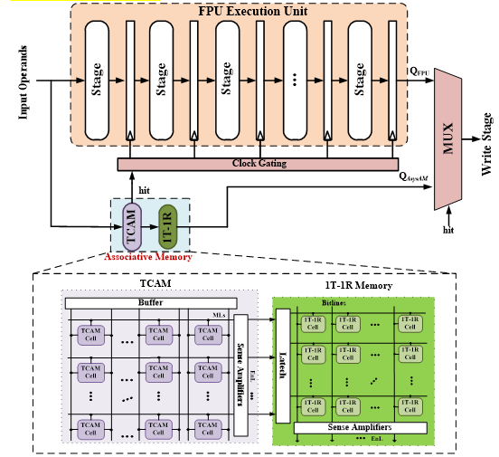
Associative Memory Integration

Slide 15
ReCAM Architecture
Solution: Split the TCAM in $m$ stages
Applying VoS on the selective blocks
What about
# of stage?
Level of voltage?
1
2
N/m bits
3
$$m$$
Input Buffer
Sense amp.
MSBs
LSBs
Less impact on accuracy

Slide 16
ReCAM: Bitline Approximation
ShortStop [Pinckney’13] technique to put the blocks under approximation
Each Block can approximate individually
Approximation starts from lease significant blocks
Adaptive Architecture in 5ns!
1
2
3
$$4$$
Input Buffer
Sense amp.
MSBs
LSBs

Slide 17
ReCAM: Row Approximation
First TCAM rows has more probability of hit rate ➔ high error rate in case of approximation
Partitioned TCAM to row blocks and apply selective approximation
VoS starts from last rows
1
2
3
$$4$$
Input Buffer
Sense amp.

Slide 18
ReCAM Framework
Number of block in approximation
Application type
Acceptable accuracy of loss (10% average relative error in this case [Esmaeilzadeh’12]
Tradeoff between the energy and accuracy
- Adaptive architecture!

Slide 19
Experimental Setup
AMD GPUs
Image processing applications from AMD APP SDK v2.5
Multi2Sim for AMD Southern Islands GPU, Radeon HD 7970 device
OpenCL applications: Sobel, Robert, Sharpen, Shift
FPU ASIC flow
6-stage balanced FPUs generated by FloPoCo
Synthesized and mapped using a 45-nm TSMC
Optimized for power and a clock period based on TCAM delay:
Synopsys Design Compiler
FPU power estimation: Synopsys PrimeTime (1.0V)
ReCAM design flow
Transistor-level HSPICE simulations for power and delay using 3T-1R TCAM cell [Chang’15]

Slide 20
ReCAM Size
What’s the best ReCAM size?!
ReCAM Size
Hit rate
TCAM energy
TCAM delay
FPU: average clock gating time
Solution?
ReCAM approximation
Solution?
Parallel search

Slide 21
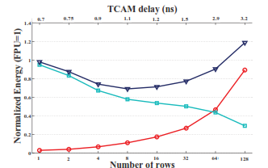
Experimental Results
GPGPU Energy Consumption:
Trade-off between FPU and TCAM energy consumption
Minimum point: tradeoff between FPU and TCAM consumption
Energy saving compared to GPU alone:
GPU + Exact Matching ReCAM | + 24%

Slide 22
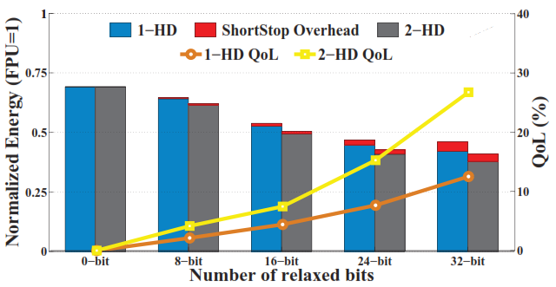
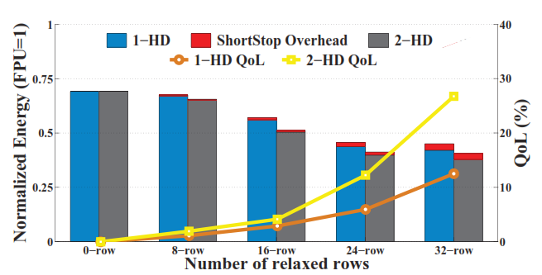
Experimental Results
ReCAM approximation:
Maximum number of blocks (bitline/rows) under 1-HD or 2-HD approximation
Acceptable quality of service (10% average relative error)
Sobel- bitline Approximation
Sobel – Row Approximation
2-HD
1-HD
2-HD
1-HD
Average energy saving over 8 applications
GPU + Bitline Approximate ReCAM | 43%
GPU + Row Approximate ReCAM | 45%

Slide 23
Conclusion
Approximation is a technique to reduce energy at the cost of computation inaccuracy
Fine grained approximation tuning is required to adaptively relax the computation of different application
Proposed ReCAM is Resistive Configurable Associative Memory which relaxes computation in both row and bitline views
Goal: energy saving with minimum impact on inaccuracy
ReCAM integration with GPU results in 45% energy efficiency on average over eight GPGPU applications

