Slide 1
WILD: A Workload-Based Learning Model to Predict Dynamic Delay of Functional Units
Xun Jiao*, Yu Jiang⁺, Abbas Rahimi$, and Rajesh K. Gupta*
*University of California, San Diego
⁺Tsinghua University
$University of California, Berkeley

Slide 2
Agenda
Motivation
Our Methodology
Experimental Results
Conclusions

Slide 3
STA-induced Performance Loss
Static Timing Analysis:
Delay of critical path → Conservative timing margin
In reality, critical path not sensitized → shorter delay < Tclk
Dynamic path analysis → real delay?
Dynamic Slack

Slide 4
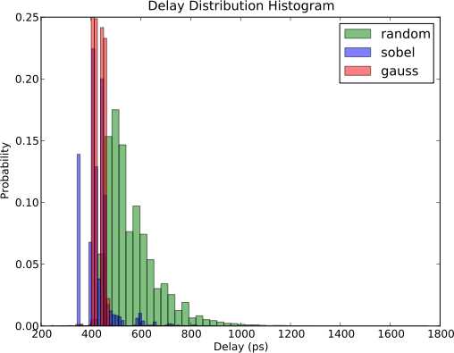
Instruction-level Dynamic Analysis
[roy2012predicting], [xin2011identifying], [constantin2015exploiting]
Measure worst delay for instructions:
For example, 1ns for ADD, 2ns for DIV…
INT_ADD
Overlooks the impact of input operands
Worst delay
Need to consider operand for path sensitization
Wide range of delay
We firstly propose to use machine learning methods to predict the dynamic delay for a given input operands, considering the impact of operands on dynamic path sensitization.

Slide 5
Agenda
Motivation
Our Methodology: WILD Model
Problem Formulation and Overview
Three Key Phases
Experimental Results
Conclusions

Slide 6
Problem Formulation
Learn relationship between input operands and dynamic delay.
Cycle t:
x[1],x[2]…x[t-1],x[t]
Model
D[t]
Solve three problems:
Measure the dynamic delay at each cycle;
Identify input features from operands;
Learn the mapping relationship.

Slide 7
Overview
Random Data Generator
Workload Signature
Feature Extraction
Input Feature
Application
Architecture Simulator
b) Input Feature
Extraction
Model
Training
a) Dynamic Timing Analysis
RTL Description
Dynamic Timing Analysis
Dynamic Delay
TSMC 45nm
Synthesis
c) Model Training
Place & Route
Gate-level Netlist
Gate-level Simulation
Switching
Activity
Three key phases:
Dynamic Timing Analysis → dynamic delay;
Input Feature Extraction → input feature;
Model Training → learning model.

Slide 8
Agenda
Motivation
Our Methodology: WILD Model
Problem Formulation and Overview
Three Key Phases
Dynamic Timing Analysis
Input Feature Extraction
Model Training
Experimental Results
Conclusions

Slide 9
Dynamic Timing Analysis
Random Data Generator
Workload Signature
Feature Extraction
Input Feature
Application
Architecture Simulator
b) Input Feature
Extraction
Model
Training
a) Dynamic Timing Analysis
RTL Description
Dynamic Timing Analysis
Dynamic Delay
TSMC 45nm
Synthesis
c) Model Training
Place & Route
Gate-level Netlist
Gate-level Simulation
Switching
Activity
RTL description | An open-source tool: Flopoco
Synthesis | Synopsys Design Compiler
Place&Route | Synopsys IC Compiler
Gate-level Simulation | Mentor Graphics Modelsim
Dynamic Timing Analysis | Python-Written VCD Analysis Script

Slide 10
Dynamic Timing Analysis
We parse and analyze VCD file to measure the dynamic delay at each cycle.
Wrapper
y[0]
Wrapper
x1[31:0]
y[1]
y[31:0]
x2[31:0]
……
……
y[31]
CLK
Measure dynamic delay at each cycle:
Run gate-level simulation at a safe clock period;
Dump the toggling activity of endpoints (y[0],…y[31]) at each cycle via VCD file;
Locate the last toggle event time $T[n]$ at cycle $n$;
Locate last positive clock edge $T^{′}[n]$.
Compute delay at each cycle: $D\left[n\right]=T\left[n\right]−T^{′}\left[n\right], n=1,2,…N$.

Slide 11
Agenda
Motivation
Our Methodology: WILD Model
Problem Formulation and Overview
Three Key Phases
Dynamic Timing Analysis
Input Feature Extraction
Model Training
Experimental Results
Conclusions

Slide 12
Input Feature Extraction
Random Data Generator
Workload Signature
Feature Extraction
Input Feature
Application
Architecture Simulator
b) Input Feature
Extraction
Model
Training
a) Dynamic Timing Analysis
RTL Description
Dynamic Timing Analysis
Dynamic Delay
TSMC 45nm
Synthesis
c) Model Training
Place & Route
Gate-level Netlist
Gate-level Simulation
Switching
Activity
Random Data Generator | Python-Written Script
Application | Sobel filter, Gaussian filter from AMD APP SDK v2.5. Input images from Caltech-UCSD Birds 200 vision datasets.
Arch-Simulator | Modified Multi2Sim
Workload Signature | Data preprocess
Feature Extraction | Trial-and-error process

Slide 13
Input Feature Extraction
Data preprocessing:
Decimal → Binary
Remove repetitive pattern
Clean binary vector
Question remains:
For D[t] at cycle t, will the history input x[t-1], x[t-2], … have impact on it?

Slide 14
Input Feature Extraction
Trail-and-error process:
Scenario 1: fix x[t], vary x[t-1]
Scenario 2: fix x[t] and x[t-1], vary x[t-1]
Preceding input set an state, current input toggle the state.
Input feature: {x[t], x[t-1]}.
→ D[t] changed
→ D[t] constant

Slide 15
Agenda
Motivation
Our Methodology: WILD Model
Problem Formulation and Overview
Three Key Phases
Dynamic Timing Analysis
Input Feature Extraction
Model Training
Experimental Results
Conclusions

Slide 16
Model Training
Random Data Generator
Workload Signature
Feature Extraction
Input Feature
Application
Architecture Simulator
b) Input Feature
Extraction
Model
Training
a) Dynamic Timing Analysis
RTL Description
Dynamic Timing Analysis
Dynamic Delay
TSMC 45nm
Synthesis
c) Model Training
Place & Route
Gate-level Netlist
Gate-level Simulation
Switching
Activity
Input Feature
Dynamic Delay
Model Training | Supervised learning methods

Slide 17
Model Training
2.5ns is the clean clock period for all designs, so we classify the delay into five classes:
To train the model, we apply various learning methods to these training data.

Slide 18
Model Evaluation
Evaluation metric: prediction accuracy.
$prediction_accuracy= \frac{\#matched_cycles}{\#total_cycles}$
Comparison methods:
rand: randomly predict the delay class among the non-empty classes.
naive: always predict the class which contains the most instances.
high accuracy for biased datasets.

Slide 19
Agenda
Motivation
Our Methodology
Experimental Results
Conclusions

Slide 20
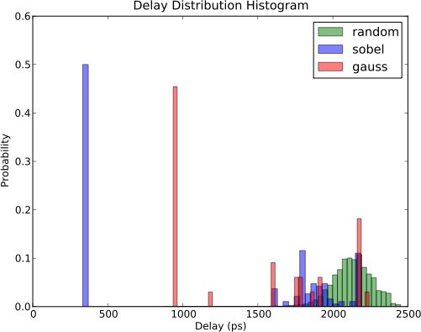
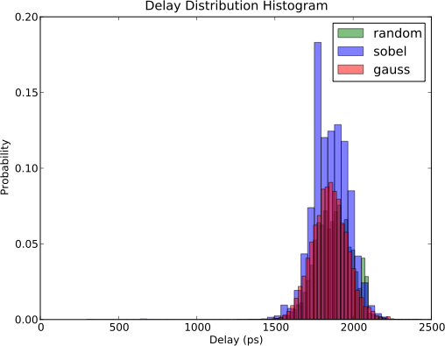
Delay Distribution of FUs
Worst delay
INT_ADD
INT_MUL
Facts:
FUs exhibit wide range of delay;
APP’s data locality.
FP_MUL

Slide 21
Model Prediction Accuracy
Facts:
WILD achieves accuracy ranging 96.2~99.8%.
WILD achieves 98.0% on average.
rand achieves 27.2% on average, always low.
naive achieves 63.6% on average, could be high.

Slide 22
Instruction-level Timing Margin Reduction
Existing model uses worst delay.
WILD uses the predicted delay class.
Misprediction: performance penalty.
AVERAGE INSTRUCTION-LEVEL TIMING DELAY(PS) USING WILD COMPARED TO EXISTING
INSTRUCTION-LEVEL TIMING MODEL

Slide 23
Agenda
Motivation
Our Methodology
Experimental Results
Conclusions and Discussions

Slide 24
Discussions
Overhead of WILD:
Hardware overhead: This model is enabled by logistic regression, less complex than SVM-based model in [ye2014chip].
Timing overhead: WILD is 60X faster than gate-level simulation.

Slide 25
Conclusions
WILD is a supervised learning model to predict dynamic delay of FUs for a given input workload.
WILD exhibits high prediction accuracy and fast execution speed.

Slide 26
THANK YOU !

