Slide 1
Hyperdimensional Computing with 3D VRRAM In-Memory Kernels: Device-Architecture
Co-Design for Energy-Efficient, Error-Resilient Language Recognition
H. Li¹, T. Wu¹, A. Rahimi², K.-S. Li³, M. Rusch², C.-H. Lin³,
J.-L. Hsu³, M. Sabry¹, S. B. Eryilmaz¹, J. Sohn¹, W.-C. Chiu³,
M.-C. Chen³, T.-T. Wu³, J.-M. Shieh³, W.-K. Yeh³,
J. M. Rabaey², S. Mitra¹, and H.-S. P. Wong¹
¹Stanford University, USA; ²UC Berkeley, USA; ³NDL, Taiwan

Slide 2
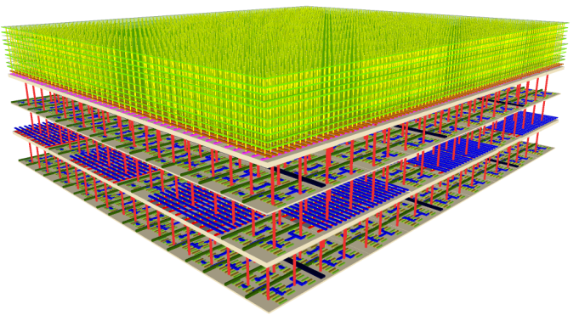
Cognitive Computing: Cross-Layer Solutions
New computation models
Tailored architectures
Fine-grained 3D integration
Intrinsic device properties

Slide 3
Deep Learning is Powerful, but...
Conventional deep learning
    Slow to train iteratively; large amount of data required
    Memory bottleneck: energy-hungry in GPU/CPU
    Lack of well-defined mathematical rules for optimization

Slide 4
Exploring New Computation Models
Conventional deep learning
    Slow to train iteratively; large amount of data required
    Memory bottleneck: energy-hungry in GPU/CPU
    Lack of well-defined mathematical rules for optimization
Hyperdimensional (HD) computing
    A neural-inspired HD vector space model [Kanerva09]
    Holographic representation: error resilient
    Well-defined arithmetic: general-purpose systems
    Capable of one-shot learning: substantially fewer samples
P. Kanerva, Cog. Comput., p.139, 2009.

Slide 5
Hyperdimensional (HD) Computing
P. Kanerva, Cog. Comput., p.139, 2009.

Slide 6
Hyperdimensional (HD) Computing
Key HD operations: MAP
Problem: memory bottleneck
Solution: in-memory MAP kernels
This work: 3D VRRAM approach
P. Kanerva, Cog. Comput., p.139, 2009.

Slide 7
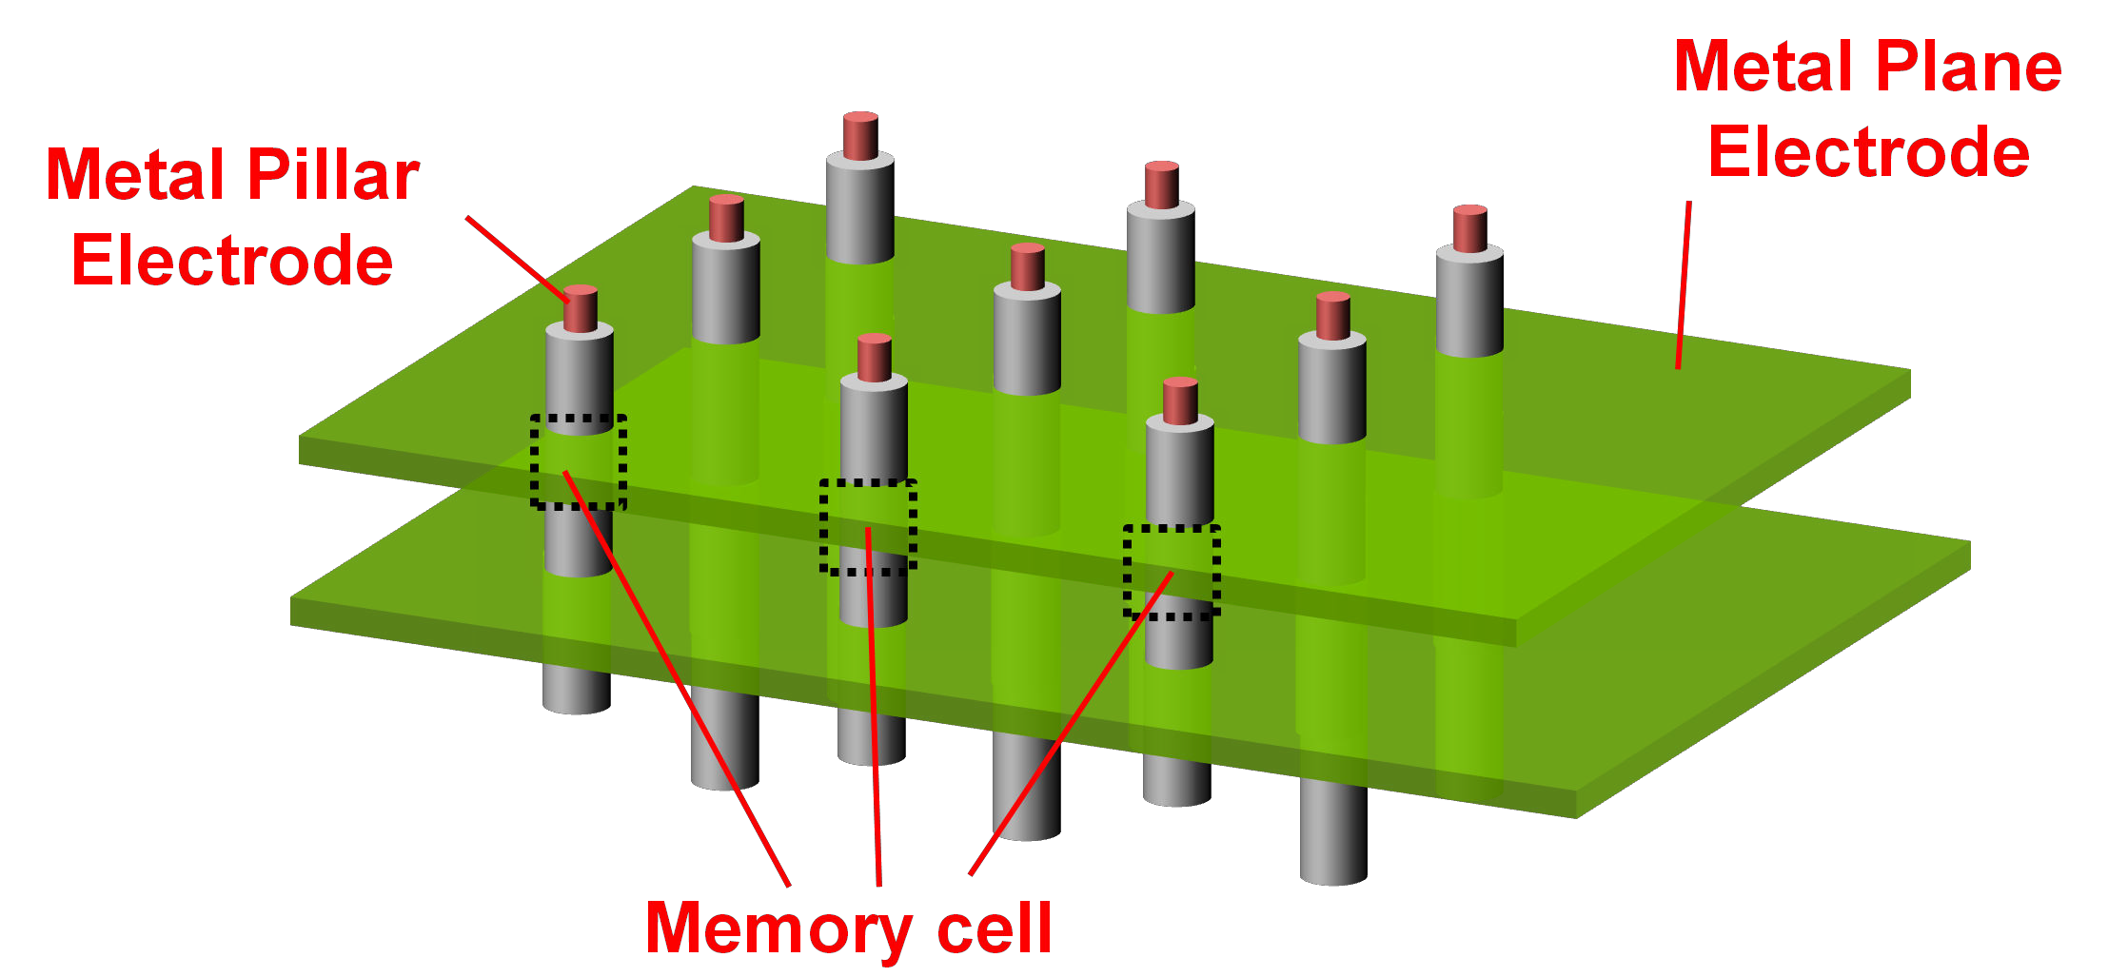
3D VRRAM Recap
VRRAM: vertical resistive random access memory
FinFET
Used in this work
H.-Y. Chen,…, H.-S. P. Wong, IEDM, 2012; H. Li, K.-S. Li,…, H.-S. P. Wong, Symp. VLSI Tech., 2016

Slide 8
Random Vectors: Utilizing RRAM Stochasticity
Binary bits statistically stored in VRRAMs for computation
1001100111……0100111101
(hyperdimensional vector)
P_{SET}: SET probability (switching from ‘0’ to ‘1’)

Slide 9
Tuning Probabilities: Sources for Computation
Measured P_{SET} dependency: voltage-time relationship
50%
P_{SET}: SET probability (switching from ‘0’ to ‘1’)

Slide 10
Tuning Probabilities: Sources for Computation
Device-to-device statistics of P_{SET} measured

Slide 11
Tuning Probabilities: Sources for Computation
Device-to-device statistics of P_{SET} measured & modeled
P_{SET} = 50% (± 4% D2D) for random ’0’s and ‘1’s for HD vectors
50%

Slide 12
In-Memory MAP Kernels using 3D VRRAM
Leverage unique structure & properties of VRRAM
MAP kernels: demonstrated on 4-layer 3D VRRAMs
In-memory HD computing enabled in 3D architecture

Slide 13
Multiplication: XOR in 3D VRRAM
Boolean logic can be in situ programmed
V_{C} = V_{DD} - V_{p}
V_{P} determined by A’s resistance
V_{P}: common pillar voltage

Slide 14
Multiplication: XOR in 3D VRRAM
Boolean logic can be in situ programmed
V_{C} < V_{RESET}
C’s state (logic output) unchanged
V_{P}: common pillar voltage

Slide 15
Multiplication: XOR in 3D VRRAM
Boolean logic can be in situ programmed
V_{C} = V_{DD} - V_{p}
V_{P} determined by B’s resistance
V_{P}: common pillar voltage

Slide 16
Multiplication: XOR in 3D VRRAM
Boolean logic can be in situ programmed
V_{C} > V_{RESET}
C’s state (logic output) flipped
V_{P}: common pillar voltage

Slide 17
Multiplication: XOR in 3D VRRAM
Programming XOR logic onto 4-layer 3D VRRAMs

Slide 18
Multiplication: XOR in 3D VRRAM
Robust logic evaluations experimentally demonstrated

Slide 19
Multiplication: XOR in 3D VRRAM
Predicted bit error rate (BER) @ 260°C: ~ 10⁻¹³

Slide 20
Addition: Current Summing
‘Physically’ adding up ‘0’s and ‘1’s in VRRAMs during readout

Slide 21
Addition: Current Summing
Reliability verified: 10¹¹ correct addition cycles measured

Slide 22
Permutation: in situ bit transfer
Pulsing in-series VRRAMs triggers bit transfer

Slide 23
Wafer-Level Verification of MAP Kernels
16 dies and 64 4-L VRRAM pillars (256 RRAM cells in total) measured

Slide 24
Device-Architecture Co-Design

Slide 25
Learning is One-Shot in HD
21 sample texts of 21 EU languages used for training
Language maps
learned/stored in VRRAM
Training dataset: Wortschatz Corpora (U. Quasthoff et al., LREC, 2006)

Slide 26
Inference Results on Unseen Dataset
21,000 sentences (1,000 for each language) used for testing
Test dataset: Europarl Parallel Corpus (P. Koehn, MT Summit, 2005)

Slide 27
Tradeoff Between Accuracy and Circuit Size
Higher dimensionality improves accuracy on larger arrays

Slide 28
3D Architecture is Area-Efficient
Benchmark: 28-nm low-power digital CMOS design w/ same HD model [Rahimi16]
3D VRRAM assumptions: 28-nm node, 36 layer, AR=30, trench slope = 89°
A. Rahimi,…, J. Rabaey, ISLPED, 2016

Slide 29
HD Computing is Error Resilient
RRAMs/CBRAMs having wide range of endurance are feasible

Slide 30
Conclusions
Hyperdimensional computing: a promising model for cognitive processors
Non-volatile in-memory MAP kernels experimentally demonstrated
VRRAM-centric HD architecture explored
  Energy- and area-efficient using 3D VRRAM
  Amazingly error resilient: NVM-friendly

Slide 31





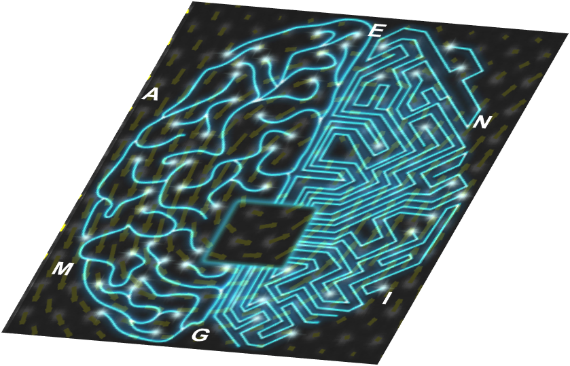



Acknowledgement
E2CDA - ENIGMA
Ministry of Science and Technology, Taiwan

Slide 32
End of Talk
Hyperdimensional computing: a promising model for cognitive processors
Non-volatile in-memory MAP kernels experimentally demonstrated
VRRAM-centric HD architecture explored
  Energy- and area-efficient using 3D VRRAM
  Amazingly error resilient: NVM-friendly

