Slide 1
An EMG Gesture Recognition System with Flexible High-Density Sensors and
Brain-Inspired High-Dimensional Classifier
Ali Moin∗, Andy Zhou∗, Abbas Rahimi∗†, Simone Benatti‡,
Alisha Menon∗, Senam Tamakloe∗, Jonathan Ting∗,
Natasha Yamamoto∗, Yasser Khan∗, Fred Burghardt∗,
Luca Benini†‡, Ana C. Arias∗, Jan M. Rabaey∗
∗UC Berkeley, †ETH Zurich, and ‡University of Bologna

Slide 2
Outline
High-dimensional (HD) Computing
  Mapping to HD Space
  HD Arithmetic
  Generic HD Processing Unit
Electromyography (EMG)-based Hand Gesture Recognition
  System Components for Flexible EMG
  Fast and one-shot learning

Slide 3
Brain-inspired High-dimensional Computing
99.9999998% of the space lies at approximately
the mean distance [0.47,0.53] from a point
Emulation of cognition by computing with high-dimensional (HD) vectors [P. Kanerva, Cogn Comput’09]
Most of the HD space is nearly orthogonal to any given point
Supports full algebra
0.47
0.53
Superb properties for nanoscalable computing paradigms [TCAS-I’17]:
General and scalable model of computing
Well-defined set of arithmetic operations
Fast and one-shot learning (no need of back-prop)
Memory-centric with embarrassingly parallel operations
Purely statistical, thrives on randomness
Extremely robust against most failure mechanisms and noise

Slide 4
What Are HD Vectors?
It is all about data representation
1st 2nd 3rd 4th 10000th
[−1 +1 −1 −1 .............. +1]
High-dimensional
Holographic
Distributed
Pseudorandom with i.i.d. components
bipolar
Combine and Compare
binary
dense
sparse
Approximate computation with fixed-size long random patterns that provides a novel look at data representations, associated operations, circuits, and architectures.

Slide 5
Mapping to HD Vectors
Each “symbol” (e.g., a channel in EMG) is represented by an HD vector chosen at random with 10,000−d:
  E₁ = [−1 +1 −1 −1 −1 +1 −1 −1 ...]
  E₂ = [+1 −1 +1 +1 +1 −1 +1 −1 ...]
  E₃ = [−1 −1 −1 +1 +1 −1 +1 −1 ...]
  E₄ = [−1 −1 −1 +1 +1 −1 +1 −1 ...]
  ...
  E₆₄ = [−1 −1 +1 −1 +1 +1 +1 −1 ...]
Every HD vector is dissimilar to others: ⟨E₁,E₂⟩ = 0
This assignment is fixed throughout computation
Item Memory (IM)
“Electrode 1”
E₁
6
10,000

Slide 6
HD Arithmetic
Componentwise addition (+) is good for representing sets, since sum vector is similar to its constituent vectors:
  ⟨A+B,A⟩ = 0.5
Componentwise multiplication (∗) is good for binding, since product vector is dissimilar to its constituent vectors:
  ⟨A∗B,A⟩ = 0
Random permutation (ρ) is good for representing sequences, since permuted vector is dissimilar:
  ⟨A,ρA⟩ = 0
∗ and ρ are invertible and preserve distance

Slide 7
Generic HD Processing Unit
Identical hardware for both learning and inference
Inputs
Preprocessing/
Transformations
Part of preprocessing can be eliminated
LD Space
m
Maps input vectors into d-dimensional (d≈10,000) pseudo-orthogonal random vectors
Nanodevice opportunity to exploit process randomness and utilize variability
Seed Generation
HD vectors
d
HD Space
HD Encoder
Encodes all input information into single HD vector
using simple local operators (∗,+,ρ)
HD vectors
d
Associative Memory
Finds closest match in trained data
Can be continuously updated
k
LD Space
Outcomes

Slide 8
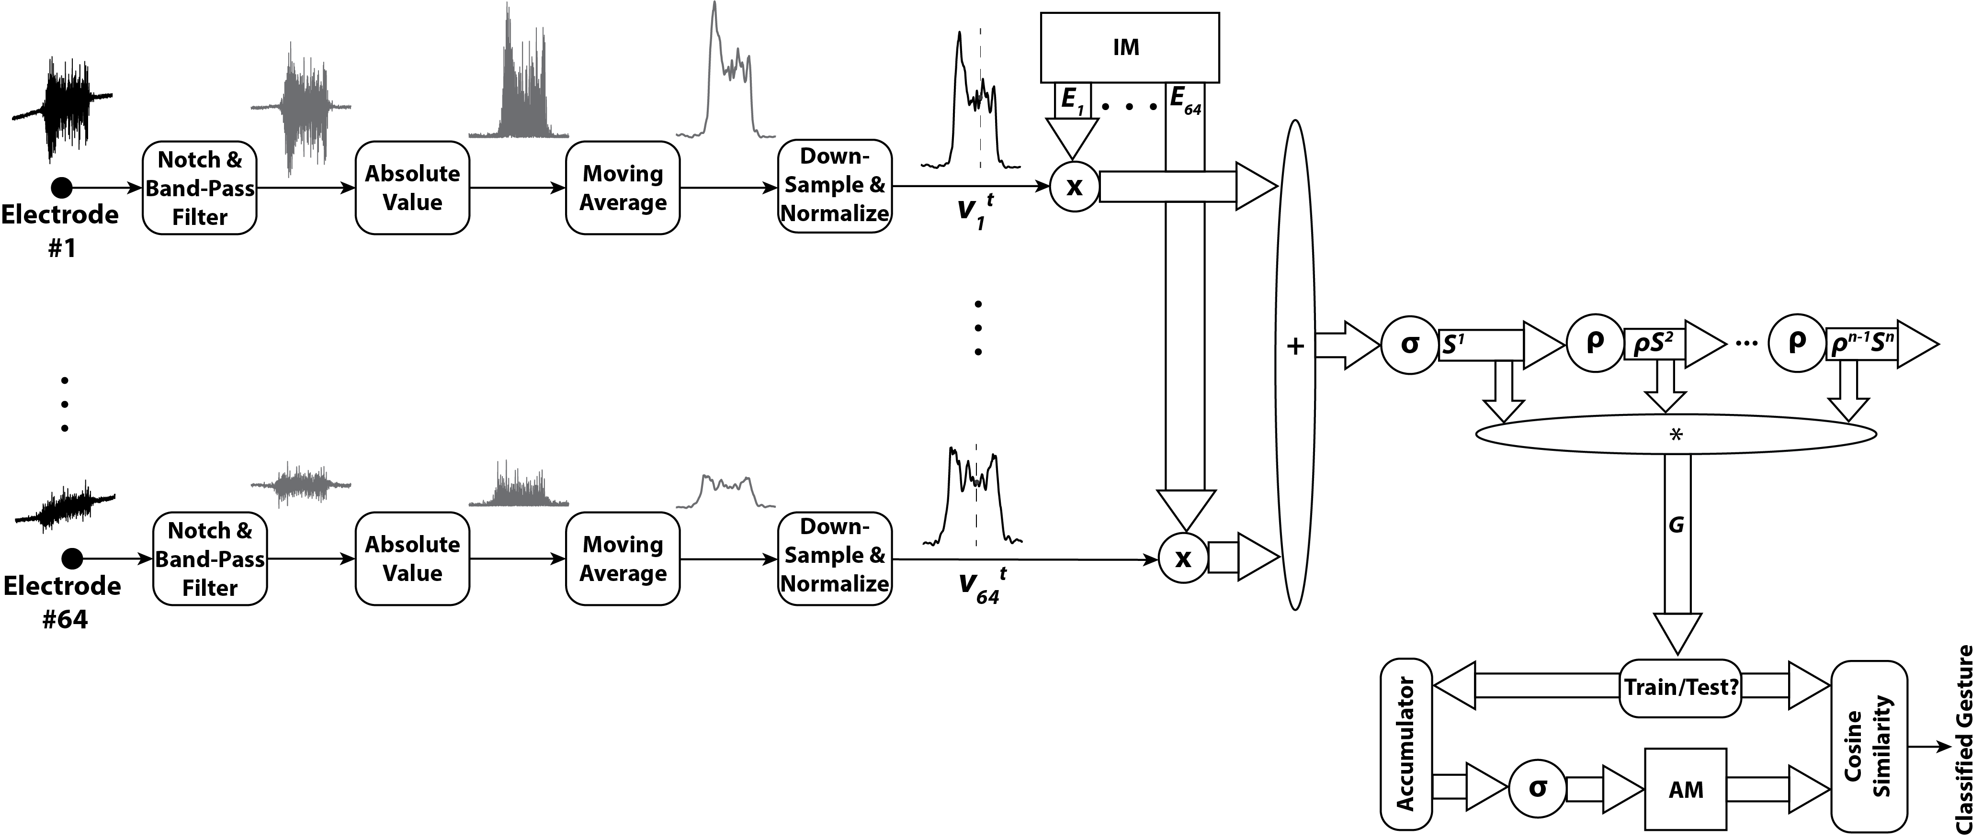
HD Processing for Gesture Recognition
Preprocessing Chain

Slide 9
HD Processing for Gesture Recognition
Preprocessing Chain
Spatial Encoding

Slide 10
HD Processing for Gesture Recognition
Preprocessing Chain
Spatial Encoding
Temporal Encoding

Slide 11
HD Processing for Gesture Recognition
Preprocessing Chain
Spatial Encoding
Temporal Encoding
Train

Slide 12
HD Processing for Gesture Recognition
Preprocessing Chain
Spatial Encoding
Temporal Encoding
Train
Test

Slide 13
Many Variants of Same …
Applications | #I | #C | HD | Baseline
Language identification [ISLPED’16] | 1 | 21 | 96.7% | 97.9%
Text categorization [DATE’16] | 1 | 8 | 94.2% | 86.4%
Speech recognition [ICRC’17] | 1 | 26 | 95.3% | 93.6%
EMG gesture recognition [ICRC’16] | 4 | 5 | 97.8% | 89.7%
Flexible EMG [this work] | 64 | 5 | 96.6% | 88.9%
EEG brain-machine interface [BICT’17] | 64 | 2 | 74.5% | 69.5%
2× lower energy than SVM
Embedded Accelerator (28nm, 1.5mm², 2mW) [DAC’18]
256 channels: 10 ms real-time constraints
10× lower energy than ARM Cortex-M4

Slide 14
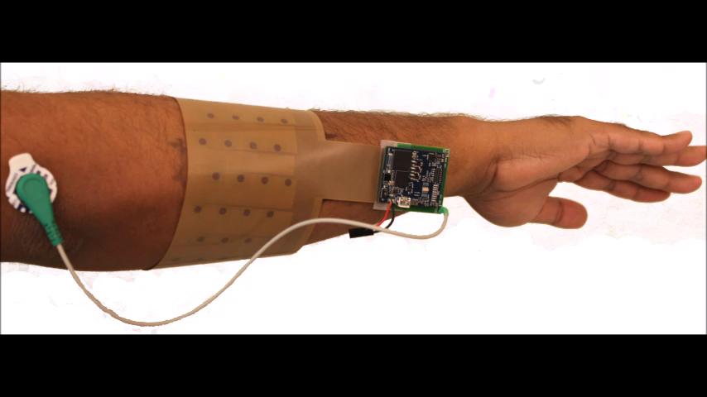
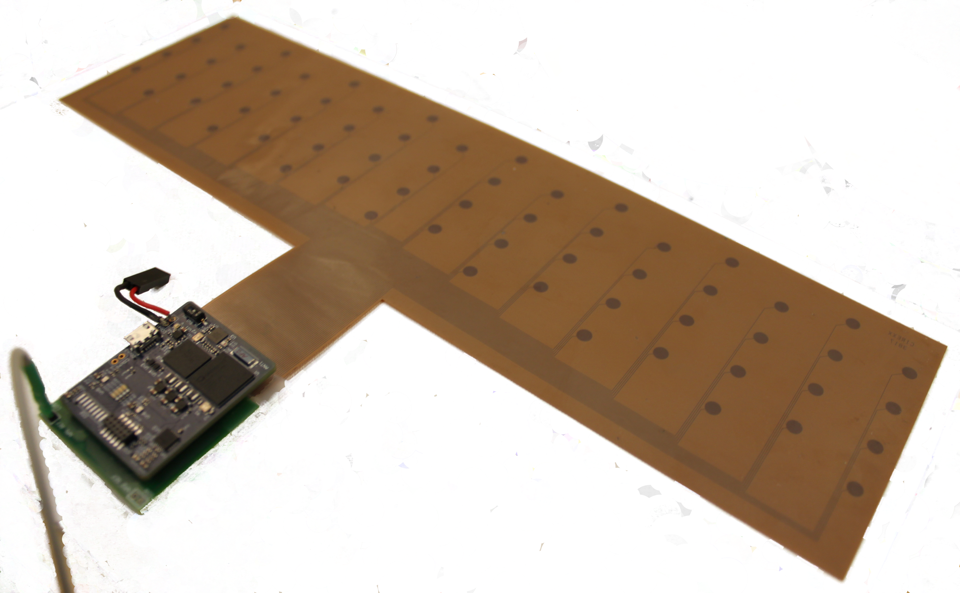


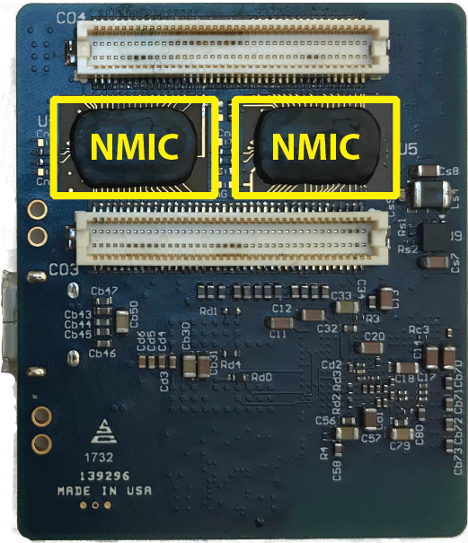
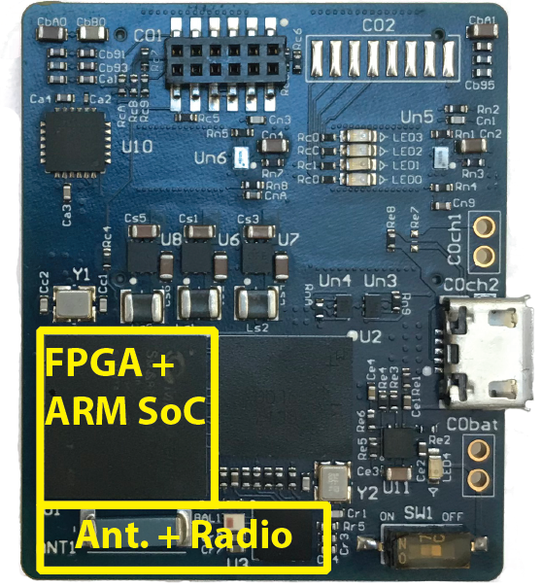
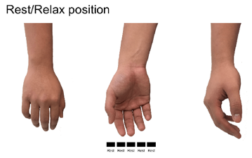
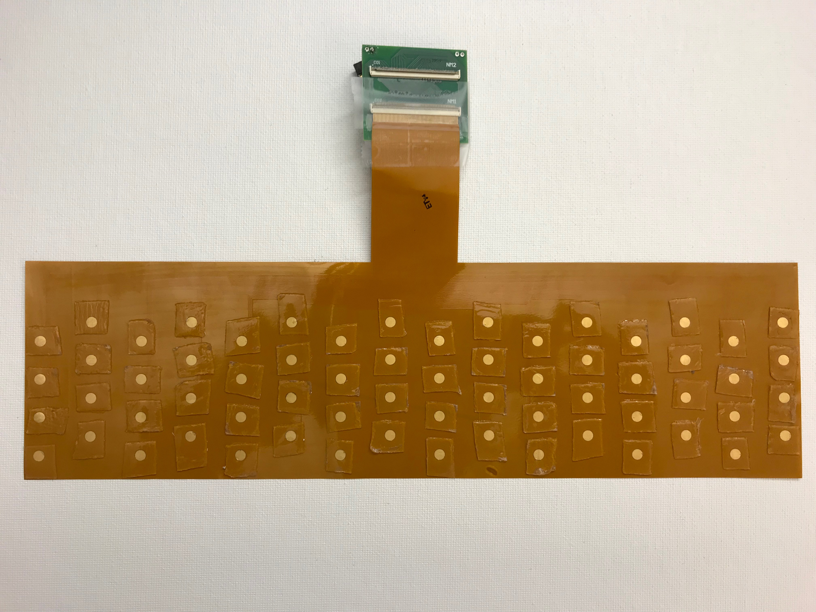
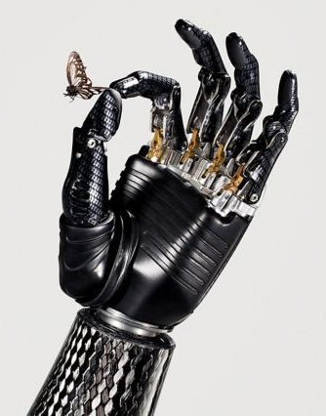
System Components for Flexible EMG
~2 Mbps Wireless Link
Sensory Array
(Flex)
Data Acquisition
(Up to 128 channels)
HD Classification (This work)
Flexible PCB 4x16 Array
(29.3 cm × 8.2 cm)
Back Side
Front Side
Or …
Fine-grained coverage of muscular surface

Slide 15
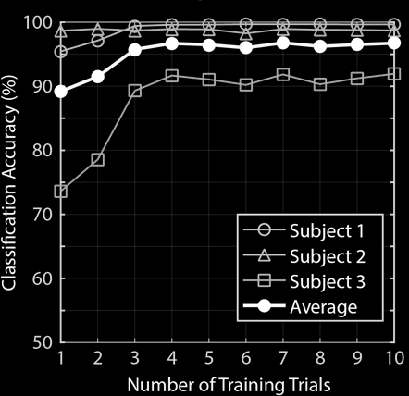
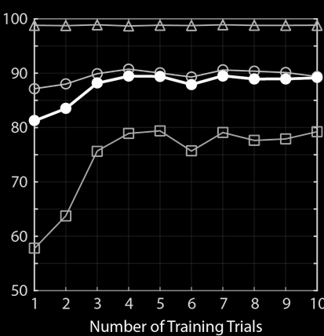
HD Learns Fast
Train/Test 30 mins apart
Train/Test 1 day apart
One-shot: 89.2%
With repositioning: 82%
SVM: 51%

Slide 16
Summary
Key properties of HD computing:
  a versatile set of arithmetic operations, generality, scalability, robustness, and fast one-shot learning
A prime candidate for wearable biosignal processing, in which
  signals are noisy and nonstationary
  training data sets are not huge
  individual variability is significant
  energy efficiency constraints are tight
Dataset and codes available at https://github.com/a-moin/flexemg

Slide 17
Thanks!

