Slide 1
A Robust and Energy-Efficient Classifier Using Brain-Inspired Hyperdimensional Computing
Abbas Rahimi, Pentti Kanerva, Jan M. Rabaey
UC Berkeley

Slide 2
Outline
Background in HD Computing
Language Recognition as an Example
HD Memory-centric Architecture
Experimental Results
Classification Accuracy
Memory footprint and Energy
Robustness

Slide 3
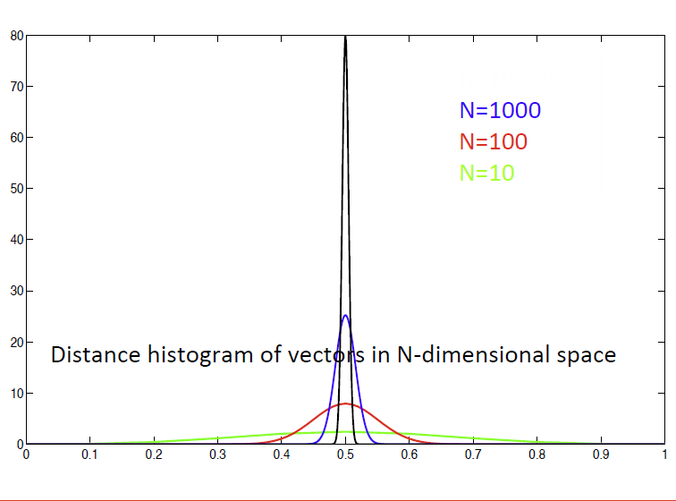
Brain-inspired Hyperdimensional Computing
HD computing:
Representation with dimension “much” (> 10,000) larger than needed to cover space
Purely statistical, thrives on randomness
Information distributed in space
Supports full algebra
Superb properties:
General and scalable model of computing
One-shot learning
Memory-centric with embarrassingly parallel operations
Extremely robust against most failure mechanisms and noise
[P. Kanerva, An Introduction to Computing in Distributed Representation with High-Dimensional Random Vectors, 2009]

Slide 4
What Are Hypervectors?
Patterns as basic data representation in contrast to computing with numbers!
Hypervectors are:
high-dimensional (e.g., 10,000 dimensions)
(pseudo)random with i.i.d. components
holographically distributed (i.e., not microcoded)
Hypervectors can:
use various coding: dense or sparse, bipolar or binary
be compared for similarity using distance metrics
be combined using arithmetic operations: multiplication, addition, and permutation

Slide 5
Mapping to Hypervectors
Each symbol is represented by a 10,000-D hypervector chosen at random:
A = -1 +1 -1 -1 -1 +1 -1 -1 ...
B = +1 -1+1 +1+1 -1 +1 -1 ...
C = -1 -1 -1 +1 +1 -1 +1 -1 ...
D = -1 -1 -1 +1 +1 -1 +1 -1 ...
...
Z = -1 -1 +1 -1 +1 +1 +1 -1 ...
Every letter hypervector is dissimilar to others, e.g., ⟨A, B⟩ = 0
This assignment is fixed throughout computation
Item Memory
“a”
A
8
10,000

Slide 6
HD Arithmetic
MAP operations:
Multiplication (*) is good for binding, since product vector is dissimilar to its constituent vectors: ⟨A*B, A⟩=0
Addition (+) is good for representing sets, since sum vector is similar to its constituent vectors: ⟨A+B, A⟩=0.5
Permutation (ρ) is good for representing sequences, makes a dissimilar vector by rotating: ⟨A, ρA⟩=0
* and ρ are invertible and preserve the distance

Slide 7
Example Problem
Identify the language from a stream of letters (n-grams)
Train with a megabyte of text from each of 21 EU languages
Test with 1,000 sentences from each (from independent source)
Train text: “ik wil hier en daar een greep uit de geschiedenis doen en ga over...”
Test sentence: “daher stimme ich gegen anderungsantrag welcher”
Item Memory
Item Memory
Letter hypervector
10,000-D
Letter hypervector
10,000-D
Encoding:
MAP operations
Encoding: MAP operations
Language hypervector
10,000-D
Text hypervector
10,000-D
Associative Memory
Associative Memory
Identified language
dutch
21×10,000-D learned language hypervectors

Slide 8
Its Algebra is General: Architecture Can Be Reused
Letter
S₁
S₂
S₃
S₄
8-bit
5-bit
5-bit
5-bit
5-bit
Item memory
Item memory
Item memory
Item memory
Item memory
10K-bit
10K-bit
10K-bit
10K-bit
10K-bit
Encoder: MAP operations
Encoder: MAP operations
10K-bit
10K-bit
Associative memory
Associative memory
Languages: 21 classes
Hand gestures: 5 classes
Applications | n-grams | HD | Baseline
Language identification | n=3 | 96.7% | 97.9%
Text categorization | n=5 | 94.2% | 86.4%
EMG gesture recognition | n=3,4,5 | 97.8% | 89.7%

Slide 9
Computing a Language Profile (1/2)
Random projection of the letters to {-1,+1}^{10,000}
From letters to trigrams (rotate and multiply)
Trigram: a three-letter sequence
“the” is encoded by ρρT * ρH * E
From trigrams to a language profile (addition)
Add all trigram hypervectors into a single 10,000-D hypervector.
For example, the following trigrams are generated from:
“The car is ready” the he# e#c #ca car ar# r#i #is is# s#r #re rea ead ady
A megabyte of text produces a profile whose components are integers with mean = 0 and standard deviation = 1,000

Slide 10
Computing a Language Profile (2/2)
Trigram encoding “the” → ρ ρT * ρH * E
T = +1 -1 -1 +1 -1 -1 ... +1 +1 -1 -1 +1 -1
/ / / / / / / / / / / /
/ / / / / / / / / /
H = +1 -1 +1 +1 +1 +1 ... +1 -1 +1 -1 +1
/ / / / / / / / / / /
/ / / / / / / / /
E = +1 +1 +1 -1 -1 +1 ... +1 -1 +1 +1
-----------------------------------------------
“the”= +1 +1 -1 +1 .... ... +1 +1 -1 -1
Adding trigrams “the car” → “the” + “he#”+ “e#c” + …
“the” = +1 +1 -1 +1 -1 +1 ....
“he#” = -1 -1 +1 +1 -1 +1 ....
“e#c” = -1 -1 +1 +1 +1 -1 ....
“#ca” = +1 -1 +1 -1 -1 -1 ....
“car” = -1 +1 +1 -1 -1 +1 ....
--------------------------------
= -1 -1 +3 +1 -3 +1 ....
“the car”

Slide 11
Experimental Setup
Language recognition dataset (21 EU languages)
Train with 1MB of text from Wortschatz Corpora
21,000 test sentences from Europarl Parallel Corpus
Baseline classifier
Nearest neighbor classifier that uses histograms of n-grams
SystemVerilog RTL and MATLAB implementations
Synopsys Design Compiler with TSMC’s 65 nm, LP process, high V_{TH} cells
Extracting switching activity using ModelSim
Power consumptions using Synopsys PrimeTime at (1.2V, 25C, TT) corner
Available to download at:
https://github.com/abbas-rahimi/HDC-Language-Recognition

Slide 12
Memory-centric HD Architecture
Item memory
Bipolar code → Binary dense code {0,1}^{10,000}
Encoder MAP operations
Multiplication → XOR
Addition → Majority rule (accumulation and thresholding)
Permutation → Fixed cyclic shift to right by 1 position
Associative memory
Cosine similarity → Hamming distance

Slide 13
Encoding Trigrams with Lower Switching Activity
Hotspot: encoder has 3X higher switching activity due to shift and XORs
Reducing switching in memory:
Storing hypervectors in their arrival order
Three Barrel shifters rotate them before XORs

Slide 14
Classification Accuracy, Memory, and Energy
High accuracy with binary components:
19× memory reduction for 1.3% lower accuracy (97.4% to 96.7%)
Compared to NN baseline:
1.2% lower accuracy with 53% energy saving for trigrams
500× smaller memory size for pentagrams
HD represents many more n-grams within the same hardware structure
 | Accuracy (%) |  | Memory (kB)
n-grams | HD | Base | HD | Base
n=2 | 93.2 | 90.9 | 670 | 39
n=3 | 96.7 | 97.9 | 680 | 532
n=4 | 97.1 | 99.2 | 690 | 12837
n=5 | 95.0 | 99.8 | 700 | 373092

Slide 15
Robustness Against Memory Errors
Near peek accuracy: HDC tolerates 8.8-fold probability of failure compared to the baseline
Robustness in low SNR:
Seed hypervectors with i.i.d. components
MAP operations are nearly i.i.d.-preserving
Holographic: a failure in a component is not “contagious”
HD algorithm is incremental with no control flow conditions

Slide 16
Summary
A robust and energy-efficient design for HD computing
Memory-centric, modular, and scalable architecture
Embarrassingly parallel and local operations
One-shot learning
Compared to a conventional NN classifier, HD
saves 53% energy (w/o harnessing robustness)
tolerates 8.8-fold probability of failure for individual memory
classifies 94% of sentences correctly (at max. 3% lower than NN)

Slide 17
Acknowledgment
This work was supported in part by Systems on Nanoscale Information fabriCs (SONIC), one of the six SRC STARnet Centers, sponsored by MARCO and DARPA.

