Slide 1


ACAM: Approximate Computing Based on Adaptive Associative Memory with Online Learning
Mohsen Imani†, Yeseong Kim†, Abbas Rahimi‡, Tajana S. Rosing†
†University of California San Diego
‡University of California Berekely

Slide 2
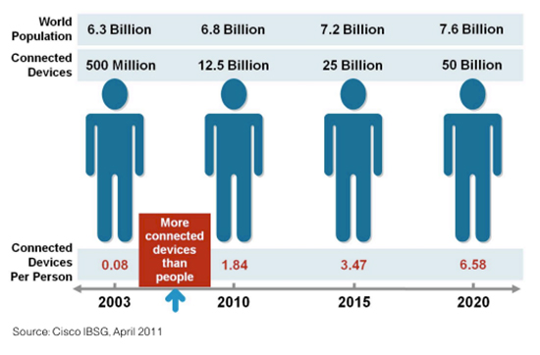
Motivation
Internet of Things (IoT):
  Billions-trillions of interconnected devices (large scale problem)
  1.8 zettabytes of data generated in 2015, increased by 50% in 2020!
  Battery powered → tight energy efficiency requirements
Solution: Approximate computing
gets results faster, at lower energy cost and with sufficient accuracy!
  Inaccuracy is inherent => most applications do not need exact results
    E.g. machine learning, speech recognition, search, graphics, etc.

Slide 3
Associative Memory
Associative memories: a promising solution to reduce energy consumption of parallel processors
Prestores high frequency patterns and their corresponding outputs
Input operands
Processor Pipeline
Result of computation
Clock gating
TCAM: Ternary Content Addressable Memory
Look up Table
MEM
Matching?
Requirements: low area, low energy consumption, high performance

Slide 4
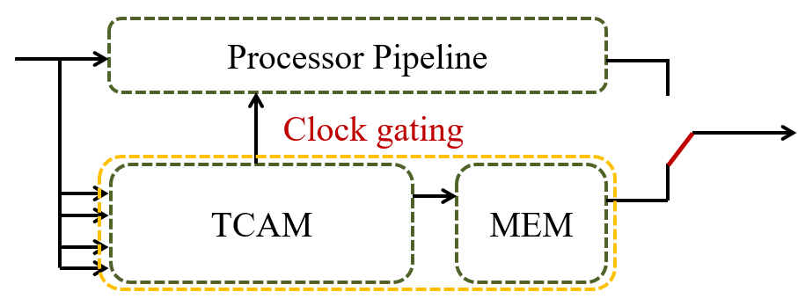
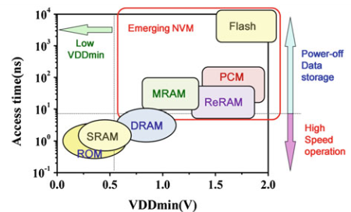
Related Work
Energy efficient computation
Energy efficient computing units
Associative memory
(“Computation with memory”)
CMOS-based [Ullah TCAS’12] [Pagiamtzis ISSCC’06][Arsovski JSSC’03]
NVM-based [Li ISSCC’14], [Chang ISSCC’15], [Huang VLSIC’14] [Govindaraj JLPED’15]
MTJ
Memristor
Exact/Approximate matching
[Zhang DAET’15],[Rahimi DAC’14]
Memoization
Approximate Computing
Associative Computing
[Guo ISCA’13] ,[Rahimi DATE’15] [Imani DATE’16],[Sharad DAC’13]
Notes:
Explain non-volatile memory
Which non-volatile did u use?
Define VOS
Which NVM, why?!
Focuse on tunable

Slide 5
Associative Memory Energy Solution
Energy Solution
Hit rate
Energy efficient TCAM
Online profiling
NVM TCAM
Low activity
Voltage Overscaling
Cost of profiling?
Guo ISCA’13
Yavits TACO’14
Sharad DAC’13
Zhang DAET’15
Imani, DATE’16
Imani, ISQED’16
Accuracy!
Rahimi, DATE’15
Imani, TETC’16
Imani, DATE’16

Slide 6
Base GPU Architecture for Approximate Design
AMD Radeon HD 7970 device from Southern Islands family
  32 compute units
    4 SIMD units
      16 stream cores (parallel lanes)
2048 stream cores per device
Thermal design power: 300W!
Floating Point Units
Integer Units
Stream Core 1
Compute Device
Compute Unit
SIMD Unit
Stream Core 2
Ultra-threaded Dispatcher
Wavefront Scheduler
Stream Core 3
IF/ID
Compute Unit 1
…
Compute Unit 32
SIMD Unit 1
SIMD Unit 2
SIMD Unit 3
SIMD Unit 4
Stream Core 16
Local Memory
…
Vector/Scalar RF
Global Memory

Slide 7
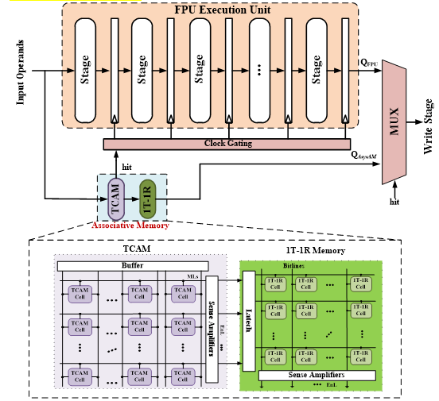
Associative Memory Integration
Notes:
We add MASC within each floating point unit; it consists of TCAM and 1t-1r memory. If data is found in MASC TCAM, we clock gate the CPU. The search is done in 1 cycle of FPU.

Slide 8
Framework of Proposed Online Profiling
Machine learning: finds the image of interest from input dataset based on pixel similarities (most represented data)
Approximate concurrent state machine: profile the selected images of interest approximately by keeping track of the number of repeated computation
Associative memory: reduce the redundant computations beside processor cores

Slide 9


Online Learning Algorithm
$$V_{t}^{S_{i}}=R_{t}^{S_{i}}+γ∙V_{t−1}^{S_{i}}$$
Temporal difference (TD) learning
TD-LRU maintains $k$ states, representing $k$ image groups of interest
$R_{t}^{S_{i}}$ is the reword value for the pixel similarity
$γ$ balances the impact of the obtained reward
TD-LRU considers the images with less than a threshold reward as non-seen images

Slide 10
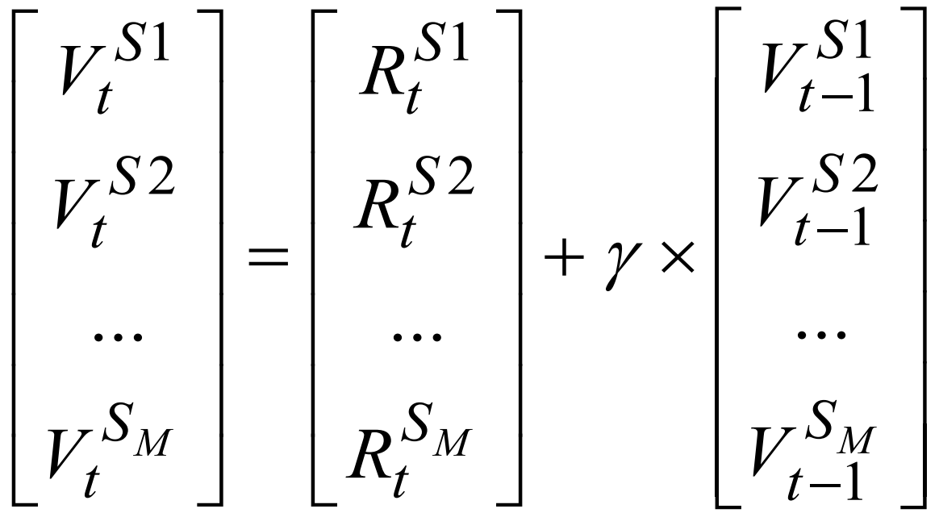


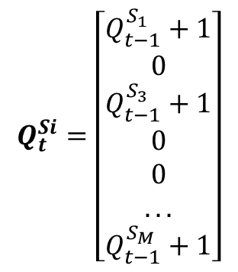


TD-LRU Learning
Input Image
Pixel Similarity
Image 1
Image 2
Image 3
Image 4
Image 5
Image M
$R_{t}^{S_{i}}$:
0.3
0.5
0.1
0.9
0.5
0.2
$Q_{t}^{Si}$:
+1
Reset 0
+1
Reset 0
Reset 0
+1
$$R_{t}^{Si}=\left[\begin{matrix}0 \\ 0.5 \\ 0 \\ \begin{matrix}0.9 \\ 0.5 \\ ... \\ 0\end{matrix}\end{matrix}\right]$$
$$Q_{t}^{Si}=\left[\begin{matrix}Q_{t−1}^{S_{1}}+1 \\ 0 \\ Q_{t−1}^{S_{3}}+1 \\ \begin{matrix}0 \\ 0 \\ ... \\ Q_{t−1}^{S_{M}}+1\end{matrix}\end{matrix}\right]$$
$$e.g\begin{matrix}, & Q_{t}^{Si}=\left[\begin{matrix}14 \\ 0 \\ 4 \\ \begin{matrix}0 \\ 0 \\ ... \\ 7\end{matrix}\end{matrix}\right]\end{matrix}$$
T_{acc}=0.35
T_{new}=10

Slide 11


TD-LRU Learning
If top K states change, we start approximate profiling
The allocated of associative memory from each state $S_{i}$:
For example: $V_{t}^{S_{a}}=0.4$ will take 2x more number of rows than those of another image state with $V_{t}^{S_{b}}=0.2$.
$P^{S_{i}}=\frac{V_{t}^{S_{i}}}{\sum_{j=1}^{M}{V_{t}^{S_{j}}}}$

Slide 12
Approximate Profiler
Profiler identifies frequent operand patterns in an approximated manner
Minimize the profiling overhead at the expense of the accuracy
Concurrent state machine: exploits a bloom filter, implemented with k hash functions to generate an input signature (m-bits vector)
False positive error: define as a number of operands might have a same signature value
f = (1-e^{-nk/m})^{k}
Parameters
n: degree of memberships | No control
m: vector size | Larger → accuracy ☺ Energy ☹
k: number of hash functions | Larger → accuracy ☺ Energy ☹

Slide 13
Approximate Profiler
Generate 60K different signatures of 128-bit length, we can profile the frequency pattern operands
5x lower memory space than the exact profiling case.
Acceptable error rate of 5.3%

Slide 14
Experimental Setup
AMD GPUs
  Multi2Sim for AMD Southern Islands GPU, Radeon HD 7970 device
  OpenCL applications: Sobel, Robert, Sharpen, Shift
FPU ASIC flow
  Balanced FPUs generated by FloPoCo
  Synthesized and mapped using a 45-nm TSMC
  Optimized for power and a clock period based on TCAM delay:
    Synopsys Design Compiler
    FPU power estimation: Synopsys PrimeTime (1.0V)
ACAM design flow
  Transistor-level HSPICE simulations for power and delay using 5T-4MTJ TCAM cell [Hanyu, DATE’15]
Notes:
CELL!!!!!!!!!!!!!!!

Slide 15
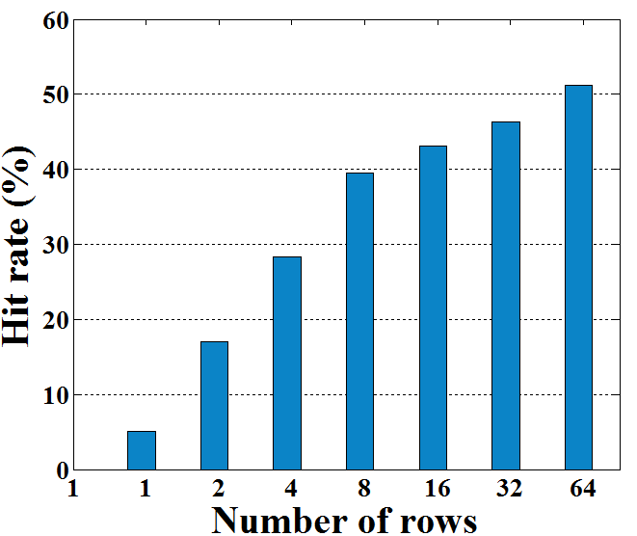
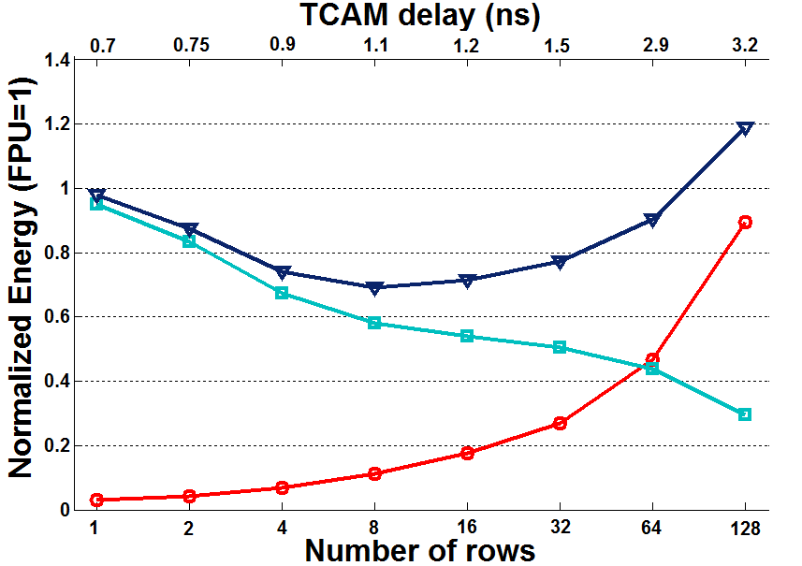
Results: GPU Energy Consumption
  Trade-off between FPU and TCAM energy consumption
  Minimum point: tradeoff between FPU and TCAM consumption
  Energy saving compared to GPU alone:
Hit Rate ☺
FPU Energy ☺
TCAM Energy ☹

Slide 16
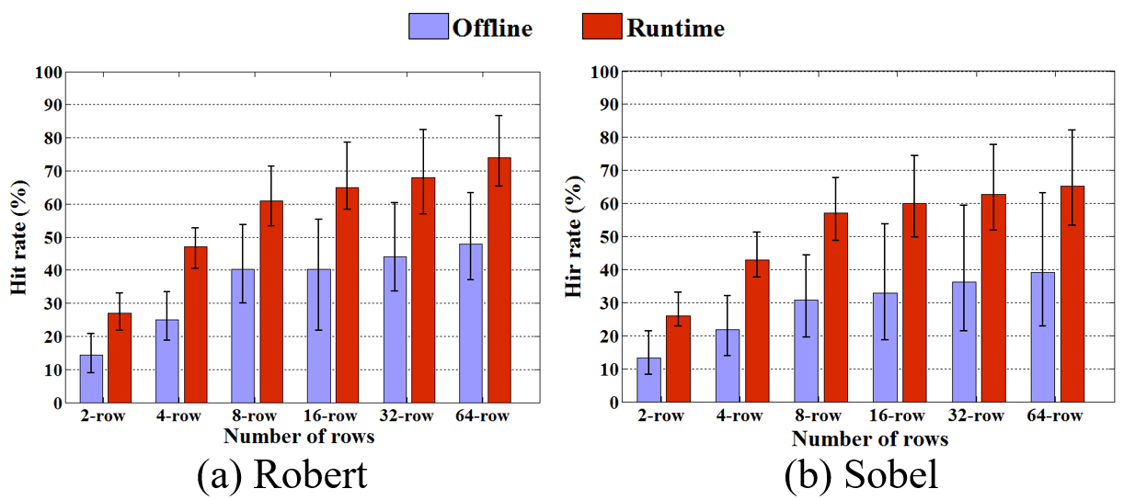
Hit Rate Comparasion Offline/Online
Offline Profiling: sampling data based on the offline observation → cannot identify the proper images to be profiled → low hit rate
Online profiling: adaptively update pre-stored the TCAM values in time by considering the data locality.
Frequent profiling until the selected images are good-enough to represent the dataset

Slide 17
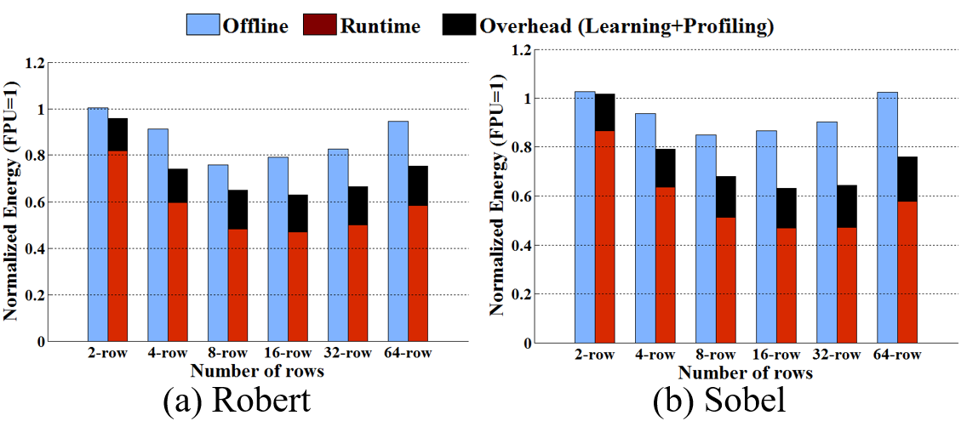
Hit Rate & Energy Saving Comparison
The learning and profiling energy is fixed (in fix dataset)
Minimum energy is in small TCAM → thus online learning is important!
ACAM saves 2.9x more energy on average than offline profiling
Average energy saving over 4 applications
GPU + Online ACAM | 35%
GPU + Offline ACAM | 12%

Slide 18
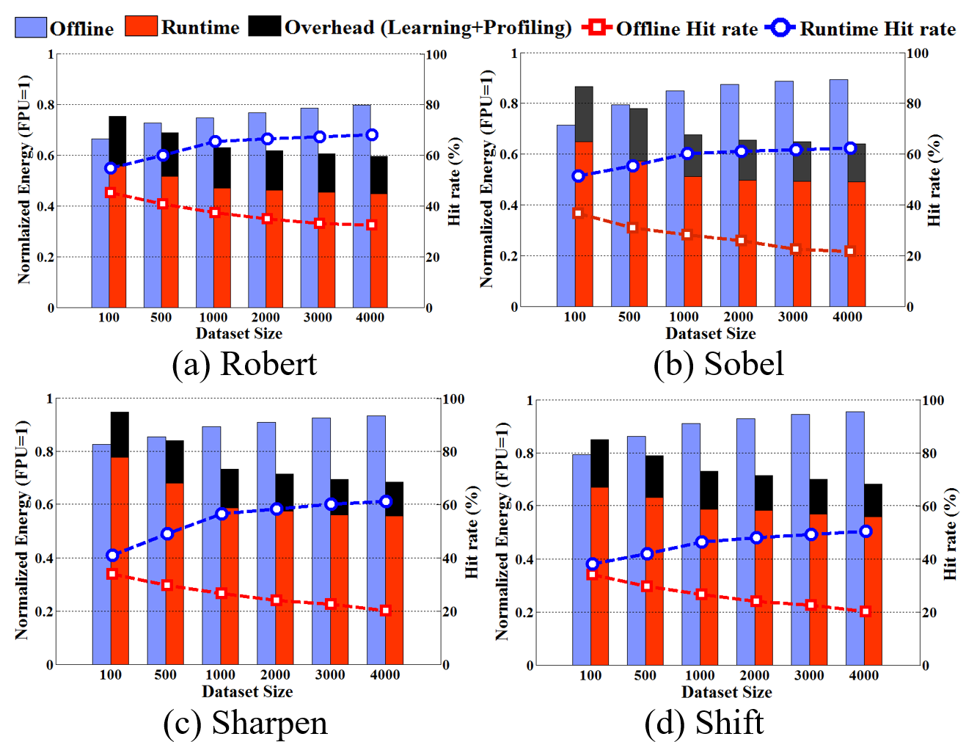
Energy in Different Dataset Size
Small dataset:
  Low hit rate difference of online and offline techniques
  Offline technique overtaken in energy saving due to zero profiling energy
  Large dataset:
  Offline profiling cannot find high-frequency patterns → low ACAM hit rate
  Online learning adaptive update the TCAM based on the temporal locality
 | Online profiling: 3.3x higher energy saving over 4 applications

Slide 19
ACAM Robustness to Dataset
GPGPU energy difference metric for the random and locality dataset cases
Online learning makes better decisions for image selections based on the locality
Online learning still outperforms 2.1x over offline profiling
Energy difference increase
 | Dataset size
 | 100 | 500 | 1000 | 2000 | 3000 | 4000
Robert | 0.04 | 0.04 | 0.07 | 0.09 | 0.11 | 0.13
Sobel | 0.02 | 0.06 | 0.13 | 0.15 | 0.16 | 0.18
Sharpen | 0.05 | 0.08 | 0.14 | 0.17 | 0.19 | 0.21
Shift | 0.04 | 0.05 | 0.09 | 0.11 | 0.12 | 0.14

Slide 20
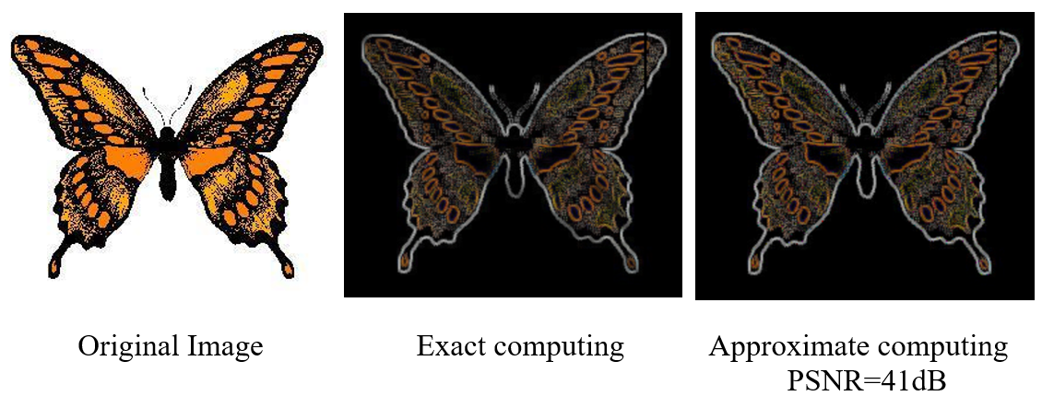
Quality Comparison
Robert Application

Slide 21
Conclusion
Associative memory exploits data locality to reduce the redundant computations
For IoT workload with large dataset, it is essential to use online profiling.
Our framework learns the workload and dramatically update the ACAM values based on recent represented data.
  35% GPGPU energy savings on average
  3.3X lower search energy consumption vs. state-of-the-art techniques.

