Slide 1
Brain-Inspired Computing Exploiting
Carbon Nanotube FETs and Resistive RAM: Hyperdimensional Computing Case Study
T. F. Wu, H. Li, P.-C. Huang, A. Rahimi,
J. M. Rabaey, H.-S. P. Wong, M. M. Shulaker, S. Mitra

Slide 2
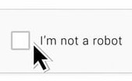
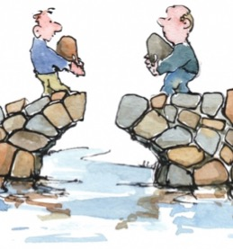


Human Cognition: Unparalleled
Simple cognitive tasks for humans:
understanding
audio/video
detecting
problems
strategic
planning
real-time
decision making
...
extremely challenging for computing systems

Slide 3
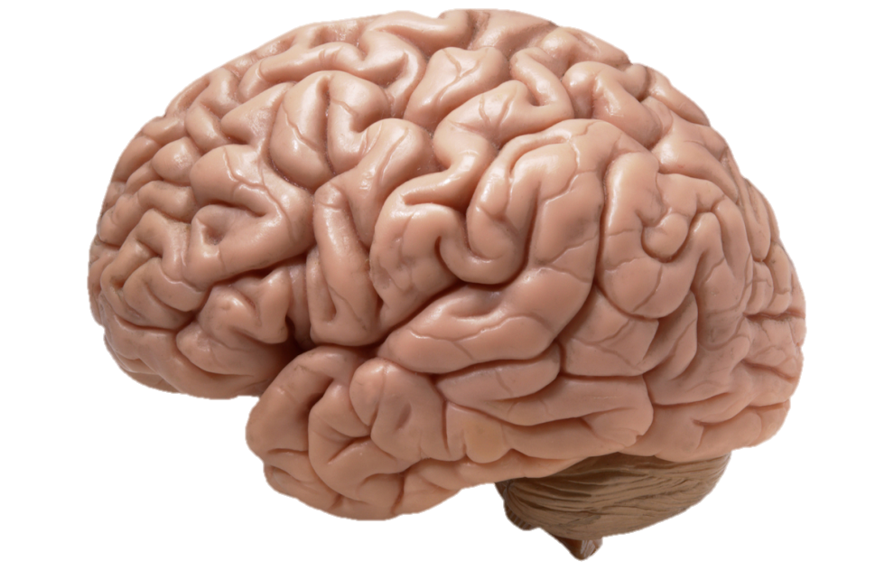
Brain-Inspired Computing Systems
high promise, major disconnect vs. human brain
billions of neurons
trillions of synapses*
Computing Models ?
Chip Realization Challenges
Hyperdimesional (HD) computing
Convolutional neural networks
Long short-term memory
Compute + memory immersed on-chip
Ultra-dense connectivity
Energy-efficiency
Small footprint
...
...
*[Voytek Scitable 13]

Slide 4
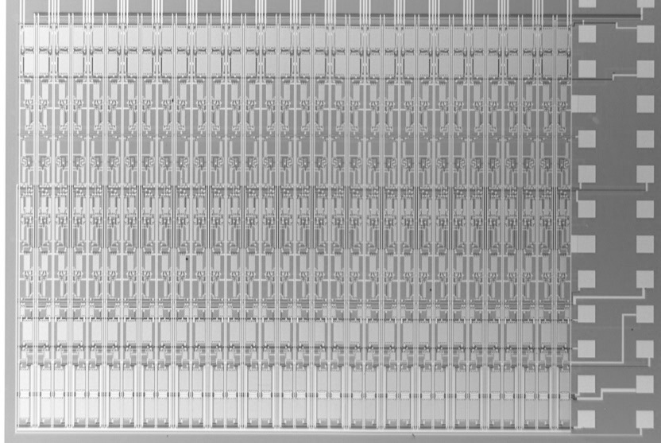
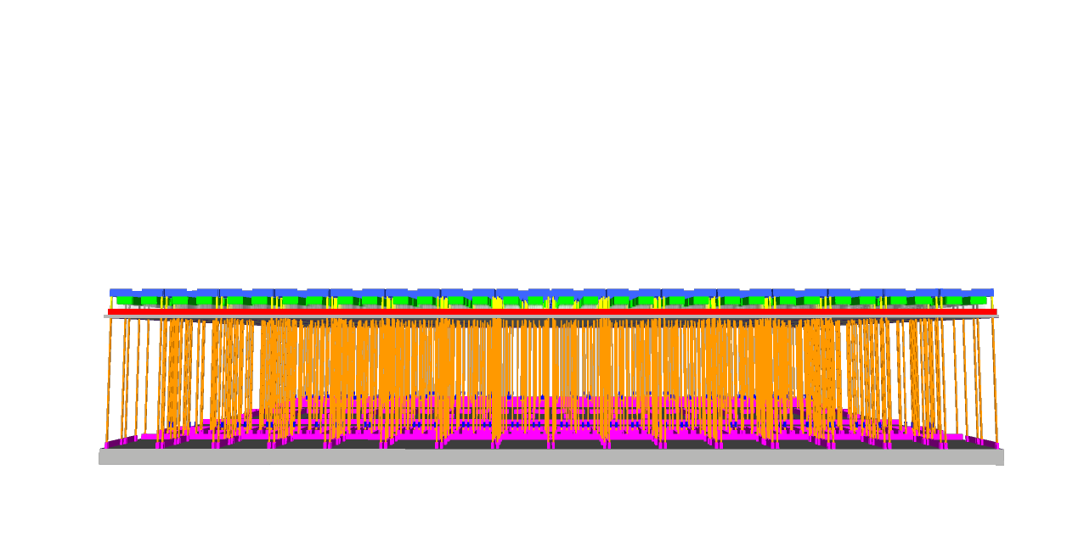
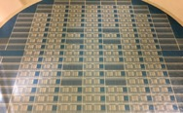
3D Nanosystem for HD Computing
Monolithic 3D integration, carbon nanotube FETs, resistive RAM
224 RRAM cells
Monolithic 3D
1,952 CNFETs
RRAM
CNFETs

Slide 5
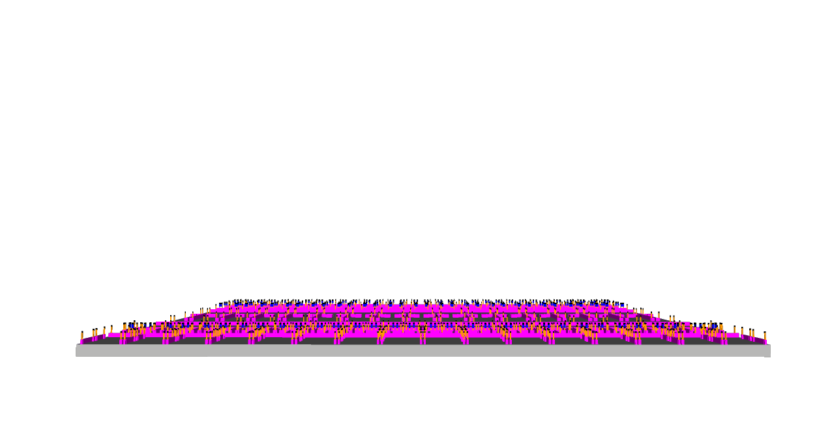
3D Nanosystem for HD Computing
Resistive RAM (RRAM) for memory and compute
224 RRAM cells
RRAM

Slide 6
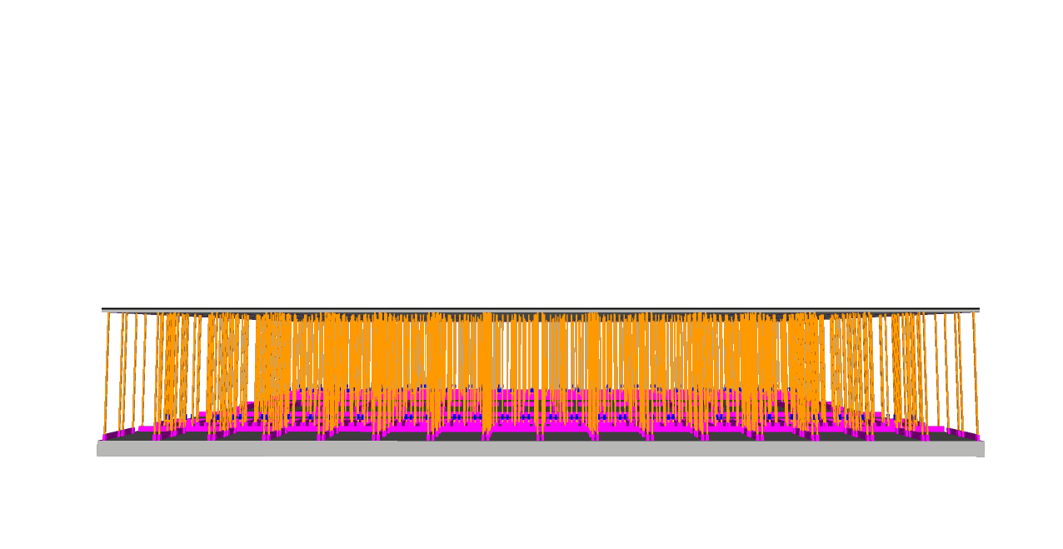
3D Nanosystem for HD Computing
Fine-grained access between computation and memory
Monolithic 3D integration
RRAM

Slide 7
3D Nanosystem for HD Computing
Energy-efficient carbon nanotube FETs (CNFETs)
1,952 CNFETs
RRAM
CNFETs

Slide 8
Key Message
Monolithic 3D nanosystem for HD computing
  Measured 98% accuracy for language classification
CNFET, RRAM, monolithic 3D overcome realization challenges
  Low-temperature fabrication key
Exploit native nanotechnology properties for HD
  Inherent variations, RRAM analog accumulator, error resilient
Live demo yesterday

Slide 9

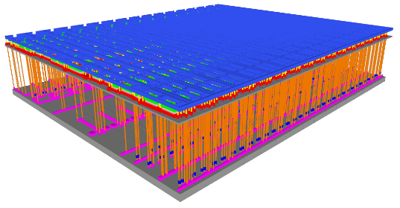
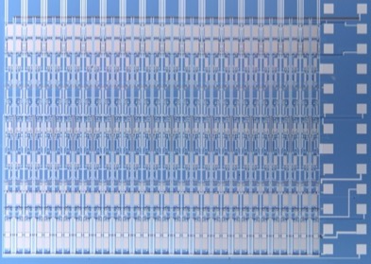
Hyperdimensional (HD) Nanosystem for Language Classification
  One-shot learning
Training text
100k characters per language
  HD vector for Spanish
  HD vector for Dutch
….
HD nanosystem
  HD vector for Italian
  Pairwise classification
Test sentences
21 European languages
English vs Spanish
Italian vs Dutch
Estonian vs Italian etc.
~100 characters per sentence
The brave men, living and dead, who struggled here, have consecrated it far above our poor power to add or detract.
  Measured: 98% accuracy (resilient to stuck-at faults)

Slide 10
HD Computing: Mapping Phase
a
b
c
……
_
11
0
0
.
.
.
0
1
1
1
0
0
0
.
.
.
0
1
0
0
1
0
0
.
.
.
1
0
1
0
0
0
0
.
.
.
1
1
1
……
Hyperdimensional (HD) vectors

Slide 11
HD Computing: Mapping Phase
a
b
c
……
_
Random projection
  Alphabet → 27 HD vectors
High dimensionality: ~kbits
  Resilient to errors
11
0
0
.
.
.
0
1
1
1
0
0
0
.
.
.
0
1
0
0
1
0
0
.
.
.
1
0
1
0
0
0
0
.
.
.
1
1
1
……
Hyperdimensional (HD) vectors

Slide 12
HD Computing: Training Phase
h
e
l
l
o
…………
0
1
1
0
.
.
.
1
1
1
1
0
1
0
.
.
.
0
1
0
1
1
1
0
.
.
.
0
0
1
1
1
1
0
.
.
.
0
0
1
0
0
0
1
.
.
.
0
1
1
English text sample

Slide 13
HD Computing: Training Phase
h
e
l
l
o
…………
0
1
1
0
.
.
.
1
1
1
1
0
1
0
.
.
.
0
1
0
1
1
1
0
.
.
.
0
0
1
1
1
1
0
.
.
.
0
0
1
0
0
0
1
.
.
.
0
1
1
HD Encoder
0
1
0
0
.
.
.
0
0
1
Multiply: Bitwise XOR
Accumulation
Permute: Circular Shift
Store in
Classifier
Memory
Training text: English
HD Vector: entire English language

Slide 14
HD Computing: Training Phase
h
o
l
a
_
…………
0
1
1
0
.
.
.
1
1
1
0
0
0
1
.
.
.
0
1
1
1
1
1
0
.
.
.
0
0
1
1
1
1
1
.
.
.
0
0
0
1
0
1
1
.
.
.
0
0
1
HD Encoder
1
1
0
1
.
.
.
0
1
1
Multiply: Bitwise XOR
Accumulation
Permute: Circular Shift
Store in
Classifier
Memory
Training text: Spanish
HD Vector: entire Spanish language

Slide 15
HD Computing: Training Phase
c
i
a
o
_
…………
0
1
1
1
.
.
.
1
0
1
0
1
0
1
.
.
.
0
0
0
1
1
1
1
.
.
.
0
0
0
0
0
0
1
.
.
.
0
1
1
1
0
1
1
.
.
.
0
0
1
HD Encoder
0
1
0
0
.
.
.
0
1
0
Multiply: Bitwise XOR
Accumulation
Permute: Circular Shift
Store in
Classifier
Memory
Training text: Italian
HD Vector: entire Italian language

Slide 16
HD Computing: Training Phase
h
a
l
o
_
…………
0
1
1
0
.
.
.
1
1
1
1
1
1
1
.
.
.
0
0
0
1
1
1
0
.
.
.
0
0
1
0
0
0
1
.
.
.
0
1
1
1
0
1
1
.
.
.
0
0
1
HD Encoder
1
0
0
1
.
.
.
1
1
0
Multiply: Bitwise XOR
Accumulation
Permute: Circular Shift
Store in
Classifier
Memory
Training text: German
HD Vector: entire German language

Slide 17
HD Computing: Inference Phase
b
r
a
i
n
…………
Classifier Memory
1
0
0
0
.
.
.
0
1
0
1
1
1
0
.
.
.
1
1
0
11
0
0
.
.
.
0
1
1
1
0
1
0
.
.
.
0
0
0
0
0
1
1
.
.
.
1
1
1
HD Encoder
0
1
0
0
.
.
.
0
0
1
HD Encoder
Multiply: Bitwise XOR
Accumulation
Permute: Circular Shift
HD Vector for English
HD Vector for Spanish
Test sentence: infer language
Associative search/compare
(via Hamming distance)

Slide 18
HD Computing: Inference Phase
b
r
a
i
n
…………
Classifier Memory
1
0
0
0
.
.
.
0
1
0
1
1
1
0
.
.
.
1
1
0
11
0
0
.
.
.
0
1
1
1
0
1
0
.
.
.
0
0
0
0
0
1
1
.
.
.
1
1
1
HD Encoder
0
1
0
0
.
.
.
0
0
1
Multiply: Bitwise XOR
Accumulation
Permute: Circular Shift
HD Vector for English
HD Vector for Spanish
Test sentence: infer language
Associative search/compare
(via Hamming distance)

Slide 19

Inside the Box: HD MAP Kernels
Permute:
circular shift
Multiply:
bitwise XOR
Accumulate:
threshold
1
0
1
1
.
.
.
0
0
0
1
0
0
1
.
.
.
0
1
0
0
0
1
1
.
.
.
1
0
1
2
0
2
3
.
.
.
1
1
1
1
0
1
1
.
.
.
0
0
0
1
0
1
0
.
.
.
0
1
0
0
1
0
1
.
.
.
0
0
1
0
1
1
0
.
.
.
0
1
1
0
1
0
1
.
.
.
0
0
1
0
0
1
1
.
.
.
0
1
0
Threshold to binary
e.g., threshold = 3/2

Slide 20
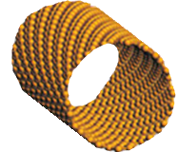
Carbon Nanotube FET (CNFET)
CNT
diameter:
~1-2 nm
Energy Delay Product
10× benefit
full-chip case studies
[IBM, IMEC, Stanford,
other commercial]
sub-
lithographic
CNT pitch

Slide 21
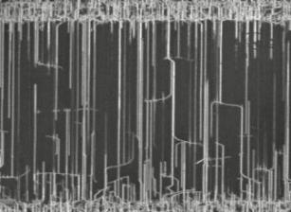
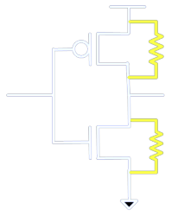
Big Promise, Major Obstacles
Processing advances alone inadequate
Mis-positioned CNTs
Metallic CNTs
Imperfection-Immune Paradigm
[VLSI Tech. 08, ISSCC 13, JSSC 14, IEDM 15]

Slide 22
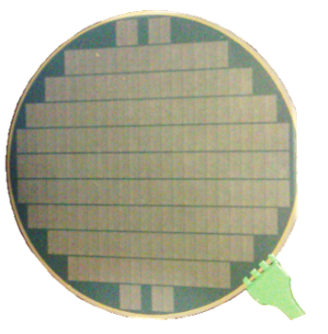
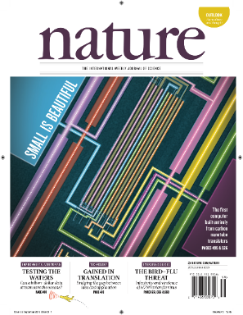
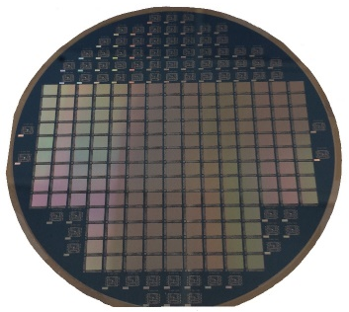
Experimental System Demonstrations
CNT computer
3D Nanosystem
>2 million CNFETs
2 million CNFETs
Instruction fetch
Data fetch
Arithmetic block
Write-back
1
2
3
4
5
6
1
2
3
7
8
instruction fetch
data fetch
arithmetic block
write-back
4
5
6
[Stanford, Nature, 2013]
7
8
[Stanford, Nature, 2017]
[Shulaker Nature 13]
[Shulaker Nature 17]

Slide 23
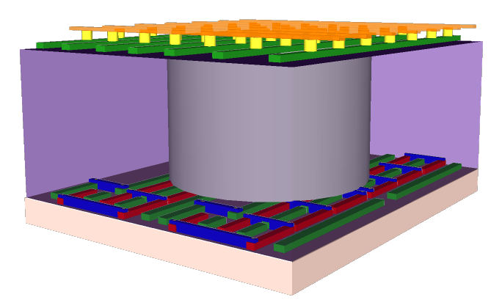

3D Integration
TSV pitch >> ILV pitch
TSV (chip stacking)
Monolithic
Through silicon via
(TSV)
Inter-layer vias (ILVs)
conventional vias for metal interconnects
e.g., 36nm for 10nm node [1]
[1] Mistry Intel 17

Slide 24
Monolithic 3D
Low-temperature fabrication required (< 400°C)

Slide 25
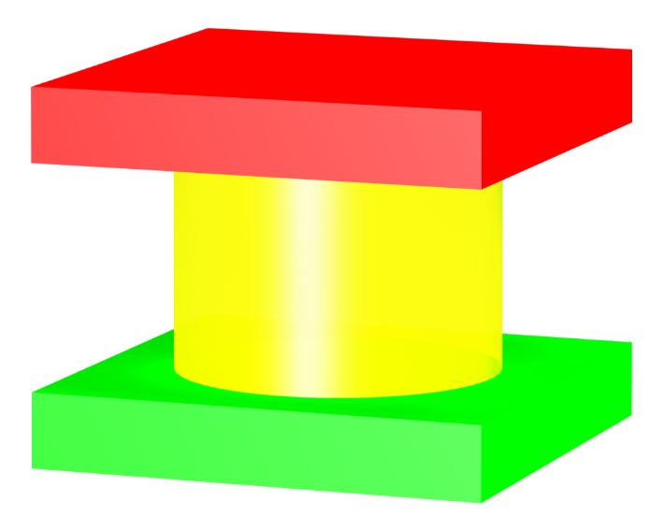
Realizing Monolithic 3D
Low-temperature fabrication: < 400°C
Logic
Memory
CNFETs
RRAM
Top Electrode
Metal Oxide
Bottom Electrode
<200 °C
<200 °C

Slide 26
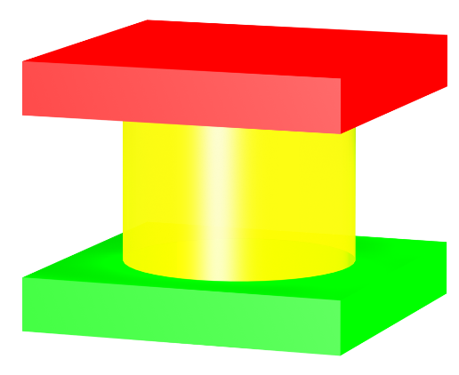
Realizing Monolithic 3D
Combine device + new architecture benefits
Naturally enabled
+
+
Emerging Logic
Emerging Memory
Monolithic 3D Integration
CNFETs
RRAM

Slide 27
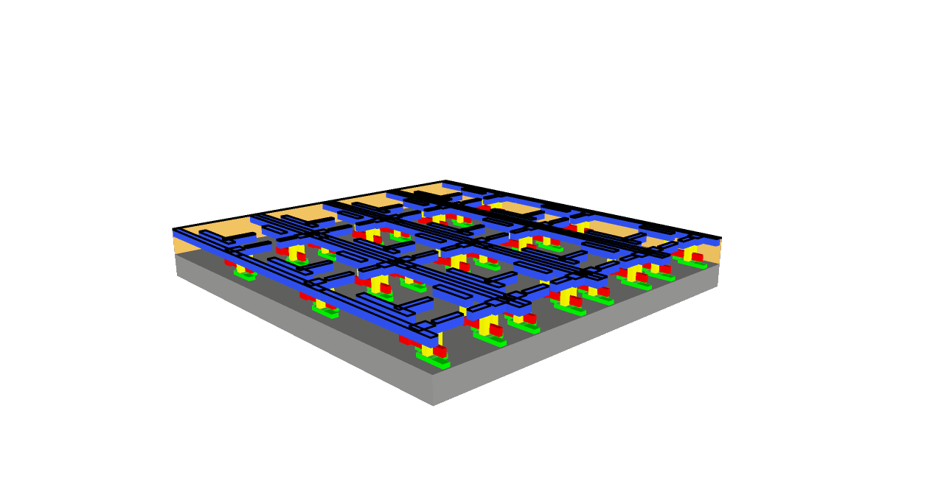
Silicon CMOS compatibility
Silicon foundry compatible
Silicon FETs or CNFETs + Inter-layer dielectric

Slide 28
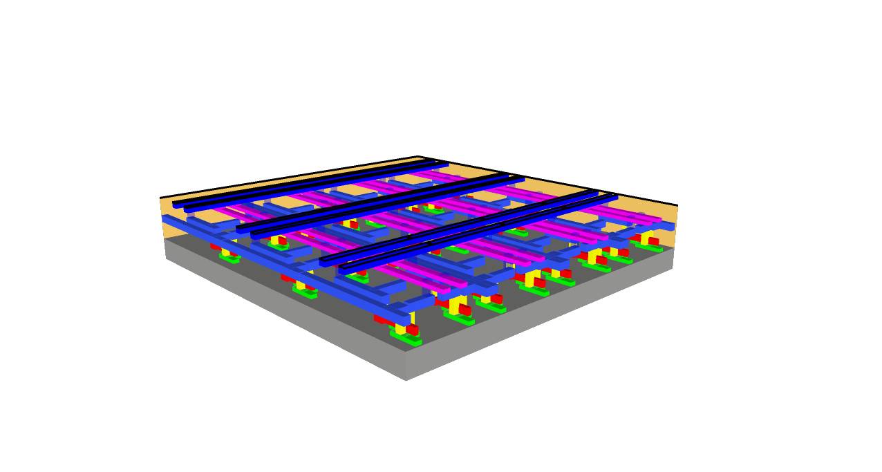
Silicon CMOS compatibility
Silicon foundry compatible
RRAM fabrication + Inter-layer dielectric

Slide 29
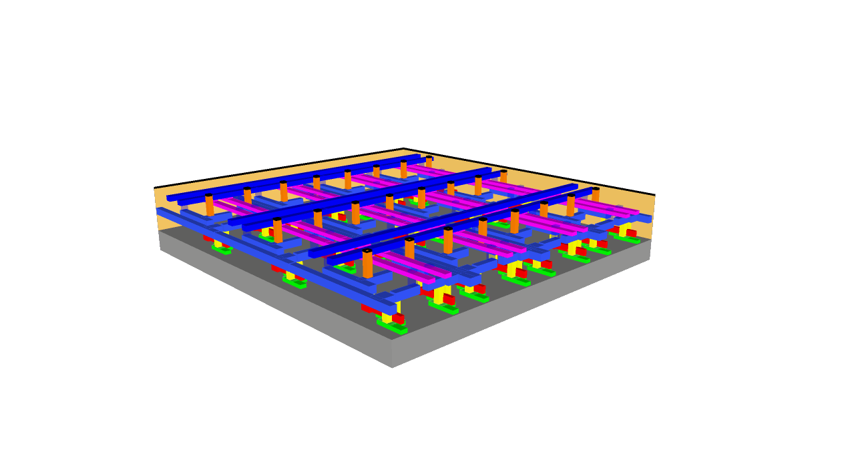
Silicon CMOS compatibility
Silicon foundry compatible
Inter-layer vias

Slide 30
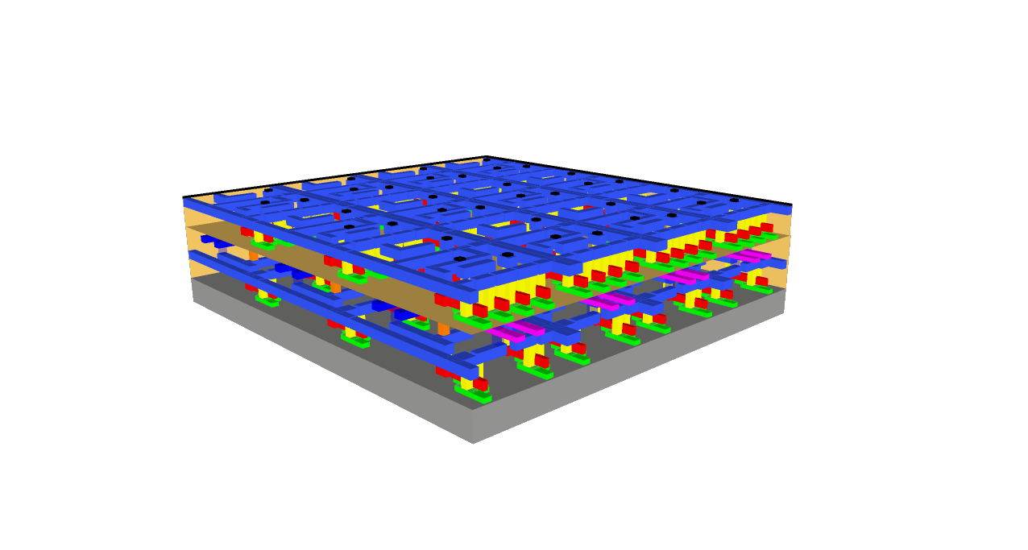
Silicon CMOS compatibility
Silicon foundry compatible
CNFET logic fabrication

Slide 31
Silicon CMOS compatibility
Silicon foundry compatible
RRAM fabrication
+ Inter-layer dielectric
Si-FETs or CNFETs
CNFET fabrication
+ Inter-layer dielectric
Inter-layer vias

Slide 32
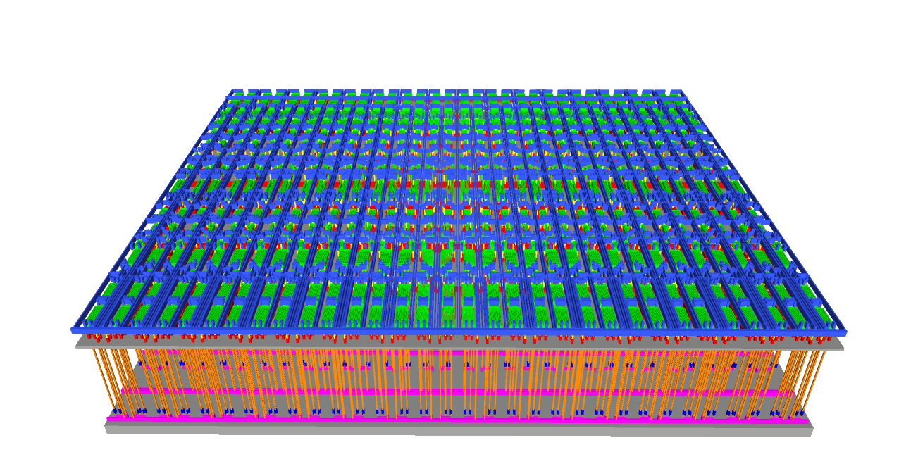
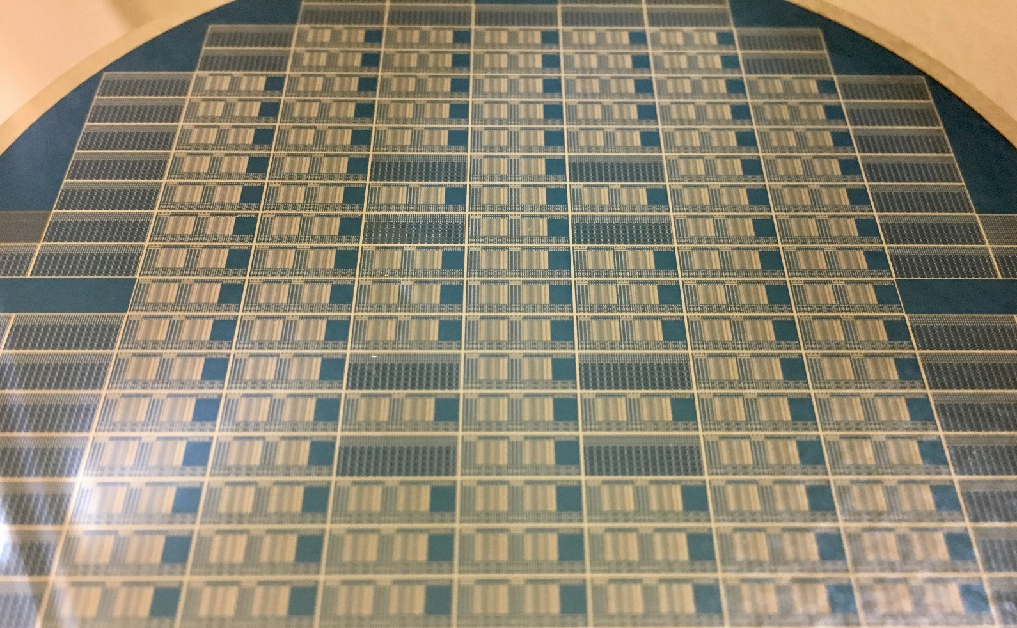
Chip overview: Monolithic 3D HD Nanosystem
Wafer-scale design and fabrication

Slide 33
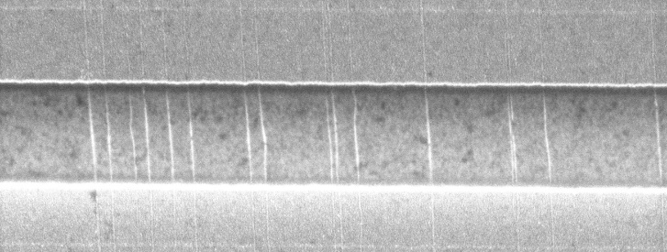
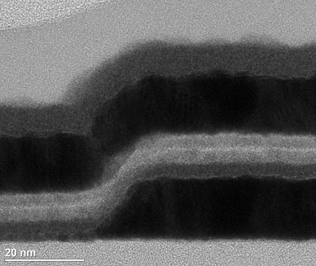
Chip overview: Monolithic 3D HD Nanosystem
Built entirely with CNFETs + RRAM
CNTs
RRAM
CNT computing logic
TiN
HfOx
Pt
Memory
Inter-layer vias

Slide 34
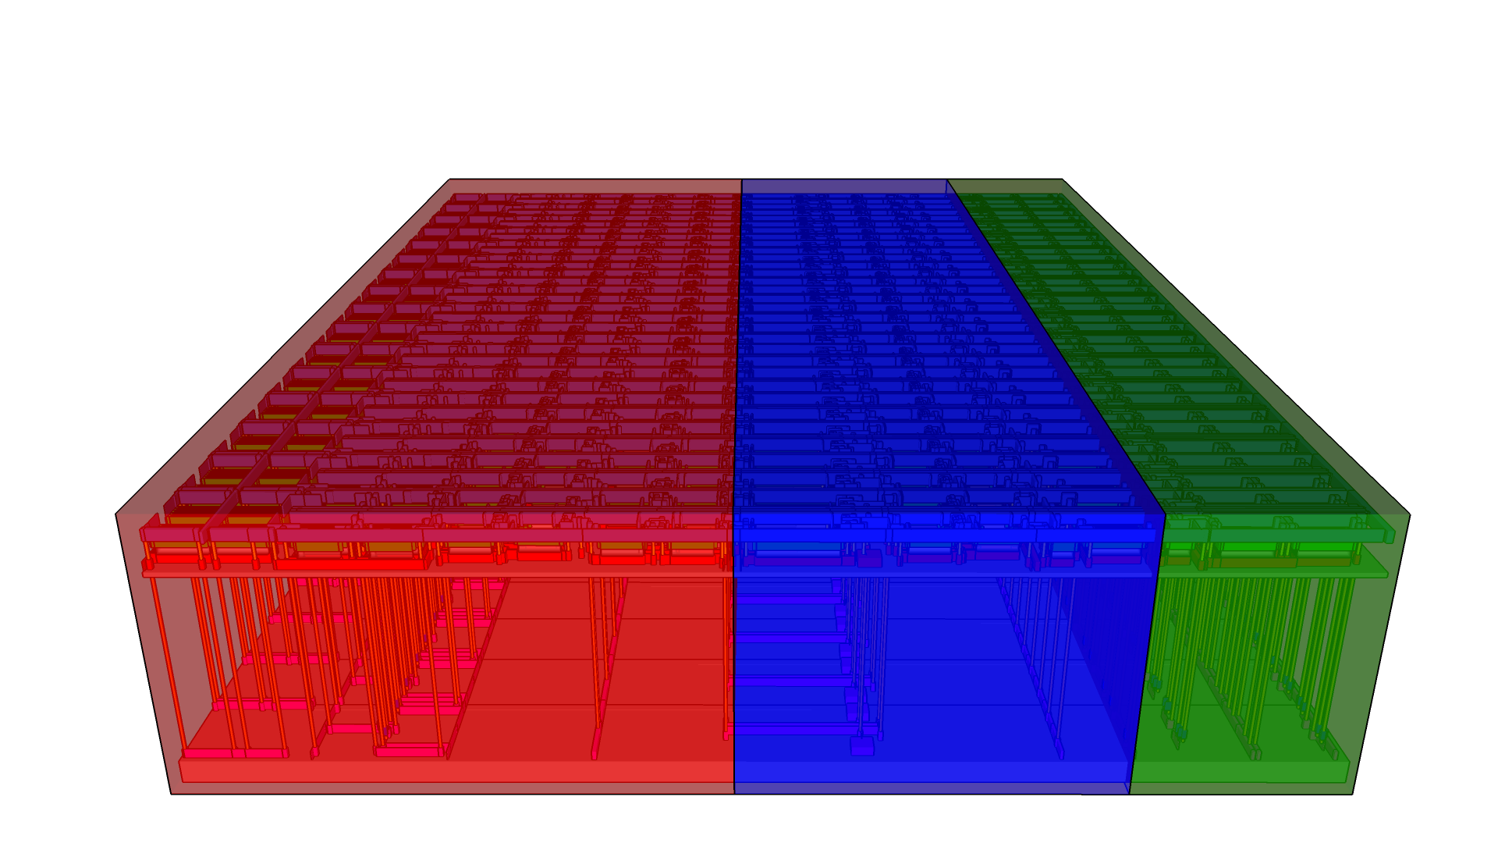
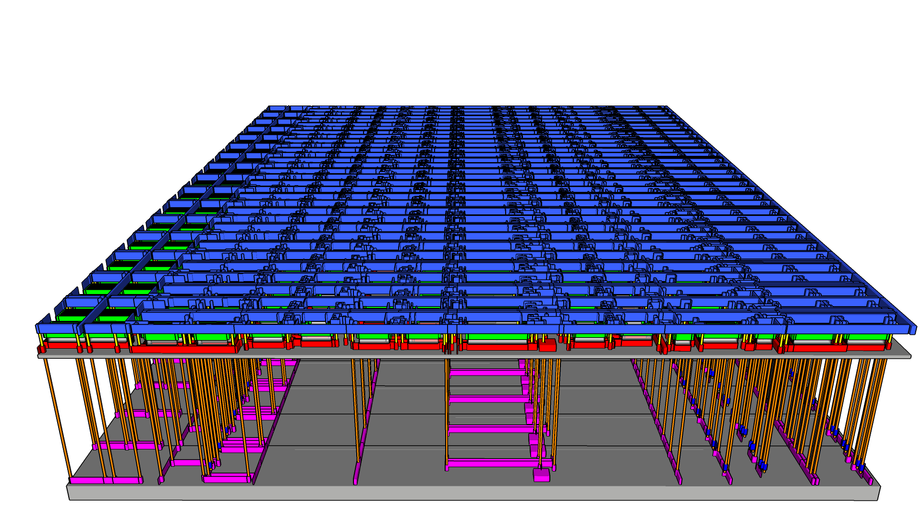
Our system: language classification
Classifier
Memory
Random Projection
HD Encoder

Slide 35
Language classification example
Input characters ➔ HD vector representation generated
0
1
1
0
.
.
.
1
1
1
0
0
1
1
.
.
.
1
0
0
0
1
1
0
.
.
.
1
1
1
0
0
1
1
.
.
.
1
0
0
Four score and seven years ago…
Classifier
Memory
Random Projection
HD Encoder

Slide 36
Our system: language classification
Generates HD vector representing entire sentence
1
1
0
1
.
.
.
0
0
1
Classifier
Memory
Random Projection
HD Encoder

Slide 37
Our system: language classification
Output currents: higher current indicates language
1
1
0
1
.
.
.
0
0
1
60 µA
English
vs.
40 µA
Spanish
Classifier
Memory
Random Projection
HD Encoder

Slide 38
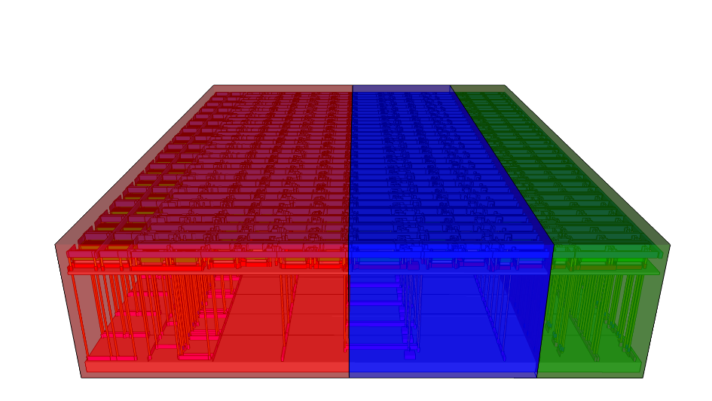
System Schematic
entirely CNFETs + RRAM
Random Projection
HD Encoder
Classifier Memory
clk2
V_{top}
lang0
lang1
in
𝛿
R
Q
D
Q
in
out
S
clk
out
clk1
𝛿
E
clk4
clk3
V_{bot}
row 1 of 32
x32
...

Slide 39

System Schematic
entirely CNFETs + RRAM
Random Projection
HD Encoder
Classifier Memory
row 1 of 32
...

Slide 40
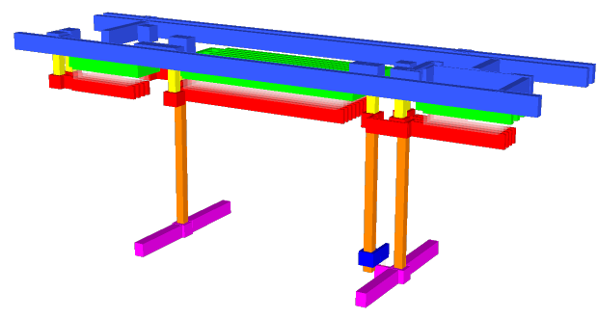
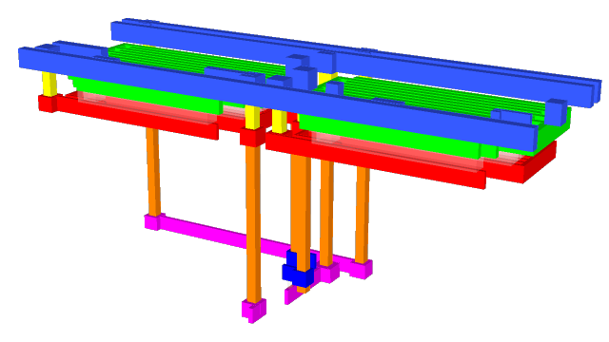
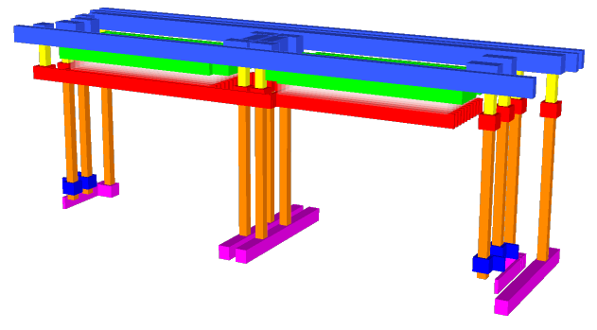
Monolithic 3D Library Cells: CNFETs + RRAM
Random Projection
HD Encoder
Classifier Memory
Layer 2
Layer 2
Layer 2
V_{DD}
Layer 1
V_{DD}
Layer 1
Layer 1
lang0
lang1
clk4
V_{top}
in
in
V_{DD}
V_{DD}
out
V_{b}
V_{b}
Pgrm
RRAM
out
V_{bot}
V_{b}
V_{b}
RRAM
Delay Cells
Accumulator
TCAM Memory Cells
row 1 of 32
...

Slide 41
Monolithic 3D Library Cells: 1 of 3
entirely CNFETs + RRAM
Random Projection
HD Encoder
Classifier Memory
Layer 2
Layer 2
Layer 2
V_{DD}
Layer 1
V_{DD}
Layer 1
Layer 1
lang0
lang1
clk4
V_{top}
in
in
V_{DD}
V_{DD}
out
V_{b}
V_{b}
Pgrm
RRAM
out
V_{bot}
V_{b}
V_{b}
RRAM
Delay Cells
Accumulator
TCAM Memory Cells
row 1 of 32
...

Slide 42

Random Projection utilizing variations
Variations inherent to nanotechnologies
CNFET drive current
RRAM resistance
Threshold voltage
CNT Count
Filament size
Filament configuration
3
2
5
Source
Source
Source
HfOx
Gate
Gate
Gate
Drain
Drain
Drain

Slide 43
Random Projection utilizing variations
Delay variations lead to high HD computing accuracy
CNFET Delay Cell
100
𝛿
V_{DD}
In
Inference Accuracy (%)
Out
V_{B}
75
Pulldown Delay
Pulldown Delay 𝞂/𝝻
𝝻: mean delay, 𝞂: standard deviation of delays

Slide 44
Random Projection utilizing variations
CNFETs: not enough variations (small 𝞂/𝝻)
CNFET Delay Cell
100
𝛿
V_{DD}
In
Inference Accuracy (%)
Out
0.3
CNFET Only
V_{B}
75
Pulldown Delay
Pulldown Delay 𝞂/𝝻
𝝻: mean delay, 𝞂: standard deviation of delays

Slide 45
Random Projection utilizing variations
RRAM variations: more than CNFETs
RRAM Delay Cell
100
𝛿
V_{DD}
0.8
In
Inference Accuracy (%)
RRAM Only
Out
75
RRAM
Pulldown Delay
Pulldown Delay 𝞂/𝝻
𝝻: mean delay, 𝞂: standard deviation of delays

Slide 46
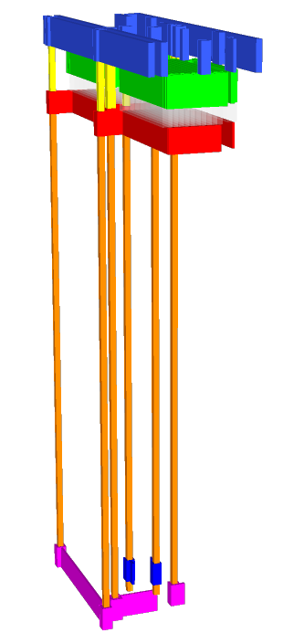
Engineering Variations
CNFET + RRAM variations combined: largest 𝞂/𝝻
CNFET + RRAM Delay Cell
CNFETs
V_{DD}
100
CNFET + RRAM
𝛿
In
1.5
Out
V_{B}
Inference Accuracy (%)
Pgrm
75
RRAM
RRAM
Pulldown Delay 𝞂/𝝻
Our implementation: V_{DD} = 3V
𝝻: mean delay, 𝞂: standard deviation of delays

Slide 47
Monolithic 3D Library Cells: 2 of 3
entirely CNFETs + RRAM
Random Projection
HD Encoder
Classifier Memory
Layer 2
Layer 2
Layer 2
V_{DD}
Layer 1
V_{DD}
Layer 1
Layer 1
lang0
lang1
clk4
V_{top}
in
in
V_{DD}
V_{DD}
out
V_{b}
V_{b}
Pgrm
RRAM
out
V_{bot}
V_{b}
V_{b}
RRAM
Delay Cells
Accumulator
TCAM Memory Cells
row 1
of 32
...

Slide 48
HD accumulator design
30X fewer transistors vs digital accumulator
7-bit digital accumulator (needed for HD)
RRAM
Analog
Accumulator
9 Transistors
>270 Transistors

Slide 49
RRAM analog accumulator: leveraging gradual reset
Pulses increase resistance of RRAM
Built with RRAM + CNFET Logic
Measured Resistance
V_{top}
10⁸
Increasing resistance
in
pulse
Pulses
10⁶
Resistance
If in = 1, pulse
10⁴
0
50
100
V_{top} – V_{bot} = -2.6V
Number of Pulses
V_{bot}
Our implementation: V_{DD} = 3V

Slide 50
RRAM analog accumulator: leveraging gradual reset
Buffer to threshold output
Built with RRAM + CNFET Logic
Measured Accumulator
V_{top}
clk
in
pulse
out
Rd
Incr
Rd
Incr
Rd
Incr
Rd
Incr
If in = 1, pulse
V_{top}-V_{bot}
out (V)
V_{bot}
Time (ms)
Our implementation: V_{DD} = 3V
in = 3V

Slide 51
Monolithic 3D Library Cells: 3 of 3
entirely CNFETs + RRAM
Random Projection
HD Encoder
Classifier Memory
Layer 2
Layer 2
Layer 2
V_{DD}
Layer 1
V_{DD}
Layer 1
Layer 1
lang0
lang1
clk4
V_{top}
in
in
V_{DD}
V_{DD}
out
V_{b}
V_{b}
Pgrm
RRAM
out
V_{bot}
V_{b}
V_{b}
RRAM
Delay Cells
Accumulator
TCAM Memory Cells
row 1
of 32
...

Slide 52
Inference in HD: RRAM current-summing
Calculate Hamming distance
Closest match vs stored HD vectors
‘0’
0.5V
Current Summing
Measured current
QV[0]
QV[0]
English identified
Spanish
identified
Stored ‘1’
RRAM
‘0’
Current Sum (µA)
QV[1]
QV[1]
Stored ‘0’
RRAM
Text 1
Text 2
lang0 (English)
lang1 (Spanish)
lang0

Slide 53
Inference in HD: RRAM current-summing
Calculate Hamming distance
Closest match vs stored HD vectors
‘0’
0.5V
Current Summing
Measured current
QV[0]
QV[0]
Eng v. Spa
Eng v. Deu
Eng v. Fra
Eng v. Gre
Stored ‘1’
RRAM
Est v. Spa
Est v. Deu
Est v. Fra
Est v. Gre
‘0’
Current Sum (µA)
…
QV[1]
QV[1]
Pol v. Spa
Pol v. Deu
Pol v. Fra
Pol v. Gre
Stored ‘0’
RRAM
lang0
lang1
lang0

Slide 54
Measured Language Classification Results
Pairwise classification of 21 European languages*
Software
99.2%
98%
Mean Accuracy (%)
Measured using our nanosystem
*Koehn, Europarl Dataset, http://www.statmt.org/europarl/, 2005.

Slide 55
Comparison to State of the Art
CNFET demos
RRAM demos
Sensor-to-Digital Interface
[Shulaker ISSCC 13]
3D Nano-
system
[Shulaker
Nature 17]
RRAM FPGA
[Liauw ISSCC 12]
CNT Computer
[Shulaker Nature 13]
32 Gb array
[Liu JSSC 14]
…
4-bit CMOS adder
[Yang ACS
Nano 17]
…
This
Work
Brain-inspired
3D RRAM
[Li VLSI Tech 17]
CNT PUF
Simulation
[Konigsmark
ASP-DAC 14]
…
…
…
Si PUF [Yang ISSCC 15]
Si PUF [Alvarez ISSCC 15]
…
Variations Utilized

Slide 56
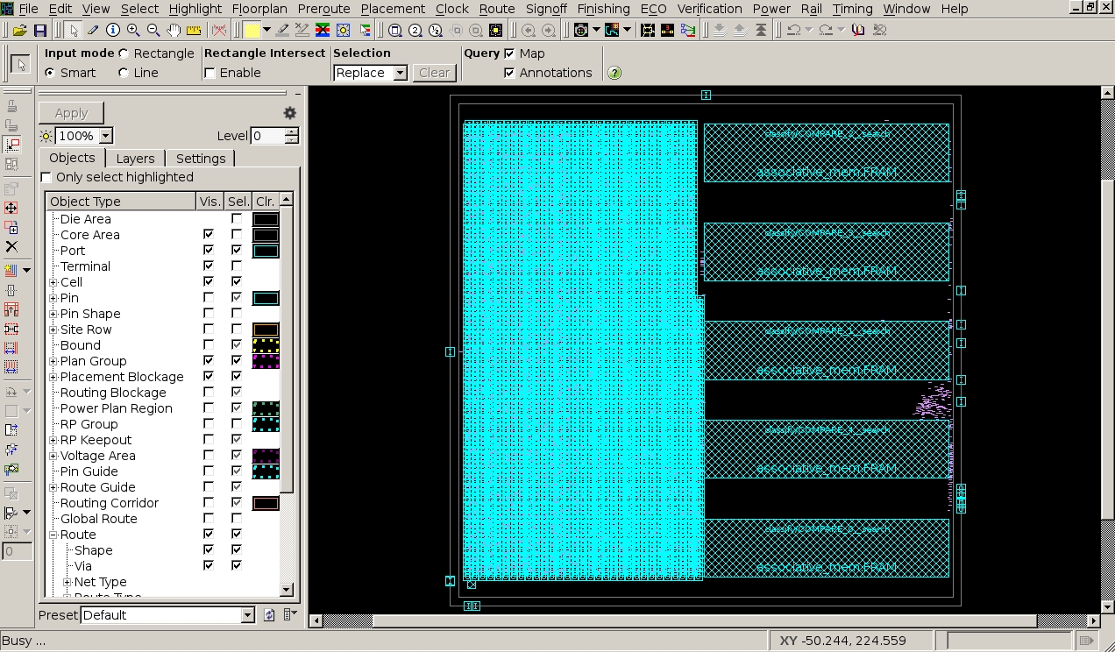
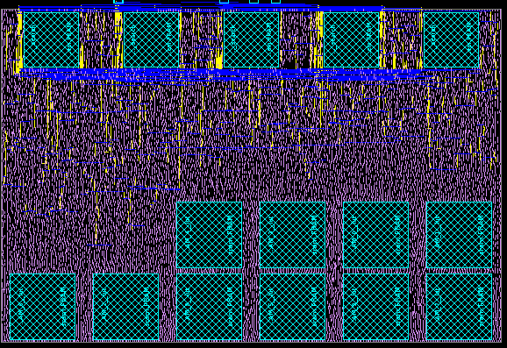
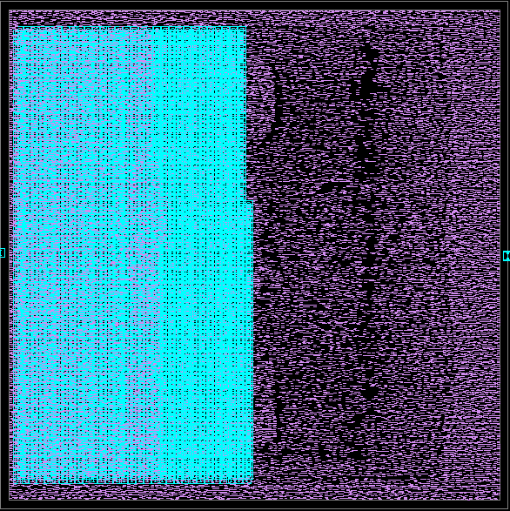
Simulated HD Computing Projections
35X less EDP, 3X smaller area
Simulated 28nm Silicon
Simulated 28nm Monolithic 3D
Silicon FETs + Silicon SRAM
CNFETs + RRAM
Classifier Mem.: SRAM TCAM
Classifier Mem.: CNFET+RRAM TCAM
3 Tiers
Random projection: SRAM lookup
Random projection: Delay cells
Digital accumulators
RRAM analog accumulators
Post place-and-route area and energy-delay product (EDP), HV dimension 10,000 bits

Slide 57
Simulated HD Computing Projections
Simulations show major benefits
Execution Time
Energy
4.6X
7.6X
Post place-and-route area and energy-delay product (EDP), HV dimension 10,000 bits

Slide 58
Key Message
Monolithic 3D nanosystem for HD computing
  Measured 98% accuracy for language classification
CNFET, RRAM, monolithic 3D overcome realization challenges
  Low-temperature fabrication key
Exploit native nanotechnology properties for HD
  Inherent variations, RRAM analog accumulator, error resilient

Slide 59
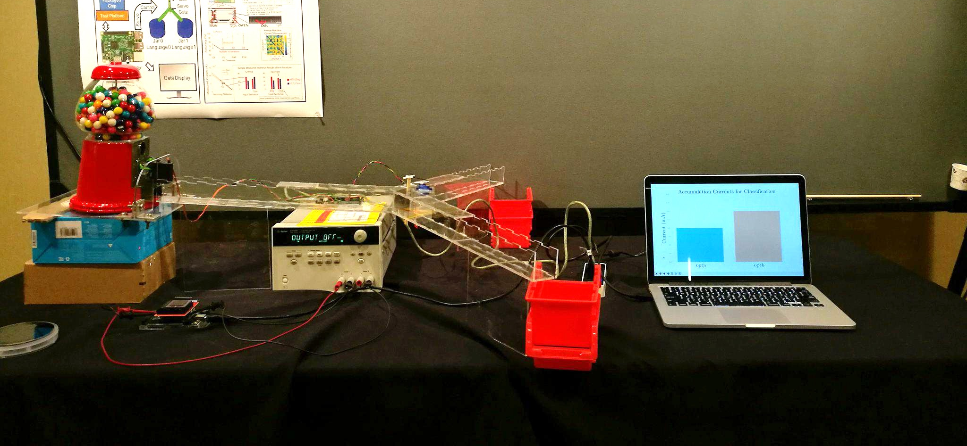
Live demo yesterday
Gumball visualization
Statistics display
Random Projection
HD Encoder
10µm
HD Classifier
CNFET + RRAM Chip
User text input

Slide 60



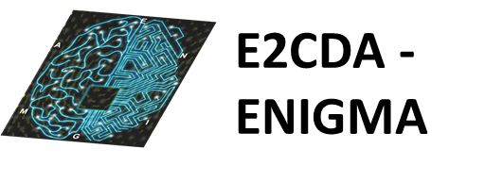


Acknowledgments

Slide 61
Key Message
Monolithic 3D nanosystem for HD computing
  Measured 98% accuracy for language classification
CNFET, RRAM, monolithic 3D overcome realization challenges
  Low-temperature fabrication key
Exploit native nanotechnology properties for HD
  Inherent variations, RRAM analog accumulator, error resilient
Live demo yesterday

