Slide 1

A Low-Power Hybrid
Magnetic Cache Architecture
Exploiting Narrow-Width Values
Mohsen Imani†, Abbas Rahimi‡, Yeseong Kim†, Tajana S. Rosing†
University of California San Diego
System Energy Efficiency Lab.
Corresponding Author: Tajana S.Rosing

Slide 2
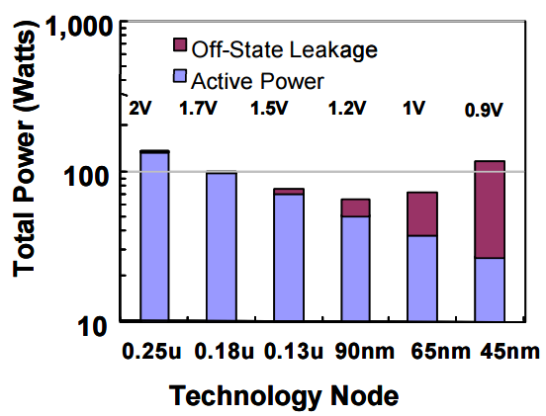
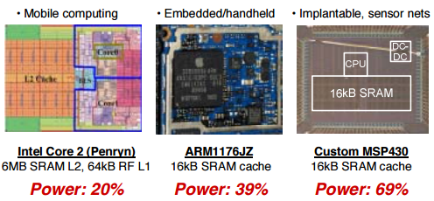
Static Random Access Memories (SRAM)
  CMOS-based SRAM: Critical processor component
  Occupy 50% of chip area in modern processors
  Require to store long-width data, e.g., 64 bits
  Consume high static power due to off-state leakage
    Becoming more significant issue with technology advances

Slide 3
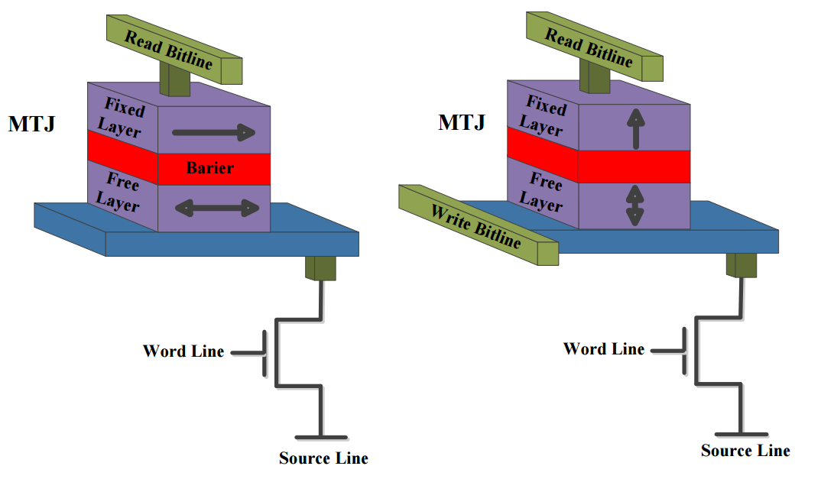
Emerging Non-Volatile Memory
Non-Volatile Memories are promising candidates to replace cache
  Example: MRAM(Magnetic RAM), PCRAM (Phase Change RAM)
  Pros: Low leakage power, high density compared to SRAM
Spin Transfer Torque RAMs (STT-RAM)
  High endurance (10¹⁰-10¹⁵)
  Fast in read
    Comparable speed of SRAM
  Higher write energy than SRAM
  Much slower write operation
Spin Orbit Torque RAMs (SOT-RAM)
  Comparable write speed to SRAM
  Higher write energy than SRAM
Fixed Layer
Free Layer
Need to address power and performance cost of write operation

Slide 4
Narrow Width Values
For many practical data, values can be represented by a fewer number of bits than the full word size
This characteristic is widely observed across applications and benchmarks e.g., SPEC Series, Mibench (CPU), Rodinia, Parboil(GPU)
  Still execute 32bit-based applications in practice
  No need to exploit all 64 bits for data
Full wordsize: 64 bits
0000 0000 0000 0000 0010 1110 1111 1010
Upper 32 bits: All zeros
Narrow-width

Slide 5
Hybrid Cache for Narrow-Width Data
Key Idea: Store in two separated cache parts
Technical challenge:
Seamless handling of non-narrow width data
  Long write latency of NVM: Performance overhead
0000 0000 0000 0000 0010 1110 1111 1010
Infrequent
updates
Energy Saving?
Frequent
updates
Non Volatile Memory
(STTRAM, SOTRAM)
CMOS-Based SRAM
+
How to serve enough cache performance with minimal energy cost?

Slide 6
Contributions
We propose a hybrid cache architecture that symmetrically locates narrow-width data
  Store the upper and lower 32-bits of every word lines in MRAM and SRAM, respectively
  Verify the narrow-width characteristic for popular processor benchmarks
The proposed hybrid cache is able tolerating the non-narrow data as well as the narrow one with no performance and energy overhead
  Double row write (DRW):
  Mitigate performance issue due to limited write buffer size
  Dynamic write buffer (DWB):
  Balances a tradeoff between buffer size and memory size cost of DRW
The evaluation shows high power saving with negligible performance degradation
  Save the cache power consumption by up to 43% and 46%
  for STT-RAM and SOT-RAM

Slide 7
Related Work
NVM-based cache: invert coding schemes
  Utilize asymmetric power/performance characteristics of writes
  Flip the data if the number of ones is more than 50%
  [Nigam, et al. ISLPED’11]
  Writes the flipped data if more than half of word isn’t same [Sangyeun, et al. Micro’09]
  Additional circuitries to invert bits would increase design cost.
Hybrid cache: block placement schemes
  Read intensive / Write intensive parts [Li et al. VLSI-SOC’11]
  High retention / Low retention parts
  [Smullen et al. HPCA’11, Sun et al. Micro’11]
  Data migration procedure is requisitive.

Slide 8
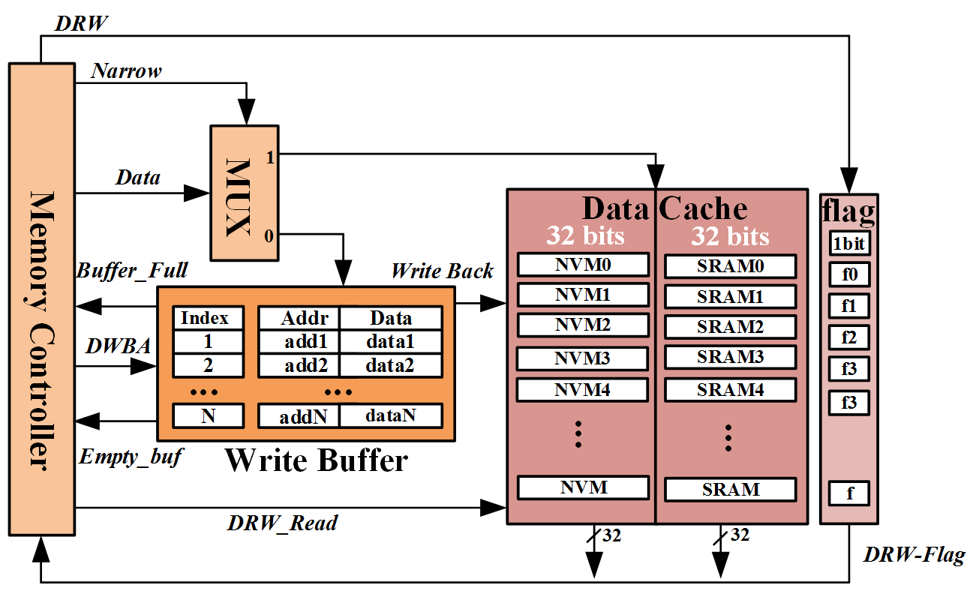
Architecture of Proposed Cache
Proposed cache consists of three parts:
  NVM-SRAM hybrid data cache: Separate upper and low bits
  Write buffer (Small SRAM): Hide overhead of non-narrow writes
  Memory controller: Control cache based on specialized write protocol

Slide 9
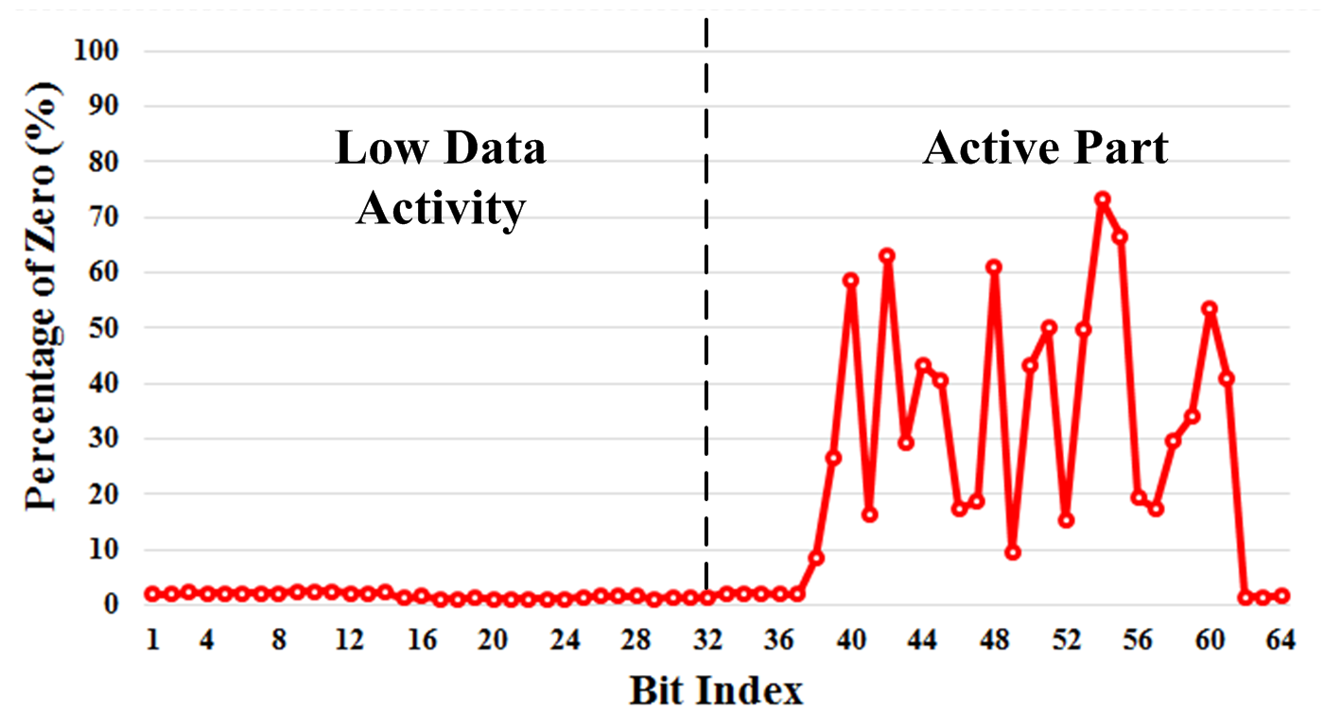
Narrow-Width Values: SPEC CPU 2006
Average data distribution in different bit indexes
  Extracted L2 cache trace for SPEC2006 using GEM5 simulator
  Show clear distinction of stored values over the bit indexes
    93% of zeros for 85% of data in L2 cache
Mostly zero wo/ frequent update
Need to update
frequently
NVMs are suitable candidates for upper 32 bits in most cases
Performance may be still degraded due to low write speed

Slide 10
Write Buffer for Non-Narrow Data
We exploit a small SRAM write buffer for STT-RAM
(No need to use for SOT-RAM thanks to its comparable write speed)
  Hide the performance issue of write operations
  Utilized for non-narrow width data (A MUX selects)
    Narrow data can be written directly without perf. overhead for most cases
Design issue: Buffer size
  Small buffer: Performance overhead
  Large buffer: Energy overhead
We address the issues by:
1) Double Row Writing (DRW)
2) Dynamic Write Buffer (DWB)

Slide 11
Double Row Writing (DRW)
DRW completely bypasses write latency of STT-RAM
even though the size of the write buffer is not sufficient
  Non-narrow width data are stored in two consecutive rows of SRAM
  → No performance degradation over the conventional SRAM
  A “DRW-flag” bit stores the status of each cache line
Write of
Non-narrow width
Write of
Non-narrow width
due to buffer_full
Write of
Narrow width
Upper 32 bits (C)
Lower 32 bits (C)
Upper 32 bits (B)
Lower 32 bits (B)
Upper 32 bits (A)
Lower 32 bits (A)
Upper 32 bits (A)
Lower 32 bits (A)
0
Upper 32 bits (B)
Lower 32 bits (B)
0
Upper 32 bits
1
Lower 32 bits
NVM
SRAM
DRW-flag

Slide 12
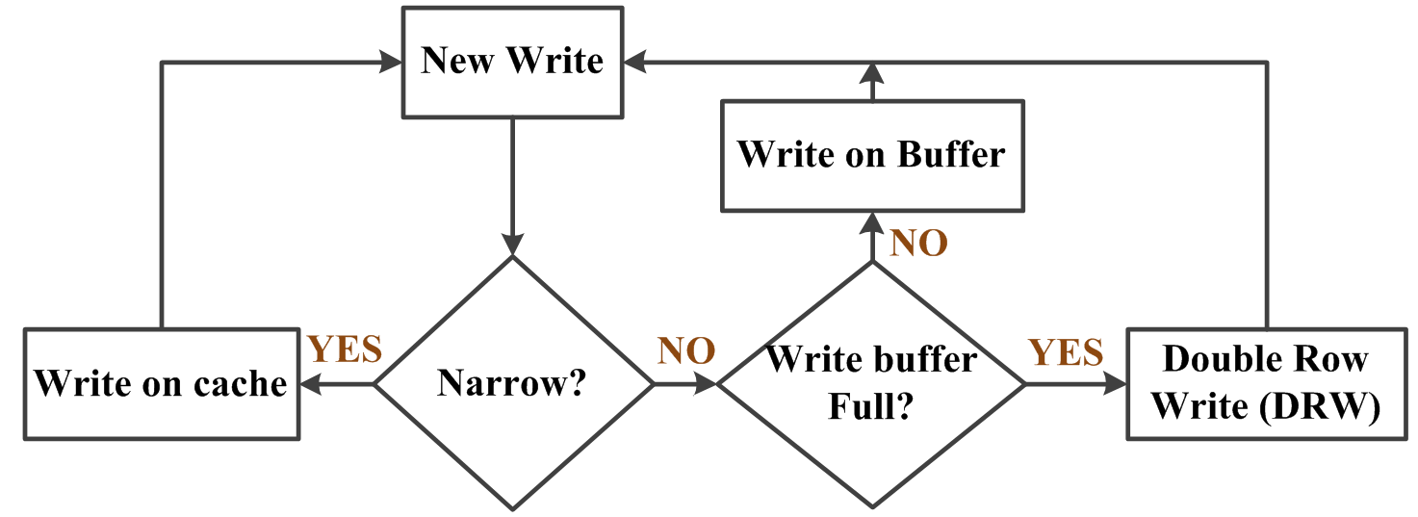
Cache Protocol for Write Operation
Cache protocol: Handle the three cases of write operations
However, a large amount of DRWs may lead to two issues:
  Decrease effective cache capacity by a factor of two in the worst case
  Degrade power efficiency due to doubled read/write operations of SRAM
Large buffer size may be required depending on applications.
→ Dynamic Write Buffer Allocation (DWB)

Slide 13
Dynamic Write Buffer Allocation (DWB)
DWB decreases write buffer energy overhead
by adjusting buffer size for different applications
  Increment the buffer size with 2KB steps
  Initiated by applications to avoid frequent DRWs
Write buffer (2KB * N)
Cache misses
Power gate
(Controller)
2 KBytes
DRW
2 KBytes
2 KBytes
DRW
Balance between
power overhead due to buffer size &
perf. overhead
2 KBytes
2 KBytes
DRW
2 KBytes
2 KBytes

Slide 14
Experimental Setup
Full-system simulation on GEM5 to evaluate L2 cache behavior
Circuit level HSPICE simulation in 45-nm technology to extract the cell features of STT-RAM and SOT-RAM
Modified NVsim to estimate power, performance and area of conventional/hybrid cache structures
Frequency | Single-core @ 2 GHz, Out-of order execution
L1 Cache | 32KB, 2-way associative
L2 Cache | 512KB, 8-way associative
Memory | DRAM, DDR3, 4GB
Extracted delay @L2
Cache Type | Worst Case Read/Write Latency
SRAM | Write:3.4ns Read:4.3ns
STT-RAM/SRAM | Write:5.9ns Read:4.3ns
SOT-RAM/SRAM | Write:3.4ns Read:4.3ns
STT-RAM | Write:5.9ns Read:1.9ns
SOT-RAM | Write:2.6ns Read:2.1ns
Benchmarks
SPEC 2006 | mcf, bzip2, gcc, hmmer, sjeng, libquantum, gobmk, milc, perlbench, bwaves, leslied3d, games, h246ref
SPEC 2000 | bzip2, gcc, vortex, twolf, swim, lucas, fma3d, apsi, ammp
Mibench | basicmath, bitcount, qsort, susan, dijkstra, patricia, sha

Slide 15
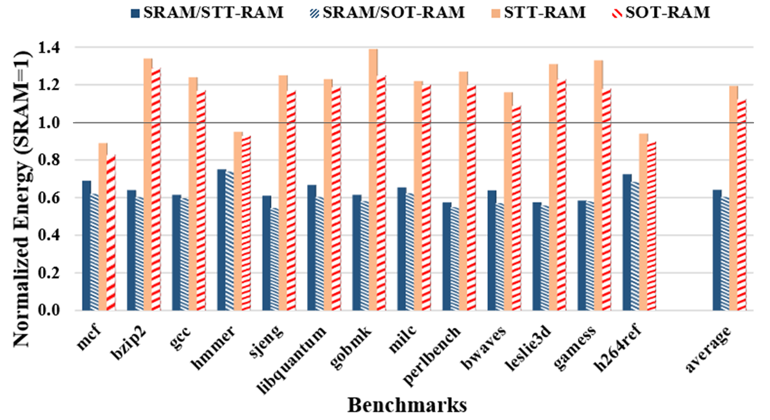
Proposed Cache wo/ Write Buffer
: Energy Consumption
Energy consumption over different benchmarks
(Normalized to the SRAM case, SPEC 2006)
  Replacement to pure NVM is not a good design choice
  due to the high write power for lower bits
Higher energy consumption
by 40% and 25%
(STT-RAM, SOT-RAM)
Always outperform SRAM
by 36% and 40%
(SRAM/STT-RAM,
SRAM/SOT-RAM)

Slide 16
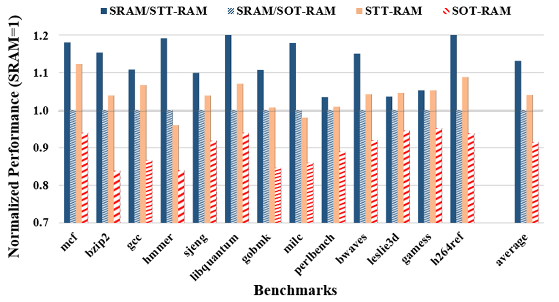
Proposed Cache wo/ Write Buffer
: Performance Overhead
Performance overhead over different cache structures
(Normalized to the SRAM case, SPEC 2006)
  A large portion of non-narrow width writes may degrade performance
Non-narrow
width writes
13% of perf. overhead for SRAM/STT-RAM case
Need to consider performance overhead
of the non-narrow width case

Slide 17
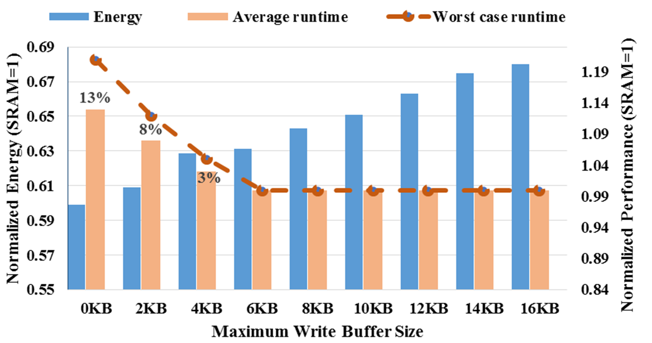
Impact of Write Buffer on Energy and
Performance of Proposed Cache wo/ DWB
Average energy/perf. overhead over different buffer sizes
(wo/ Dynamic Write Buffer Allocation, SRAM/STT-RAM, SPEC 2006)
  Use of the write buffer significantly mitigates performance overhead
High performance overhead
No performance overhead at the expense of energy consumption coming from the write buffer

Slide 18
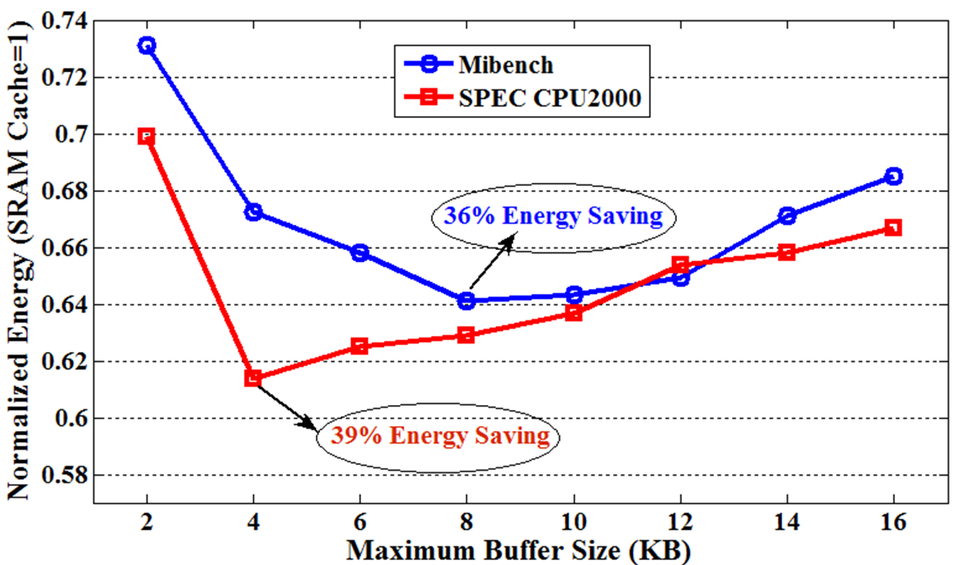
Proposed Cache with Write Buffer:
Energy Tradeoff with DWB
Average energy consumption over different buffer sizes
(with DRW and DWB, SRAM/STT-RAM)
  DWB saves more energy by adjusting buffer sizes to requirements
  For SPEC2006, DWB with 4KB buffer achieves maximum energy saving by 42% without further performance degradation
Energy saving from
Dynamic Write Buffer Allocation
Energy overhead due to increase of buffer size

Slide 19
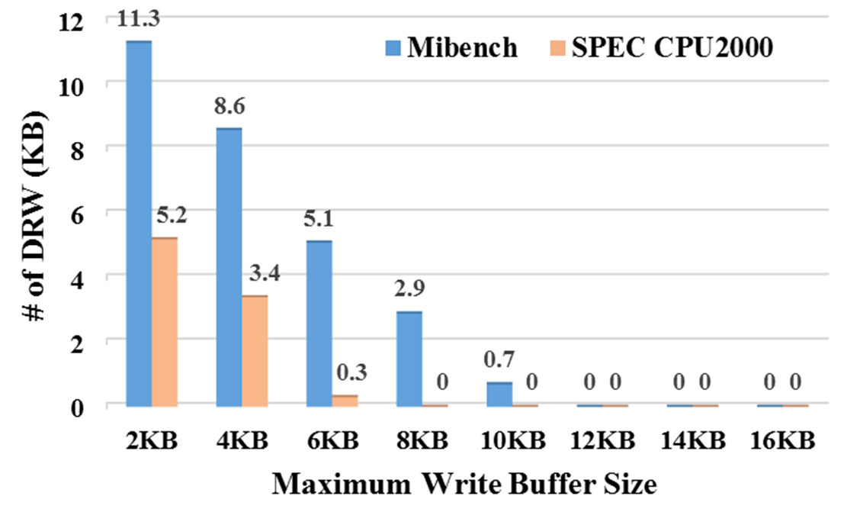
Analysis of DRW Write
Average amount DRW operations (KBytes) over buffer sizes
(with DRW and DWB, SRAM/STTRAM)
  The proposed cache balances the number of DRWs and buffer energy
  For SPEC2006, the optimal saving point of the 4KB buffer uses 2.7 KB
Decreased DRW
thanks to larger buffer size
Still use DRW at optimal energy saving point

Slide 20
Conclusion
This paper proposes a new hybrid MRAM/SRAM cache architecture
  Leverage narrow-width values to reduce power
  Separate the upper and lower 32-bit of word line
We also propose a partial double row write (DRW) technique and dynamic write buffer (DWB) allocation
  Completely hide cache latency due to slow write operation of NVMs
  Decide the trade-off between effective cache availability and the maximum buffer size
Our evaluation shows that the proposed hybrid cache can achieve energy without performance degradation
  By up to 46% power improvement with the same performance to that of the conventional SRAM cache

